Slide 1
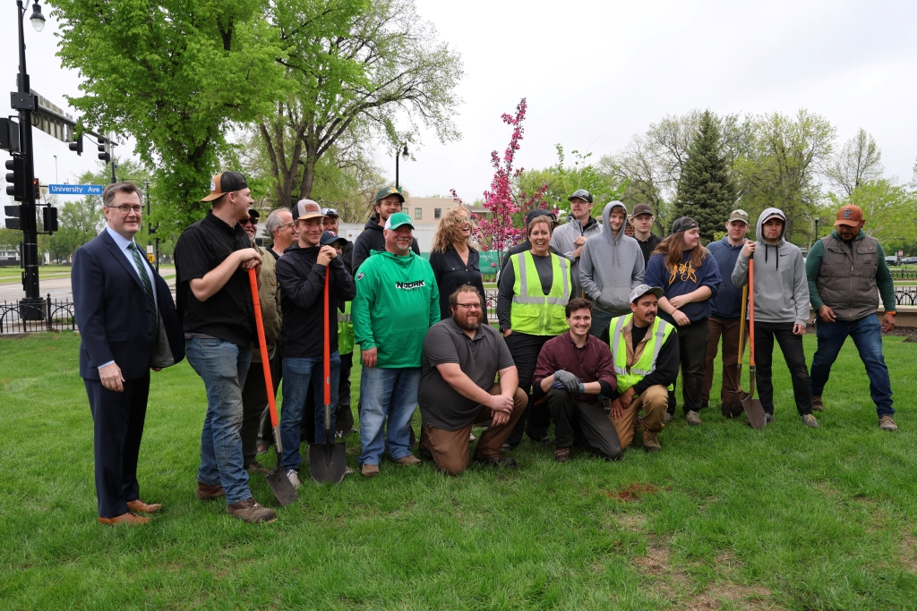
Affinity
Foster a sense of belonging and a campus culture that celebrates the unique ways we connect and contribute to UND.
Campus continues to blossom at annual Arbor Day celebration
A Tree Campus Higher Education institution, UND celebrates Arbor Day with tree planting ceremony on May 16
Strategic Priority:
Cultivate physical and online campus environments that are welcoming, safe, healthy, and inclusive. Promote sustainable practices critical to the long-term health, well-being, and success of the University community.

Slide 2
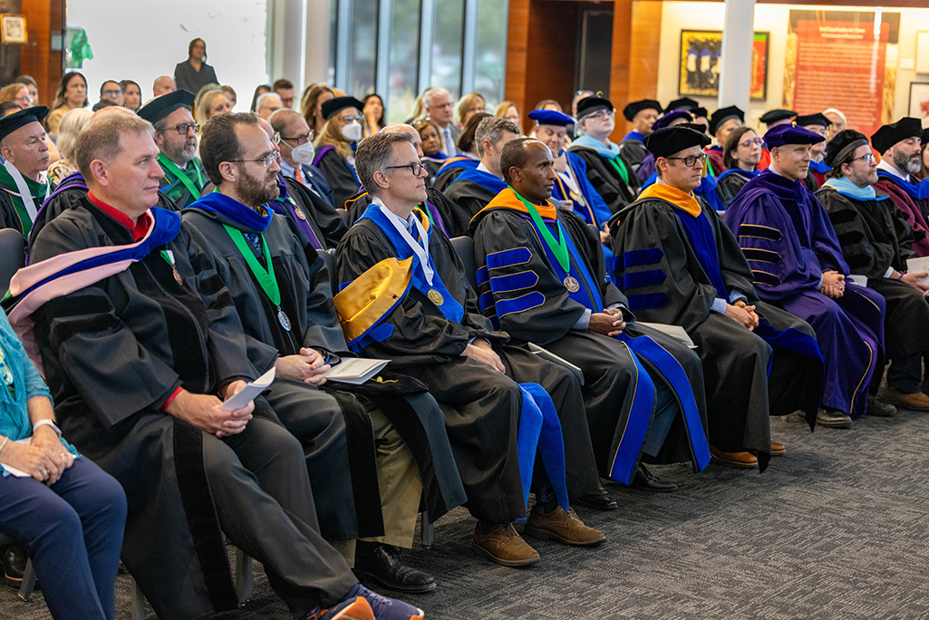
Affinity
Foster a sense of belonging and a campus culture that celebrates the unique ways we connect and contribute to UND.
UND celebrates with fanfare eight newly appointed Endowed Faculty
Crowd enjoys live music, inspirational remarks during third annual event
Strategic Priority:
Recruit and retain a robust UND work force. Provide equitable resources and opportunities for success, acknowledge the valuable contributions of UND team members, and include employee voices in decision making.

Slide 3
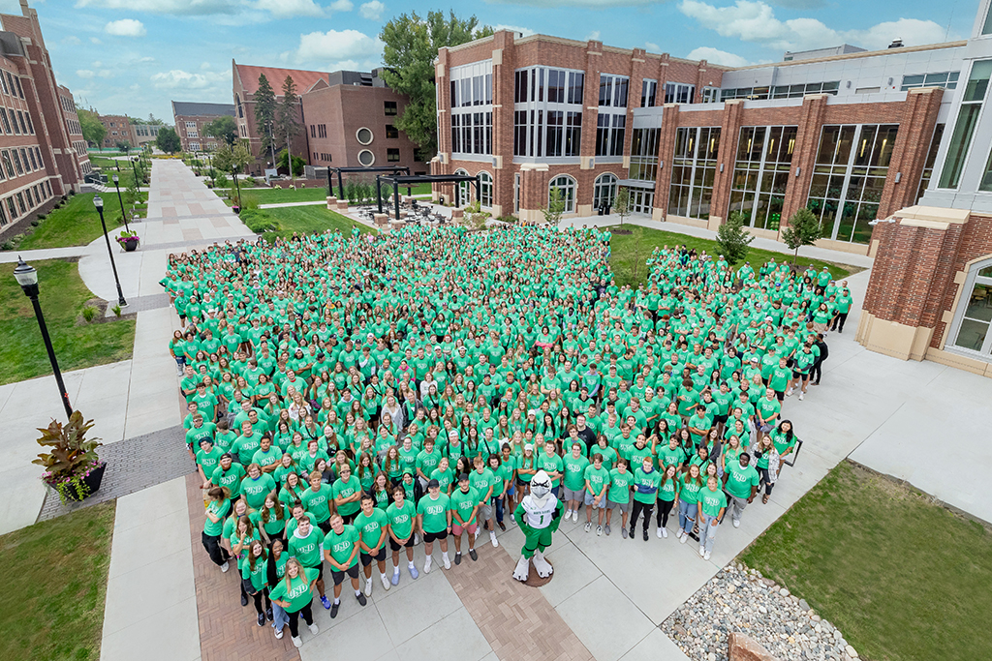
Affinity
Foster a sense of belonging and a campus culture that celebrates the unique ways we connect and contribute to UND.
Affinity at UND: Building a sense of community
Two former Student Body presidents describe ways students and alumni work together to improve the student experience at UND
Strategic Priority:
Establish a First Year Experience for new students and enhance programs for all faculty and staff that will cultivate a sense of belonging at the University of North Dakota.

Slide 4
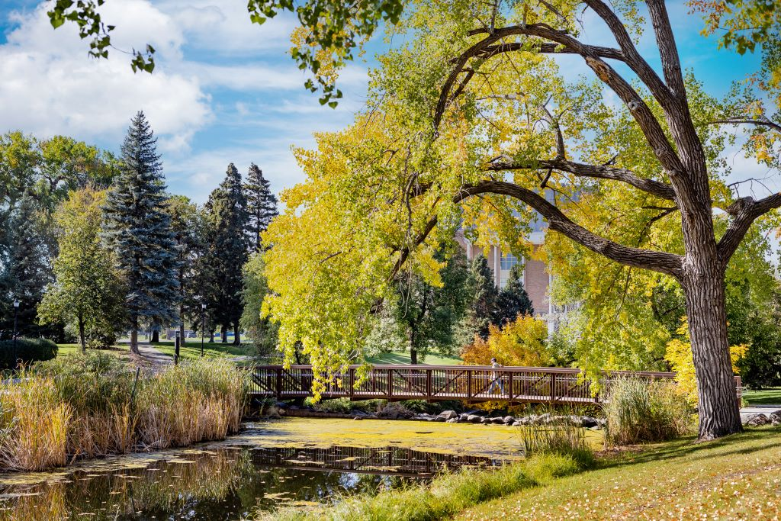
Affinity
Foster a sense of belonging and a campus culture that celebrates the unique ways we connect and contribute to UND.
With help from Audubon Society, English Coulee is for the birds
UND, Audubon Great Plains seek to transform English Coulee through 10-year partnership
Strategic Priority:
Cultivate physical and online campus environments that are welcoming, safe, healthy, and inclusive. Promote sustainable practices critical to the long-term health, well-being, and success of the University community.

Slide 5
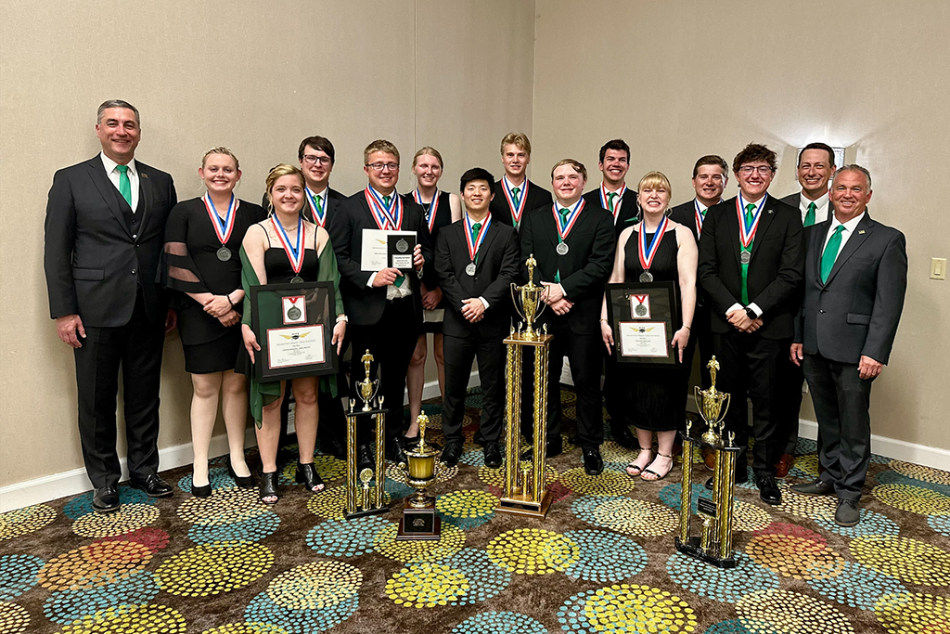
Affinity
Foster a sense of belonging and a campus culture that celebrates the unique ways we connect and contribute to UND.
UND Flying Team wins national championships at 2024 SAFECON
UND has placed first or second more than 30 times in the past 40 years — and this year, the tradition continues
Strategic Priority:
Strengthen athletic excellence at UND by supporting our student athletes and enhancing our athletic facilities.

Slide 6
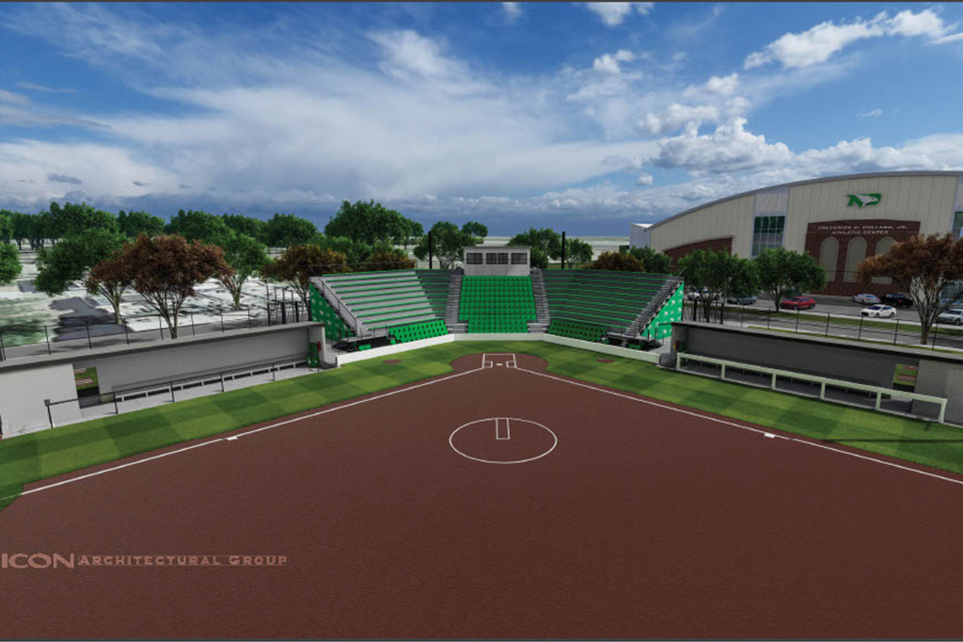
Affinity
Foster a sense of belonging and a campus culture that celebrates the unique ways we connect and contribute to UND.
New diamond in crown of UND Athletics
Memorial Village II project will enable UND Softball fans to attend home games at new, state-of-the-art field
Strategic Priority:
Strengthen athletic excellence at UND by supporting our student athletes and enhancing our athletic facilities.

Slide 7
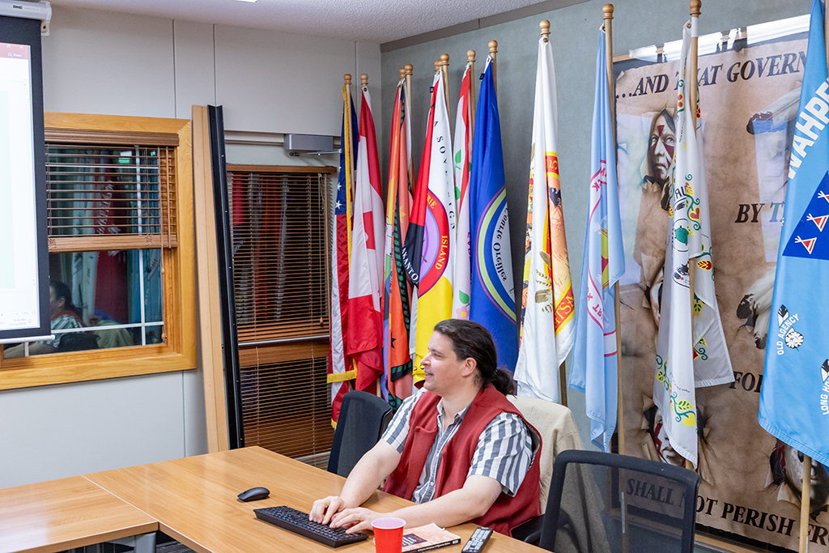
Affinity
Foster a sense of belonging and a campus culture that celebrates the unique ways we connect and contribute to UND.
UND students hone their Ojibwe skills
Weekly language table supplements University’s existing Ojibwe curriculum
Strategic Priority:
Embrace environments where people from unique cultures and backgrounds can interact, be valued and know they belong’

Slide 8
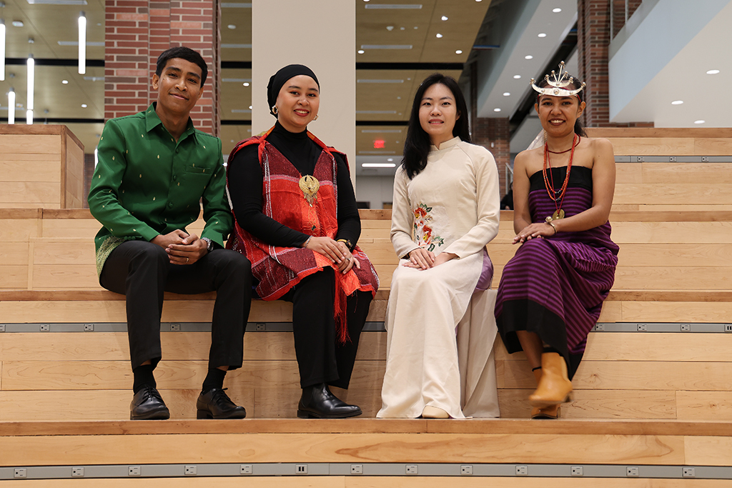
Affinity
Foster a sense of belonging and a campus culture that celebrates the unique ways we connect and contribute to UND.
Southeast Asian Leadership fellows reflect on time in North Dakota
Fellows cite helpfulness of mentors, Grand Forks community as highlights of exchange
Strategic Priority:
Globalize our campus community by increasing recruitment and retention efforts and support for international students studying at UND and for domestic students who participate in study abroad. We will embrace environments where people from unique cultures and backgrounds can interact, be valued, and know they belong.

Slide 9
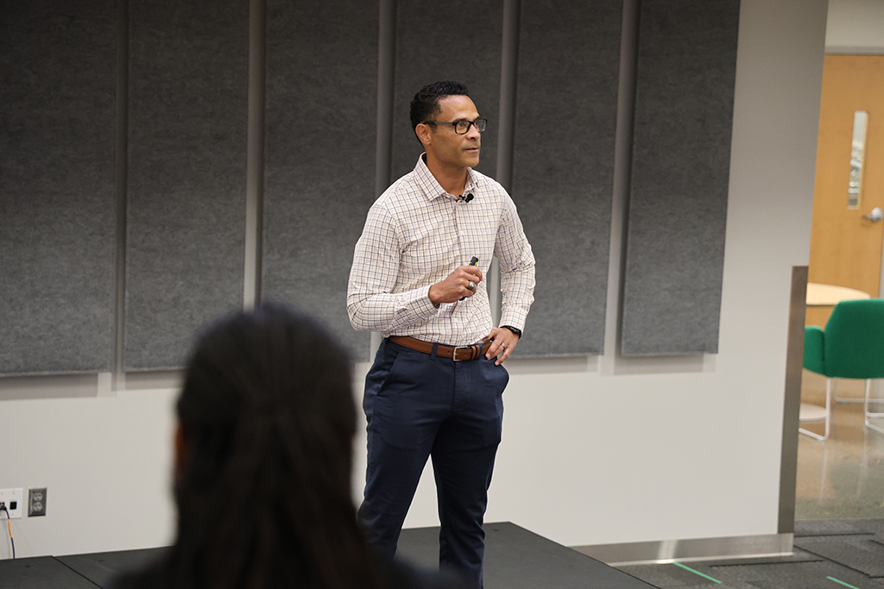
Affinity
Foster a sense of belonging and a campus culture that celebrates the unique ways we connect and contribute to UND.
Col. Tim Curry on leadership: ‘You can do tough things’
Former Grand Forks Air Force Base commander reveals surprise connection to UND in 18:83 Speaker Series talk
Strategic Priority:
Enhance UND’s military-friendly environment in which we recruit, welcome and retain military-affiliated students and families. We will increase educational pathways and programs in support of our military-affiliated students, employees, and community members.

Slide 10

Affinity
Foster a sense of belonging and a campus culture that celebrates the unique ways we connect and contribute to UND.
Affinity at UND: A sense of belonging
Through its core value of Affinity, UND strives to improve the quality of University life, write campus leaders DeAnna Carlson Zink and Bill Chaves
Strategic Priority:
Establish a First Year Experience for new students and enhance programs for all faculty and staff that will cultivate a sense of belonging at the University of North Dakota.

