Slide 1
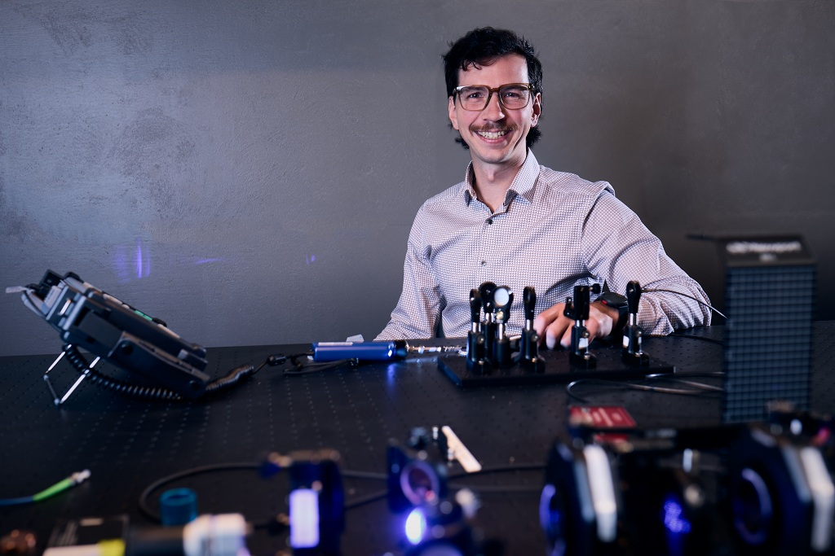
Discovery
Advance research, creative activity, and scholarship through our spirit of inquiry and our desire to better understand the world around us.
Light-speed science: UND leads nation with pioneering laser communications hub
State-funded facility positions North Dakota as national leader in next-generation satellite communications, research and workforce training
Strategic Priority:
Coordinate and manage resources to support the strategic balance of breadth and depth of research, creative activity, and scholarship happening across campus.

Slide 2
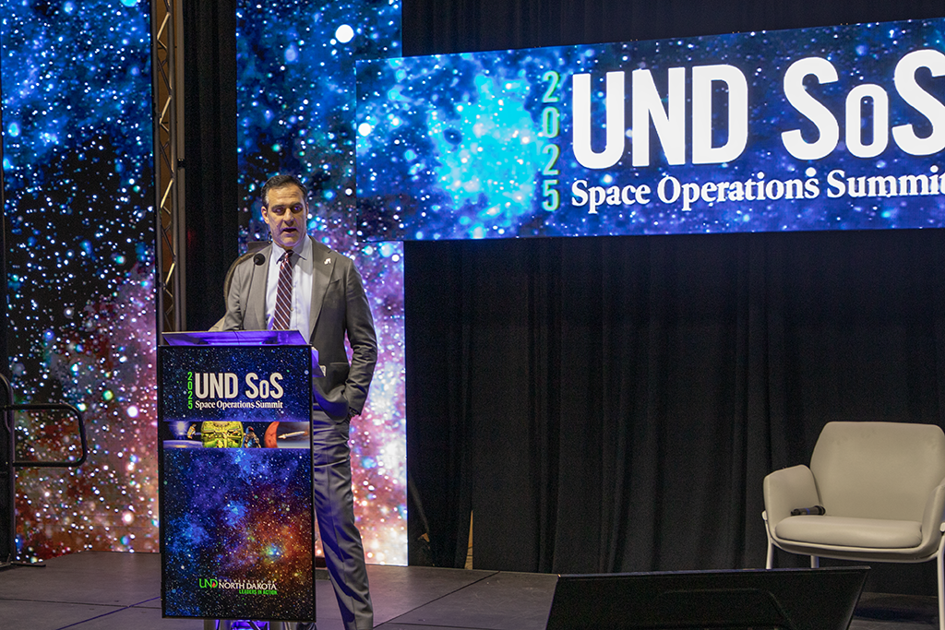
Discovery
Advance research, creative activity, and scholarship through our spirit of inquiry and our desire to better understand the world around us.
UND hosts space industry leaders for annual Space Ops Summit
Topics range from hypersonic research to NASA’s Artemis program to ‘deorbiting’ the International Space Station, and beyond
Strategic Priority:
Enhance and deepen UND’s Grand Challenge areas which foster and sustain cross-disciplinary teams dedicated to identifying solutions to pressing challenges. Be open to
the addition of new Grand Challenges to help meet society’s changing needs.

Slide 3

Discovery
Advance research, creative activity, and scholarship through our spirit of inquiry and our desire to better understand the world around us.
How AI is supercharging spacecraft propulsion
AI is powering breakthroughs in space travel, and could even lead to nuclear-powered rockets, write UND scholars in The Conversation
Strategic Priority:
Foster innovative teaching, applied learning, and transformative research that exemplifies discovery, as shown by experimenting, researching, drafting, writing, prototyping, rehearsing, etc.

Slide 4
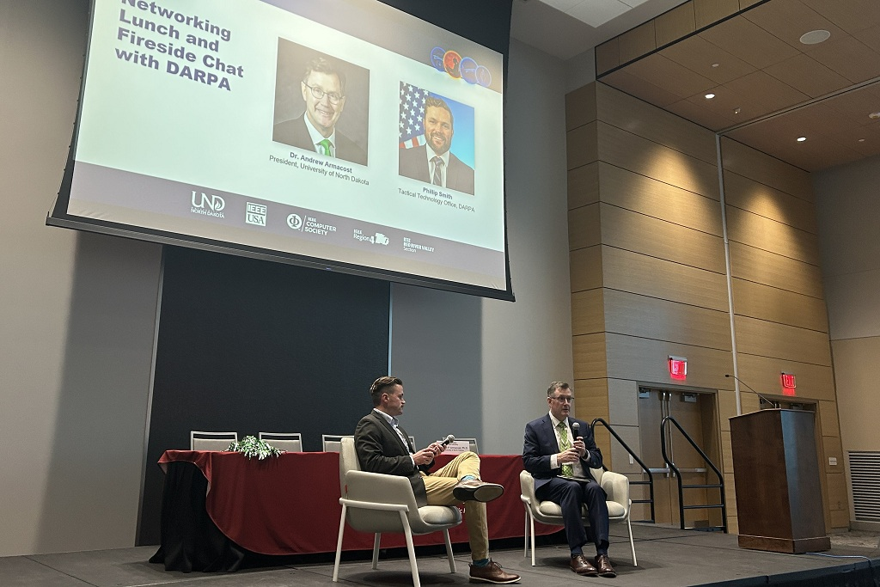
Discovery
Advance research, creative activity, and scholarship through our spirit of inquiry and our desire to better understand the world around us.
AI & Autonomy Summit showcases Grand Forks as national hub
UND summit draws top government, tech leaders to discuss AI and autonomous systems’ roles in defense, industry and society
Strategic Priority:
Facilitate and enhance connections, where new and existing partners―including industry, government, and inter-institutional collaborations, among others―can easily engage, and where internal efforts to foster partnerships can be supported and flourish.

Slide 5
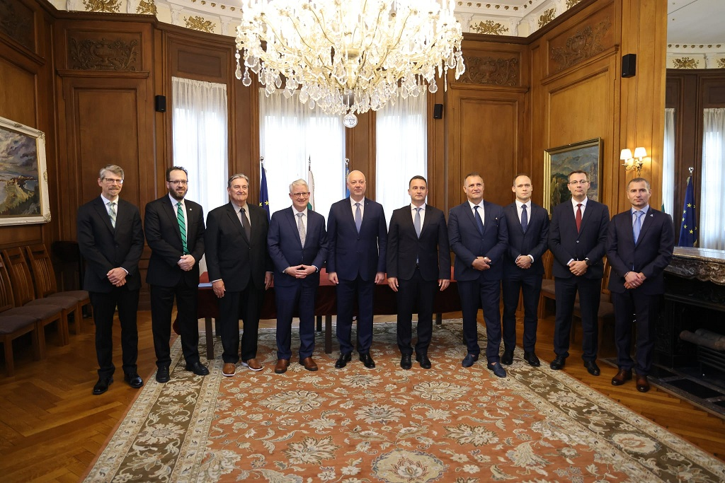
Discovery
Advance research, creative activity, and scholarship through our spirit of inquiry and our desire to better understand the world around us.
UND, Bulgarian Energy Holding forge new partnership on rare earth elements research
Agreement builds on UND’s world leadership in extracting rare earth elements from lignite coal
Strategic Priority:
Facilitate and enhance connections, where new and existing partners―including industry, government, and inter-institutional collaborations, among others―can easily engage, and where internal efforts to foster partnerships can be supported and flourish.

Slide 6
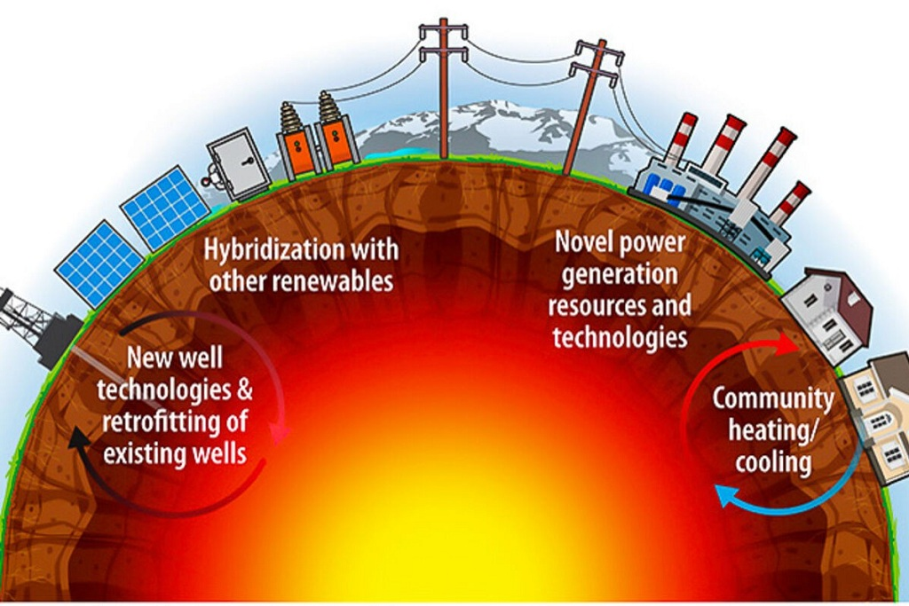
Discovery
Advance research, creative activity, and scholarship through our spirit of inquiry and our desire to better understand the world around us.
On geothermal energy, the next clean energy frontier
Interest is growing in this ‘low-emission power source that can provide continuous electricity almost anywhere on the planet,’ UND scholar writes in The Conversation
Strategic Priority:
Enhance and deepen UND’s Grand Challenge areas which foster and sustain cross-disciplinary teams dedicated to identifying solutions to pressing challenges. Be open to
the addition of new Grand Challenges to help meet society’s changing needs.

Slide 7
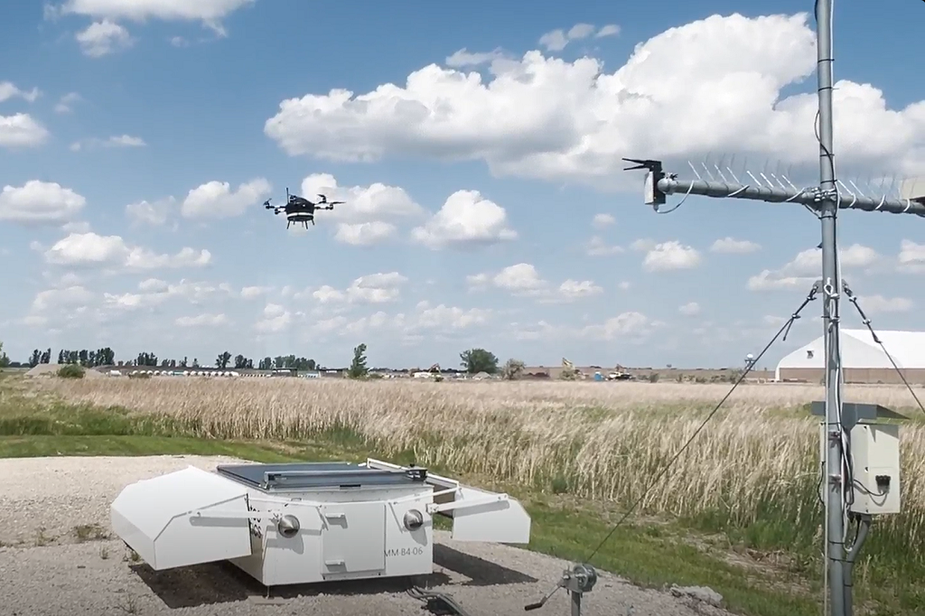
Discovery
Advance research, creative activity, and scholarship through our spirit of inquiry and our desire to better understand the world around us.
A weather eye over GrandSKY
In partnership with GrandSKY, UND researchers use specialized drone to gauge weather, improve forecasting
Strategic Priority:
Foster innovative teaching, applied learning, and transformative research that exemplifies discovery, as shown by experimenting, researching, drafting, writing, prototyping, rehearsing, etc.

Slide 8
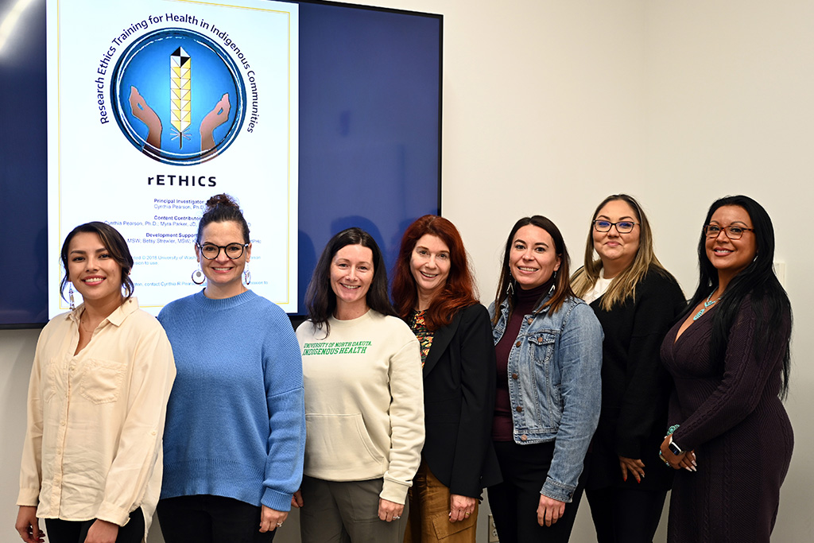
Discovery
Advance research, creative activity, and scholarship through our spirit of inquiry and our desire to better understand the world around us.
The trust builders
UND’s Department of Indigenous Health trains researchers on working with Indigenous communities more ethically
Strategic Priority:
Strengthen service units that support creativity, research and innovation in all stages, from program development to promotion and beyond.

Slide 9
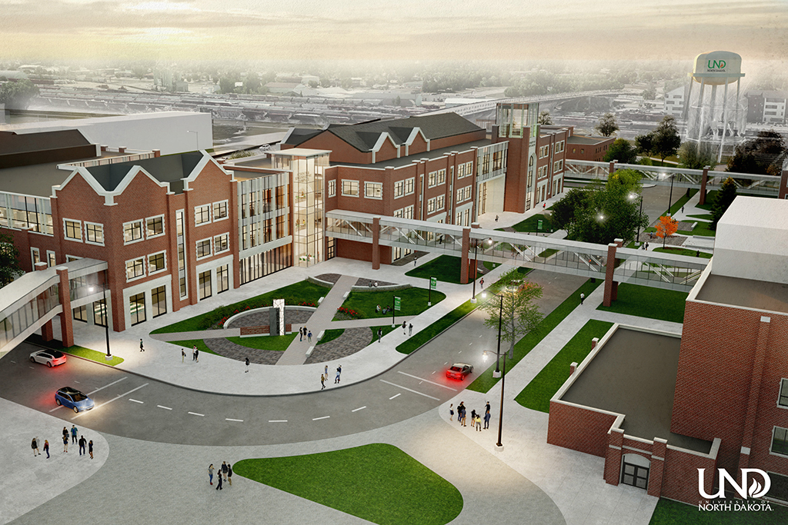
Discovery
Advance research, creative activity, and scholarship through our spirit of inquiry and our desire to better understand the world around us.
UND leaders grateful for Legislature’s continued support of higher ed
New STEM complex, national security mission among areas robustly funded for 2025-27 biennium
Strategic Priority:
Further empower departments and units to establish appropriate and measurable outcomes for creative activity and research. These outcomes should be specific to each department’s professional discipline and incorporated into the evaluation process and faculty tenure and promotion standards.

Slide 10
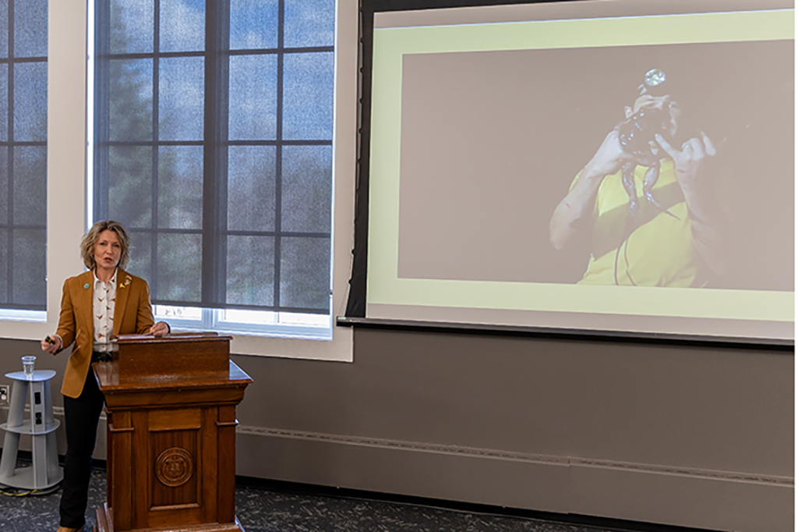
Discovery
Advance research, creative activity, and scholarship through our spirit of inquiry and our desire to better understand the world around us.
Becoming a citizen conservationist
Through effective storytelling, outdoor enthusiasts can effect change, says UND alumna Marilyn Vetter in annual Paur Lecture
Strategic Priority:
Infuse creative expression, critical inquiry, and innovation across the students’ learning journeys by supporting comprehensive curricular and co-curricular participation in research.

