Slide 1

Equity Enhance pathways to higher education and establish supportive learning structures that help all people realize their full potential. Embrace the evolving diversity of perspectives, peoples, and ideas as a core strength.
Vera Kelsey, UND’s woman of the world
In honor of Women’s History Month, learn more about UND’s history-making 1914 graduate, Vera Kelsey
Strategic Priority:
Promote diverse perspectives and inclusive worldviews by offering inclusive teaching methods, high-impact practices, professional development programs and opportunities to understand diverse populations and meet their changing needs.

Slide 2

Equity Enhance pathways to higher education and establish supportive learning structures that help all people realize their full potential. Embrace the evolving diversity of perspectives, peoples, and ideas as a core strength.
Two UND distance learners excel as athletes on world stage
Olympic hopefuls Paige Jones and Michelle DiCicco praise UND program’s support and flexibility
Strategic Priority:
Ensure equity in our online learning environment by increasing support for online, hybrid and blended learning and access to the various student services and opportunities of traditional UND students.

Slide 3

Equity Enhance pathways to higher education and establish supportive learning structures that help all people realize their full potential. Embrace the evolving diversity of perspectives, peoples, and ideas as a core strength.
Stitched with generosity
Alumni help create confidence-building style of career center’s Freeman Professional Closet
Strategic Priority:
Reduce barriers to higher education by increasing affordability through scholarships, need-based aid, and Open Educational Resources. Invest in support services with the aim of boosting retention and degree completion.

Slide 4
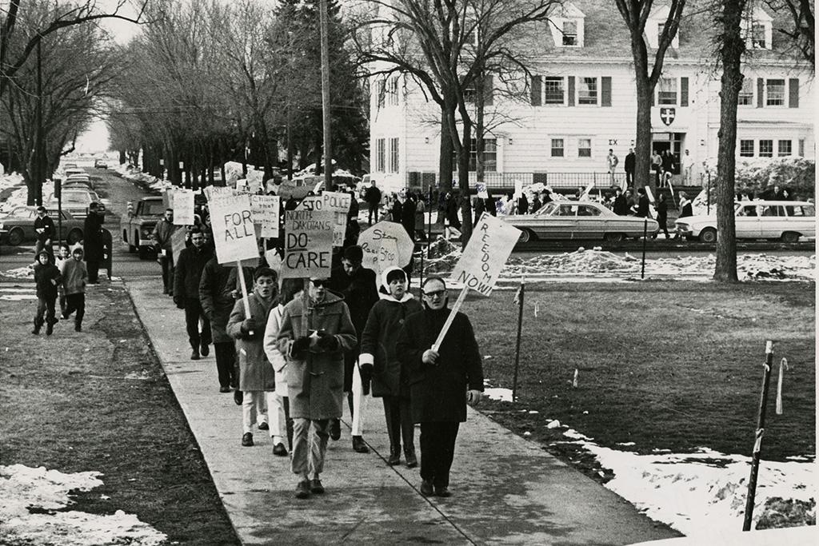
Equity Enhance pathways to higher education and establish supportive learning structures that help all people realize their full potential. Embrace the evolving diversity of perspectives, peoples, and ideas as a core strength.
PHOTOS: Black History at UND
In recognition of Black History Month, learn more about pivotal figures and events from UND’s history
Strategic Priority:
Frame Essential Studies and the Liberal Arts as foundational to diversity, equity, inclusion, and accessibility (DEIA) learning, enabling us to value and appreciate both our collective identity as humans and the tremendous variation within our humanity.

Slide 5
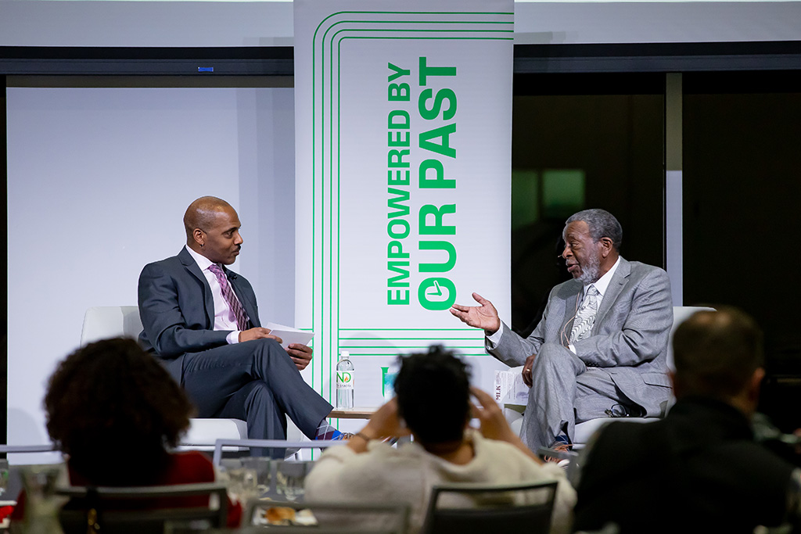
Equity Enhance pathways to higher education and establish supportive learning structures that help all people realize their full potential. Embrace the evolving diversity of perspectives, peoples, and ideas as a core strength.
Advancing the dream of Dr. King
Speak up in the face of injustice, says Paul Pitts, UND’s first Black student body president, at MLK Jr. Day event
Strategic Priority:
Promote diverse perspectives and inclusive worldviews by offering inclusive teaching methods, high-impact practices, professional development programs and opportunities to understand diverse populations and meet their changing needs.

Slide 6
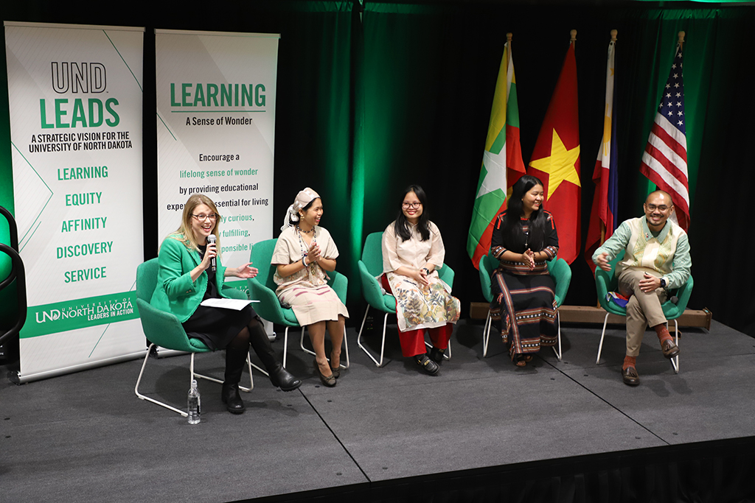
Equity Enhance pathways to higher education and establish supportive learning structures that help all people realize their full potential. Embrace the evolving diversity of perspectives, peoples, and ideas as a core strength.
UND says goodbye to Southeast Asian Leadership fellows
Visitors partner with campus, community mentors on projects to supplement their educations and work back home
Strategic Priority:
Frame Essential Studies and the Liberal Arts as foundational to diversity, equity, inclusion, and accessibility (DEIA) learning, enabling us to value and appreciate both our collective identity as humans and the tremendous variation within our humanity.

Slide 7
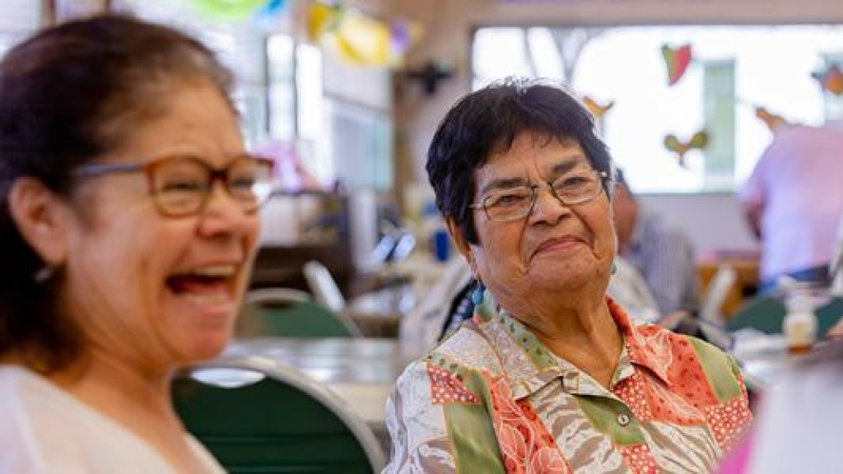
Equity Enhance pathways to higher education and establish supportive learning structures that help all people realize their full potential. Embrace the evolving diversity of perspectives, peoples, and ideas as a core strength.
Thirty years of changing the lives of Native Elders
The National Resource Center on Native American Aging celebrates 30 years and shows no signs of slowing down
Strategic Priority:
Establish cooperative relationships with the surrounding communities and Indigenous nations, seeking their guidance in embracing restorative justice that empowers all communities through a collaborative process. Work to become a premier institution for Indigenous Studies.

Slide 8

Equity Enhance pathways to higher education and establish supportive learning structures that help all people realize their full potential. Embrace the evolving diversity of perspectives, peoples, and ideas as a core strength.
Multiculturalism for a better UND
Two-day conference explores how faculty and staff can embrace multiculturalism to help students flourish
Strategic Priority:
Promote diverse perspectives and inclusive worldviews by offering inclusive teaching methods, high-impact practices, professional development programs and opportunities to understand diverse populations and meet their changing needs.

Slide 9
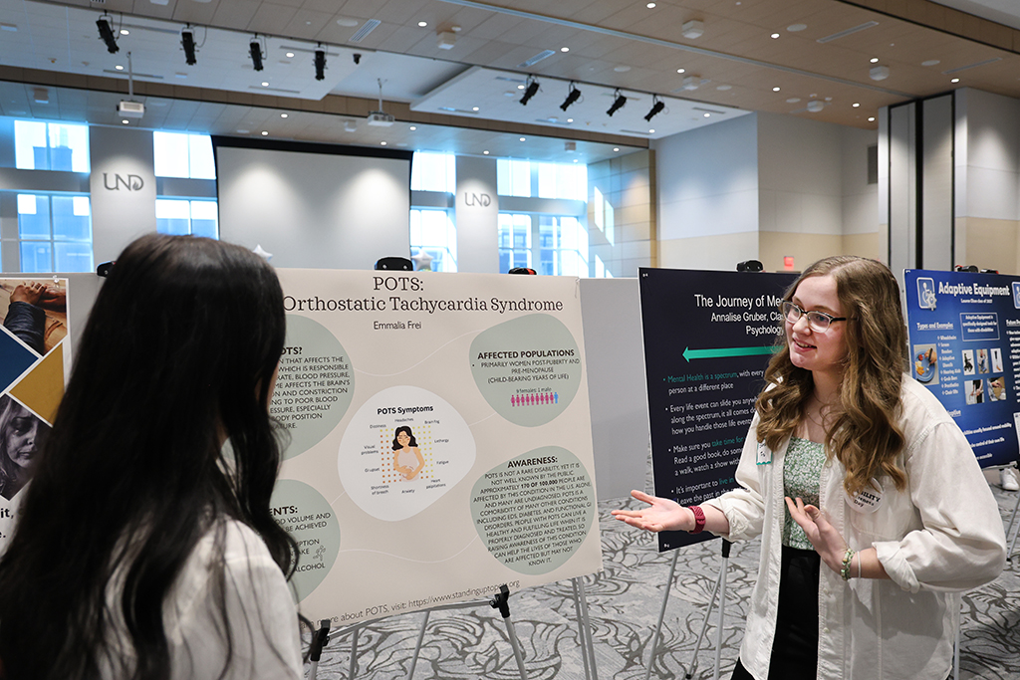
Equity Enhance pathways to higher education and establish supportive learning structures that help all people realize their full potential. Embrace the evolving diversity of perspectives, peoples, and ideas as a core strength.
Inaugural Disability Awareness Day is for learning
Global expert ‘reimagines’ movement where excluded groups join forces to advance change
Strategic Priority:
Implement flexible working and learning options that make UND more accessible to a broader, more diverse population. Work to meet the changing needs of our students and employees with a commitment to access and inclusion.

Slide 10
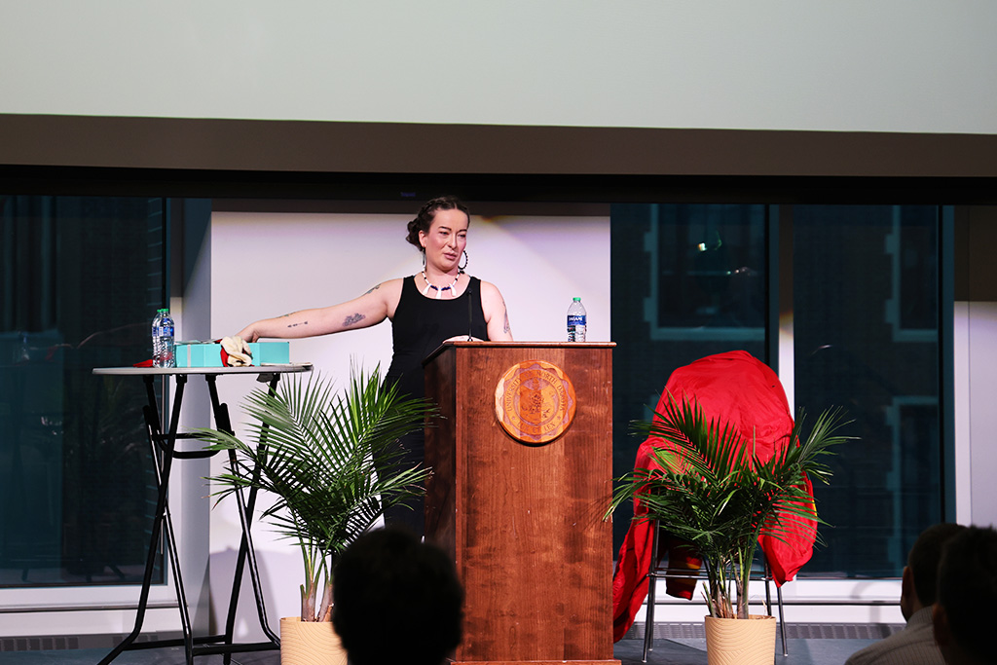
Equity Enhance pathways to higher education and establish supportive learning structures that help all people realize their full potential. Embrace the evolving diversity of perspectives, peoples, and ideas as a core strength.
One nurse, two worlds
For RAIN’s Indigenous speaker series, Whitney Fear Johnson − tribal member, documentary subject and nurse practitioner – spoke with nursing students
Strategic Priority:
Invest in diverse area studies, programs and initiatives that will help faculty, staff, and departments enhance DEIA efforts.

