Slide 1
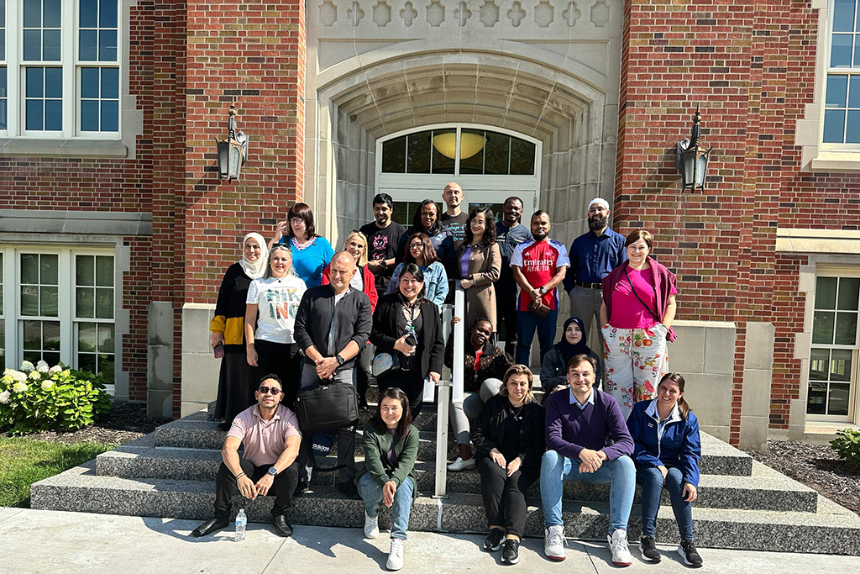
Learning
Encourage a lifelong sense of wonder by providing educational experiences essential for living intellectually curious personally fulfilling, and socially responsible lives.
Teaching across borders at UND
Educators from 23 countries worldwide connect, learn how to sharpen students’ critical thinking skills through Fulbright program
Strategic Priority:
Foster a global perspective to prepare students for engagement and leadership, by promoting
experiences that expand horizons even as they build skills.

Slide 2
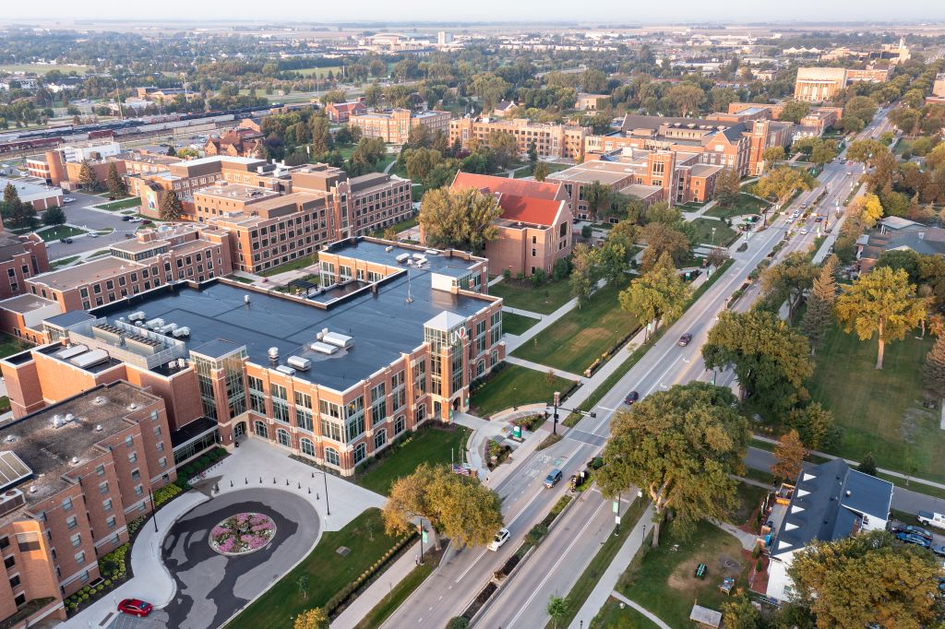
Learning
Encourage a lifelong sense of wonder by providing educational experiences essential for living intellectually curious personally fulfilling, and socially responsible lives.
Building on success: UND seeks community input for new Campus Plan
Survey and Open Forum announced as UND invites community to help shape the future of campus
Strategic Priority:
Enhance physical and virtual learning spaces to ensure faculty and students have the tools and
resources necessary for productive and enriching educational experiences.

Slide 3
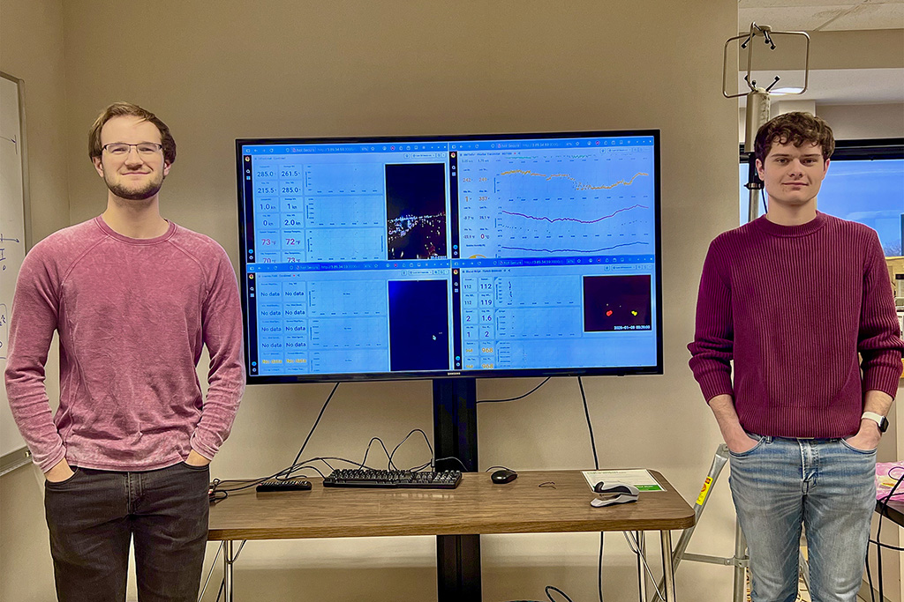
Learning
Encourage a lifelong sense of wonder by providing educational experiences essential for living intellectually curious personally fulfilling, and socially responsible lives.
UND launches Data Skills Pathway to prepare students for AI-age careers
Hands-on program connects students to paid research, internships and in-demand jobs, in North Dakota and nationwide
Strategic Priority:
Promote digital technologies for engaged learning and value-added opportunities for students, faculty, staff, alumni and collaborators.

Slide 4
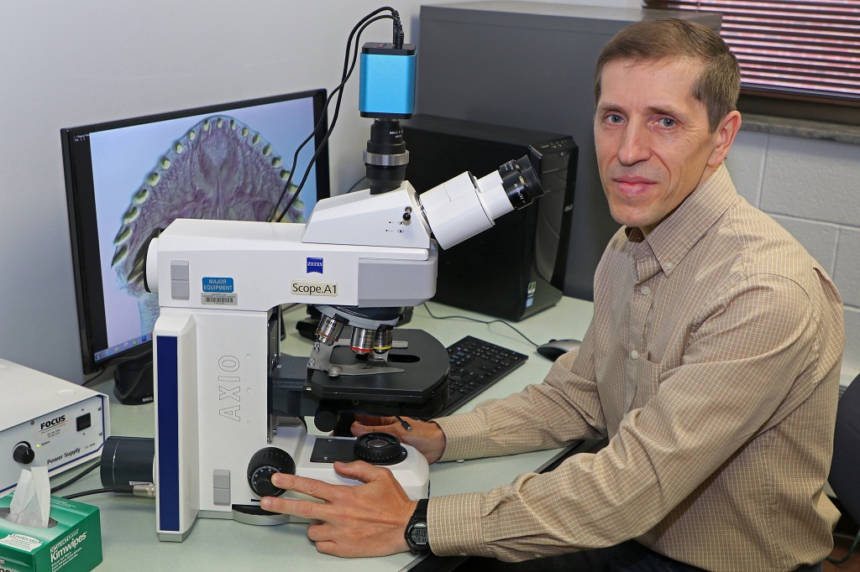
Learning: Expand individualized advising and mentoring
Encourage a lifelong sense of wonder by providing educational experiences essential for living intellectually curious personally fulfilling, and socially responsible lives.
‘Mutualistic symbiosis,’ in the classroom and the field
In successful mentor-mentee relationships, both sides gain, explains UND’s Vasyl Tkach, one of the top scholars — and mentors — in parasitology
Strategic Priority:
Expand individualized advising and mentoring, to help students see how skills can be transferred across courses and extra-curriculars. Provide opportunities for students to document
learning, showcase their work and disseminate research and ideas.

Slide 5
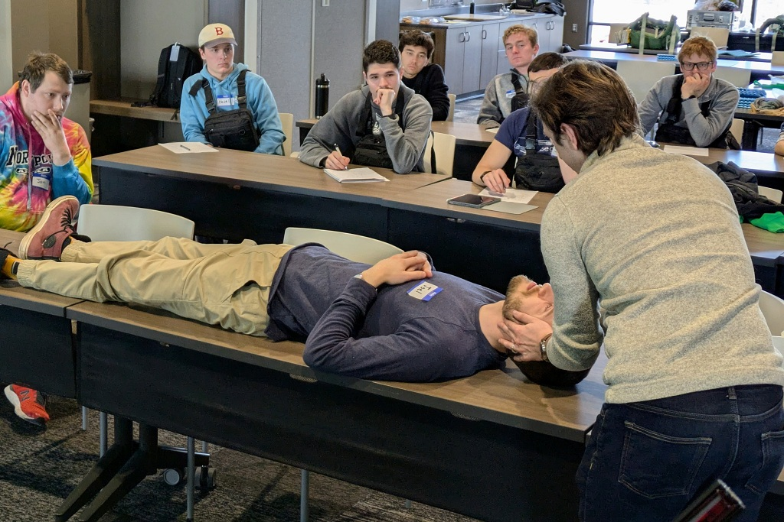
Learning
Encourage a lifelong sense of wonder by providing educational experiences essential for living intellectually curious personally fulfilling, and socially responsible lives.
Aviation + medicine = survival
Faculty, students from UND medical and aerospace colleges team up to train aviation majors on accident survival
Strategic Priority:
Serve the whole student with foundational learning opportunities that support their growth and creativity. Promote core competencies of life skills, including the abilities to set and achieve goals,
work on a team, and make responsible choices.

Slide 6
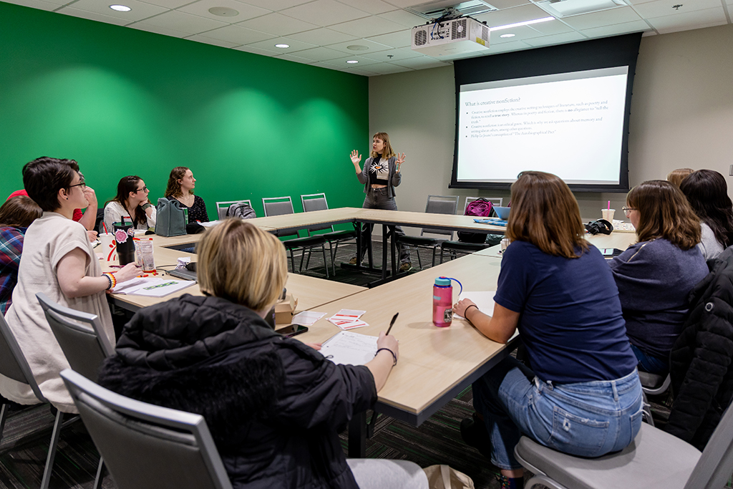
Learning
Encourage a lifelong sense of wonder by providing educational experiences essential for living intellectually curious personally fulfilling, and socially responsible lives.
Art, tech, community fluoresce at 56th UND Writers Conference
UND Writers Conference explores ways in which technology, literature, art can commingle, strengthen communities
Strategic Priority:
Provide credit and non-credit learning opportunities for campus and online students, UND employees, alumni and community members through innovative programming, rural and urban community outreach, and cross-disciplinary and cross-institutional collaborations.

Slide 7
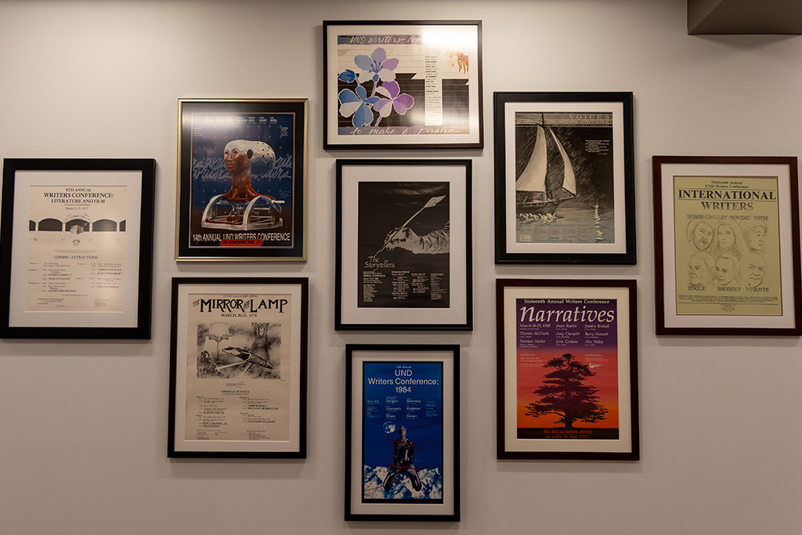
Learning
Encourage a lifelong sense of wonder by providing educational experiences essential for living intellectually curious personally fulfilling, and socially responsible lives.
Every student a writer at UND
In line with its ‘Learning’ core value, the University commits to helping students become the best writers they can be
Strategic Priority:
Serve the whole student with foundational learning opportunities that support their growth and creativity. Promote core competencies of life skills, including the abilities to set and achieve goals, work on a team, and make responsible choices.

Slide 8
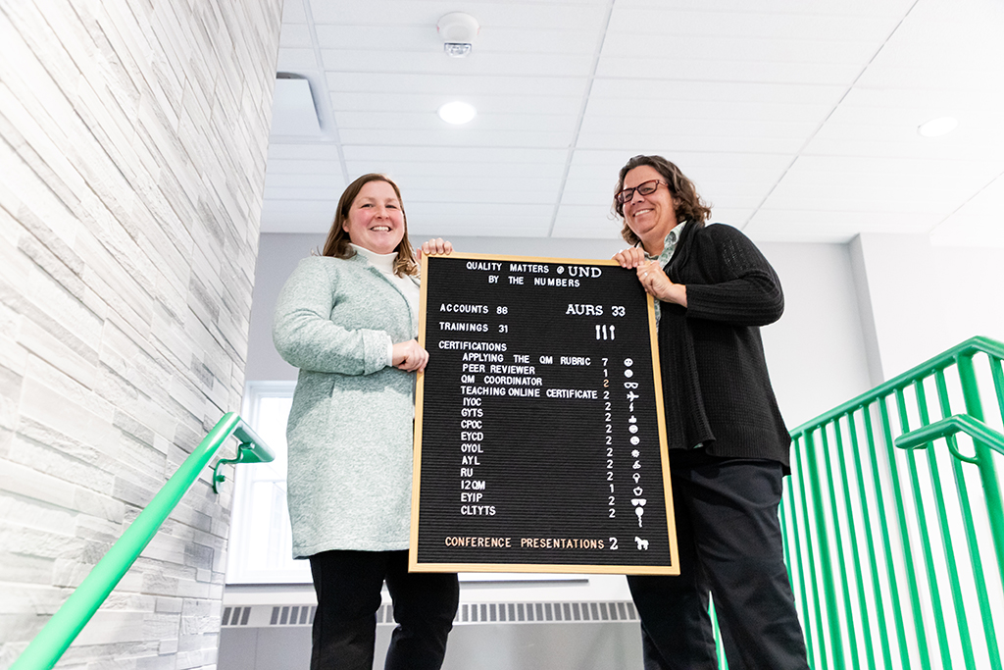
Learning
Encourage a lifelong sense of wonder by providing educational experiences essential for living intellectually curious personally fulfilling, and socially responsible lives.
At UND, ‘Quality Matters’ in course design
New course-design platform affords more objectivity, incorporates best practices, UND instructional designers say
Strategic Priority:
Promote digital technologies for engaged learning and value-added opportunities for students, faculty, staff, alumni and collaborators.

Slide 9

Learning
Encourage a lifelong sense of wonder by providing educational experiences essential for living intellectually curious personally fulfilling, and socially responsible lives.
UND CONNECT project brings Spanish Storytime to life
Spanish Storytime at GF Public Library immerses children in culture and active learning
Strategic Priority:
Infuse dynamic learning approaches, environments and student-centered pedagogy (e.g. competency-based, project-based, high impact practices, etc.) in the core curriculum. Enhance the goals of fostering creative expression, critical inquiry, and interdisciplinary learning.

Slide 10
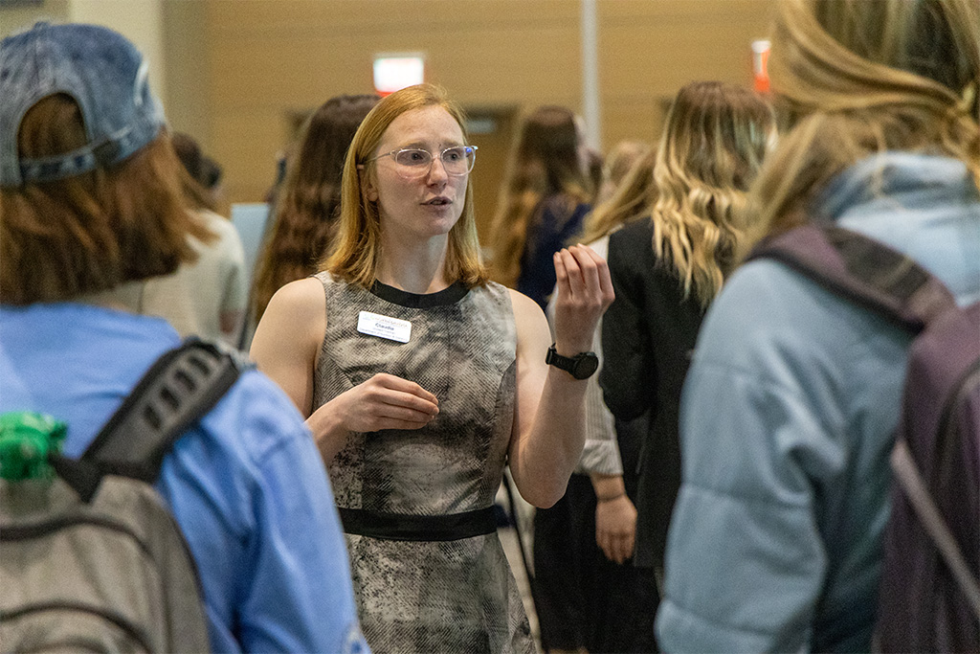
Learning
Encourage a lifelong sense of wonder by providing educational experiences essential for living intellectually curious personally fulfilling, and socially responsible lives.
Research showcase tackles Ozempic, arthritis, patient falls and other topics
Presentations at College of Nursing & Professional Disciplines’ annual event wrestle with real-world issues
Strategic Priority:
Expand individualized advising and mentoring, to help students see how skills can be transferred across courses and extra-urriculars. Provide opportunities for students to document learning, showcase their work and disseminate research and ideas.

Slide 11
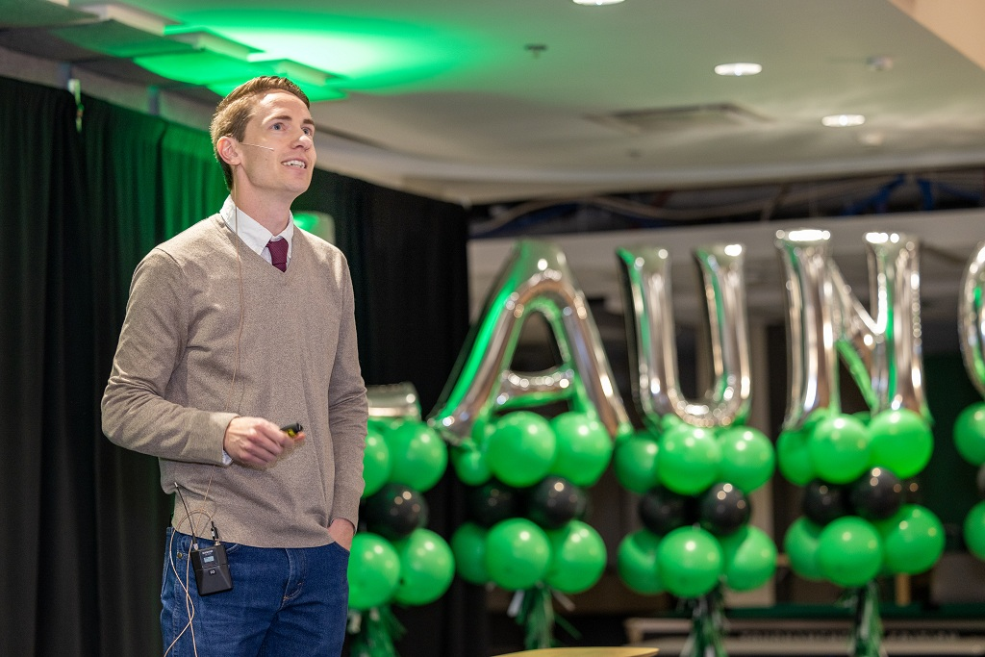
Learning
Encourage a lifelong sense of wonder by providing educational experiences essential for living intellectually curious personally fulfilling, and socially responsible lives.
UND entrepreneurs present business ideas at LAUNCH event
Early-stage entrepreneurs step up in Memorial Union, pitch products developed with UND programs’ support
Strategic Priority:
Cultivate experiential learning opportunities with real-world applications, rewarding collaborations that are built on applied learning.

