Slide 1
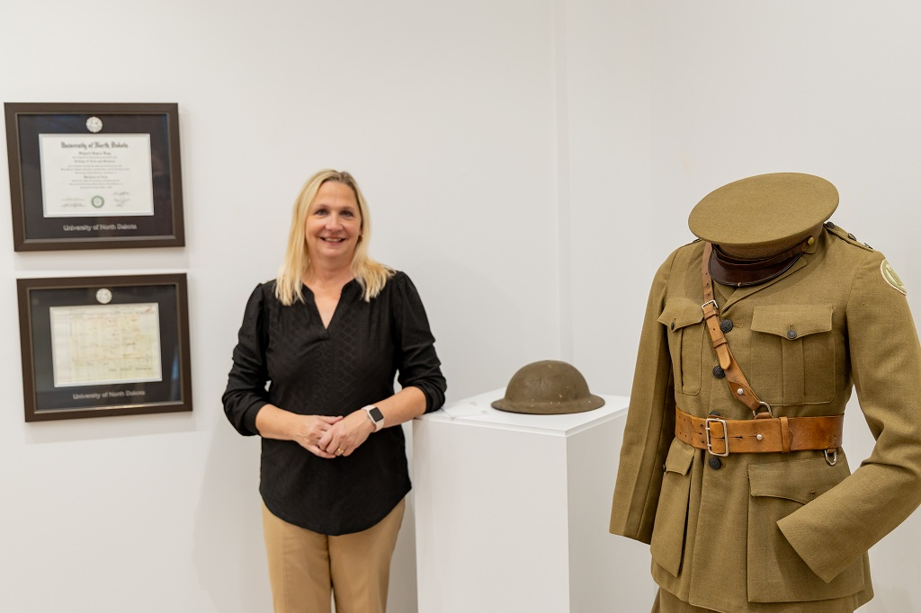
Service
Engage in collaborations that serve the evolving needs of our people, tribal nations, the state of North Dakota, and our global community.
UND Military History Display opens in Memorial Union Gallery
Display honors 142 years of military history at UND and very long line of UND community members who’ve served
Strategic Priority:
Promote the arts and humanities, which contribute to the cultural vibrancy of the state and help attract and retain talent in our communities.

Slide 2
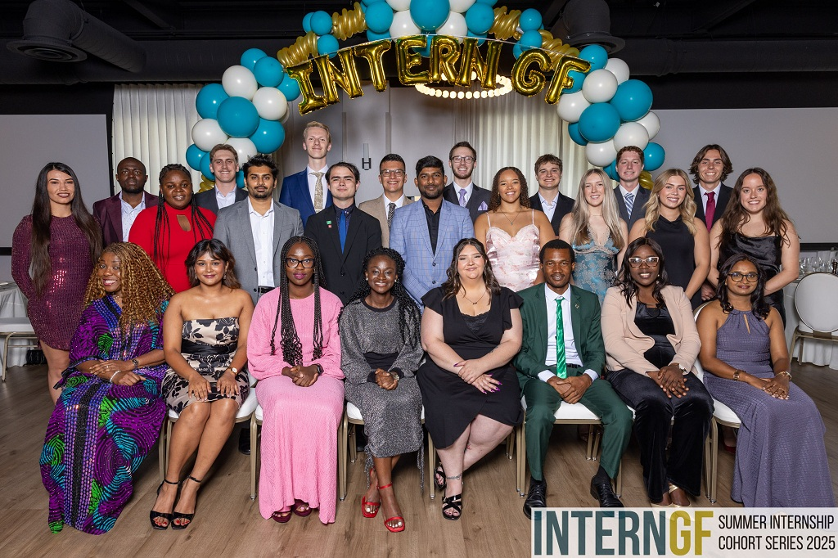
Service
Engage in collaborations that serve the evolving needs of our people, tribal nations, the state of North Dakota, and our global community.
InternGF sets students up for success
As 2025 Closing Ceremony shows, participants network, explore region’s culture and imagine future for themselves in Greater Grand Forks
Strategic Priority:
Expand innovation and entrepreneurship to bring about the creation of new jobs and economic opportunities.

Slide 3
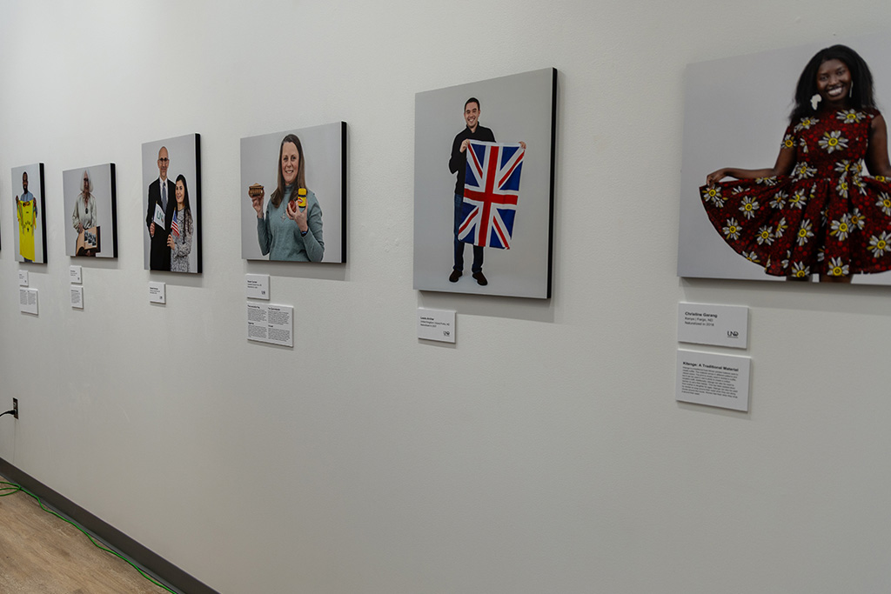
Service
Engage in collaborations that serve the evolving needs of our people, tribal nations, the state of North Dakota, and our global community.
Memorial Union Gallery features ‘New Americans’ exhibit
A UND CONNECT project, ‘From Many Places, One Community’ captures stories of immigration, identity and the meaning of becoming an American
Strategic Priority:
Create “front doors” to UND, helping streamline ways for people and partners to engage and collaborate. Embrace practices that allow flexibility and encourage positive risk taking.

Slide 4
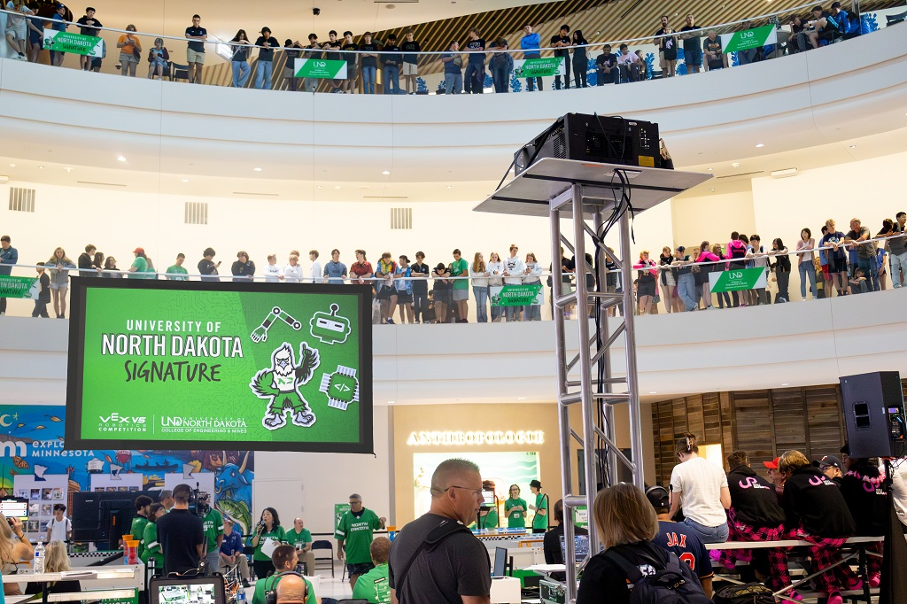
Service
Engage in collaborations that serve the evolving needs of our people, tribal nations, the state of North Dakota, and our global community.
UND leads charge in competitive robotics
UND hosts VEX Robotics tournament at Mall of America, supporting next generation of engineers and scientists
Strategic Priority:
Provide lifelong-learning opportunities that appeal to community members of all ages, and capitalize on the expertise at UND. Provide curricular and co-curricular opportunities for UND students to give back and serve their communities.

Slide 5

Service
Engage in collaborations that serve the evolving needs of our people, tribal nations, the state of North Dakota, and our global community.
Getting beyond answers like ‘fine’ and ‘nothing’
Writing in The Conversation, UND Education & Human Development Dean Shelbie Witte offers five simple ways to spark real talk with kids
Strategic Priority:
Address the health, educational, safety, cultural, economic, and workforce needs of our community, state and region via research and educational collaborations.

Slide 6
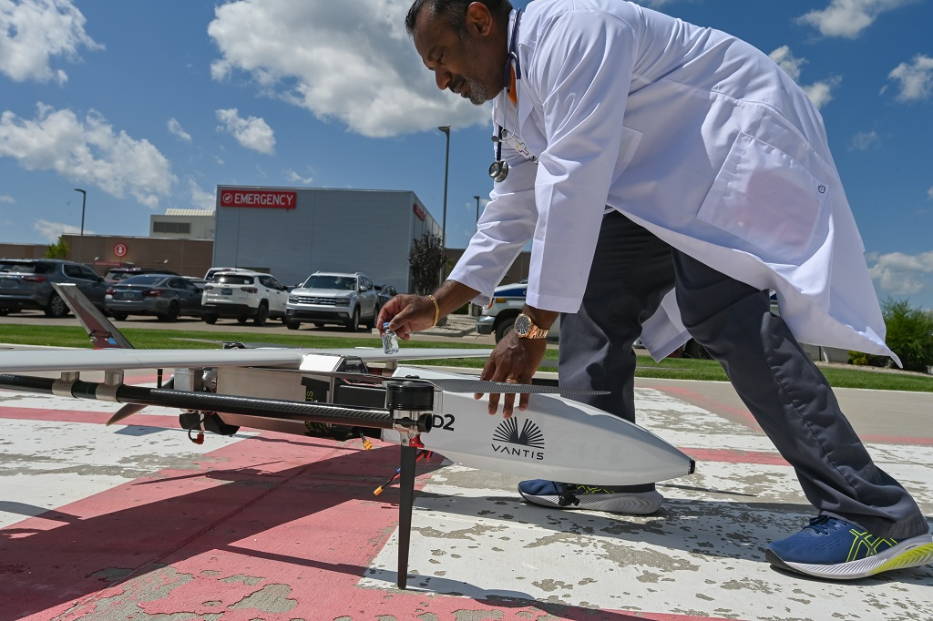
Service
Engage in collaborations that serve the evolving needs of our people, tribal nations, the state of North Dakota, and our global community.
UND, partners complete landmark medical drone delivery trial
Project Rural Reach flight carries medical supplies from Williston, N.D., to Watford City, N.D., in just over 35 minutes
Strategic Priority:
Provide lifelong-learning opportunities that appeal to community members of all ages, and capitalize on the expertise at UND. Provide curricular and co-curricular opportunities for UND students to give back and serve their communities.

Slide 7
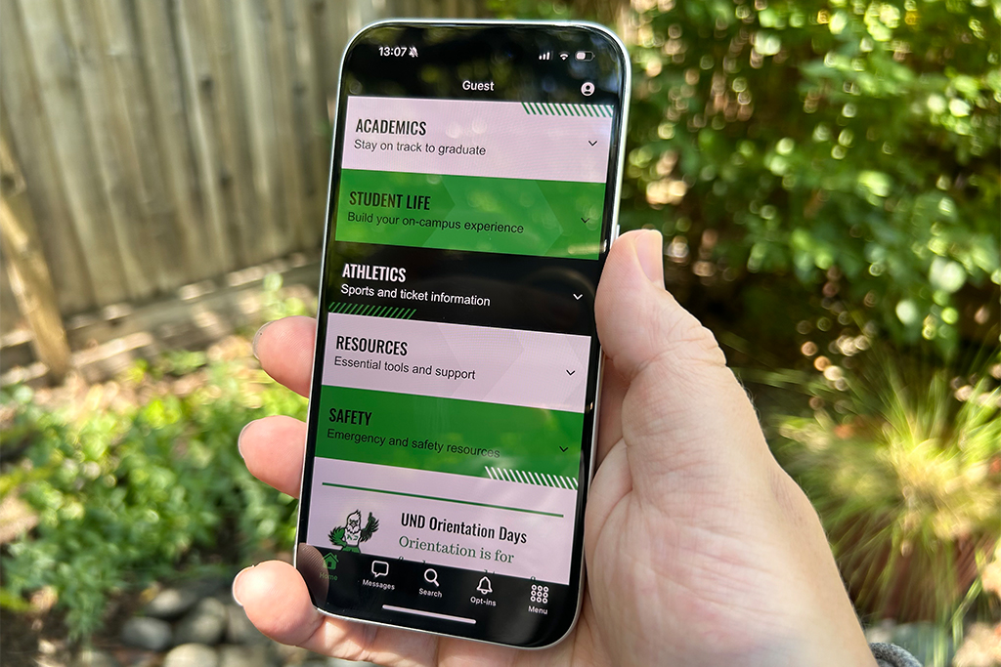
Service
Engage in collaborations that serve the evolving needs of our people, tribal nations, the state of North Dakota, and our global community.
New-look refresh for My UND app puts accessibility first
Enhancements to UND’s official mobile app go hand-in-hand with University’s digital accessibility goals
Strategic Priority:
Create “front doors” to UND, helping streamline ways for people and partners to engage and collaborate. Embrace practices that allow flexibility and encourage positive risk taking.

Slide 8
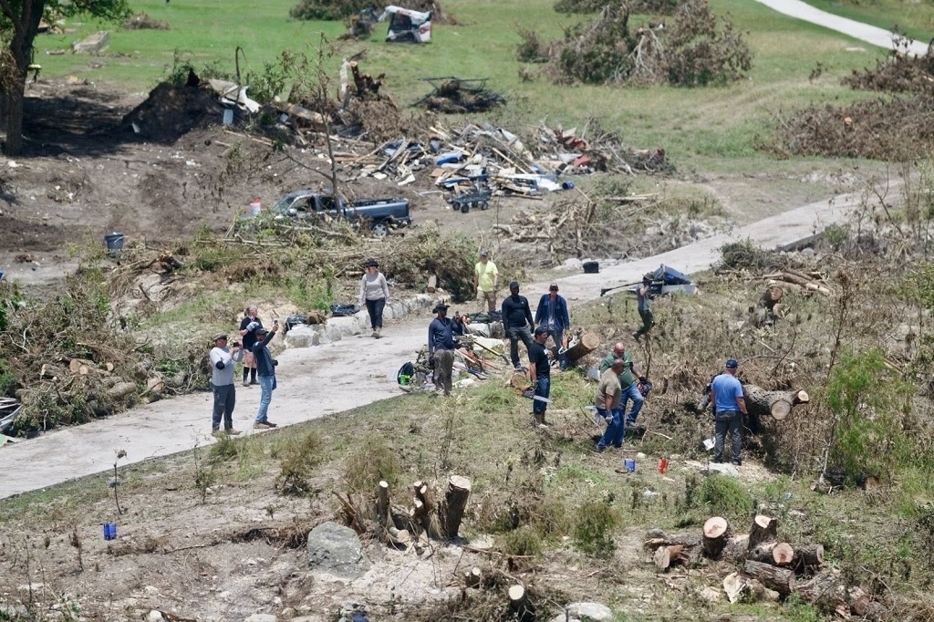
Service
Engage in collaborations that serve the evolving needs of our people, tribal nations, the state of North Dakota, and our global community.
Addressing disasters’ emotional toll
In the wake of floods and tornadoes, sustained mental health support is critical, UND scholar writes in The Conversation
Strategic Priority:
Address the health, educational, safety, cultural, economic, and workforce needs of our community, state and region via research and educational collaborations.

Slide 9
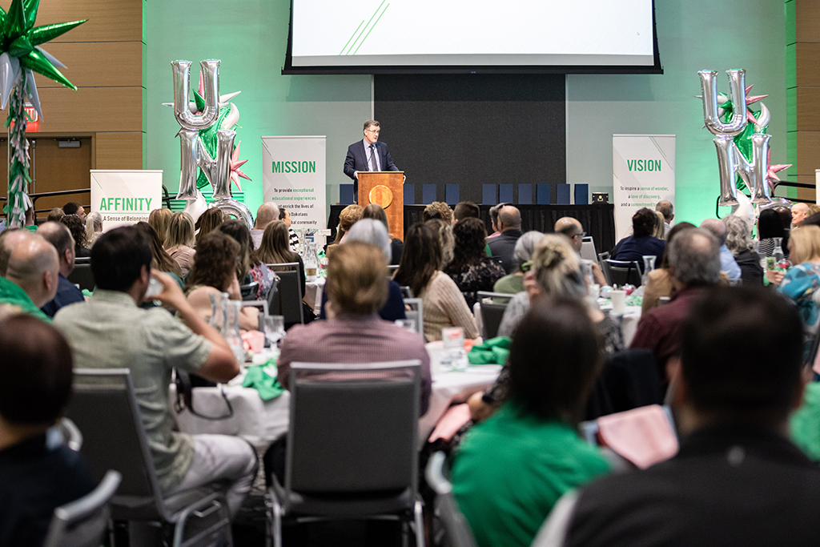
Service
Engage in collaborations that serve the evolving needs of our people, tribal nations, the state of North Dakota, and our global community.
UND presents Meritorious Service Awards at annual luncheon
2025 Staff Recognition Luncheon features service milestones and special awards for UND personnel
Strategic Priority:
Strengthen services and cultivate programs for recruiting, mentoring and advancing historically underserved and marginalized students and employees.

Slide 10
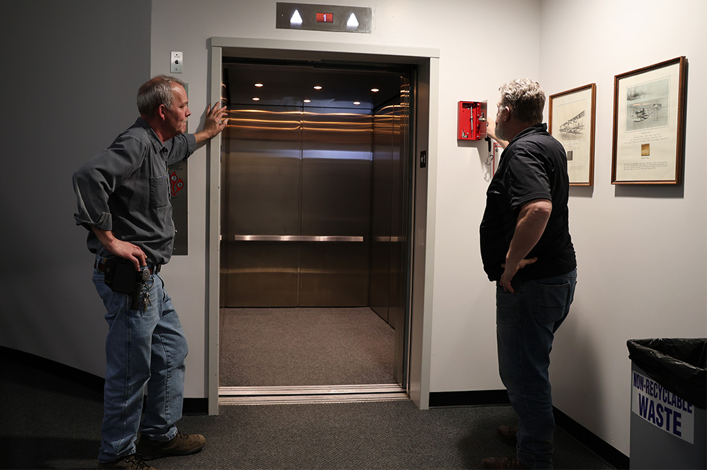
Service
Engage in collaborations that serve the evolving needs of our people, tribal nations, the state of North Dakota, and our global community.
Light-speed Going up: UND’s 108 elevators keep doing the heavy lifting
At UND, monthly inspections and prioritized upgrades keep elevators working and campus buildings accessible
Strategic Priority:
Cultivate North Dakota partnerships that highlight our national and global leadership in areas such as Rural Health, Autonomous Systems, Energy and Environment, Space Studies and National Security.

