Slide 1
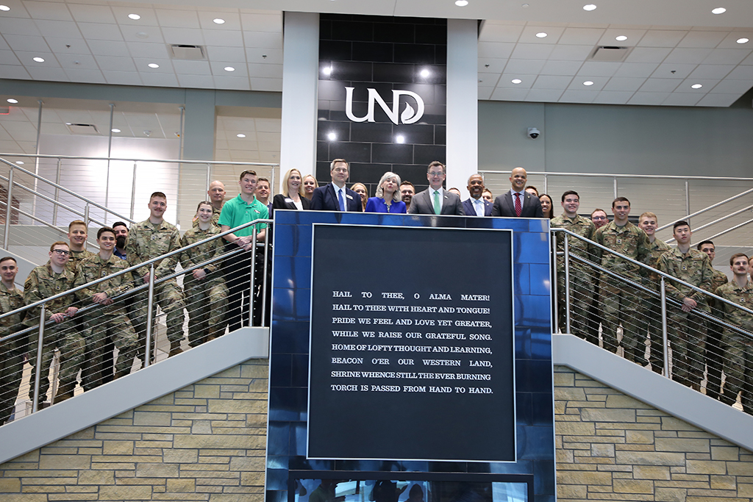

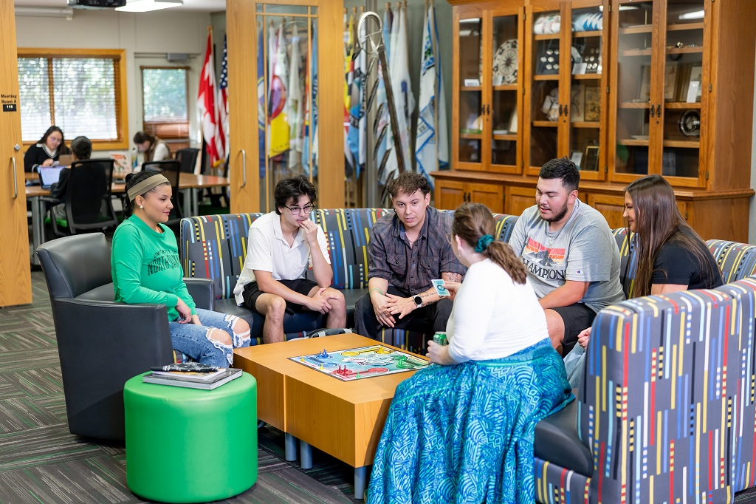


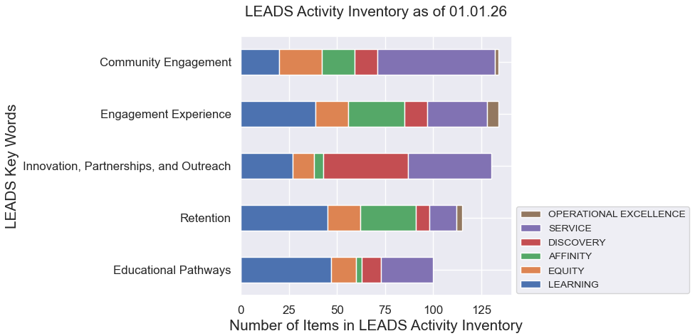
UND LEADS in Action: Turning Data into Direction
What We’re Doing
The initiatives and activities from across campus that are aligned with the strategic priorities of LEADS.
UND Today
LEADS Activity Inventory
Analytics & Trend Analysis
How We’re Doing
The metrics we would expect to be influenced by our collective attention to LEADS strategic priorities.
Strategic Priority Outcome Metrics
Implementation Team Analysis: “Levels of Achievement”
Since the January 2023 launch of LEADS, over 1000 stories connecting the work we do to the LEADS core values.
Identifying and monitoring a variety of outcome metrics provides a sense of the impact of our collective commitment to LEADS.
Currently monitoring 40+ outcomes such as experiential learning enrollments, NSSE indicators, patterns in students’ enrollment, research funding levels, scholarly collaborations, etc.
Open to submissions from anyone across campus, the Activity Inventory contains approximately 325 (and counting) items illustrating the breadth and variety of campus-wide LEADS-aligned work.
The data we’ve collected requires analysis and interpretation. The LEADS Implementation Team assigns a “level of achievement” on a 5-point scale for all 37 LEADS strategic priorities, providing a collective sense of strength, areas of growth, and their changes over time.
Where do LEADS-aligned activities “fit” relative to common higher education key words? In what ways is campus-wide LEADS-aligned activity changing over time?

Slide 2
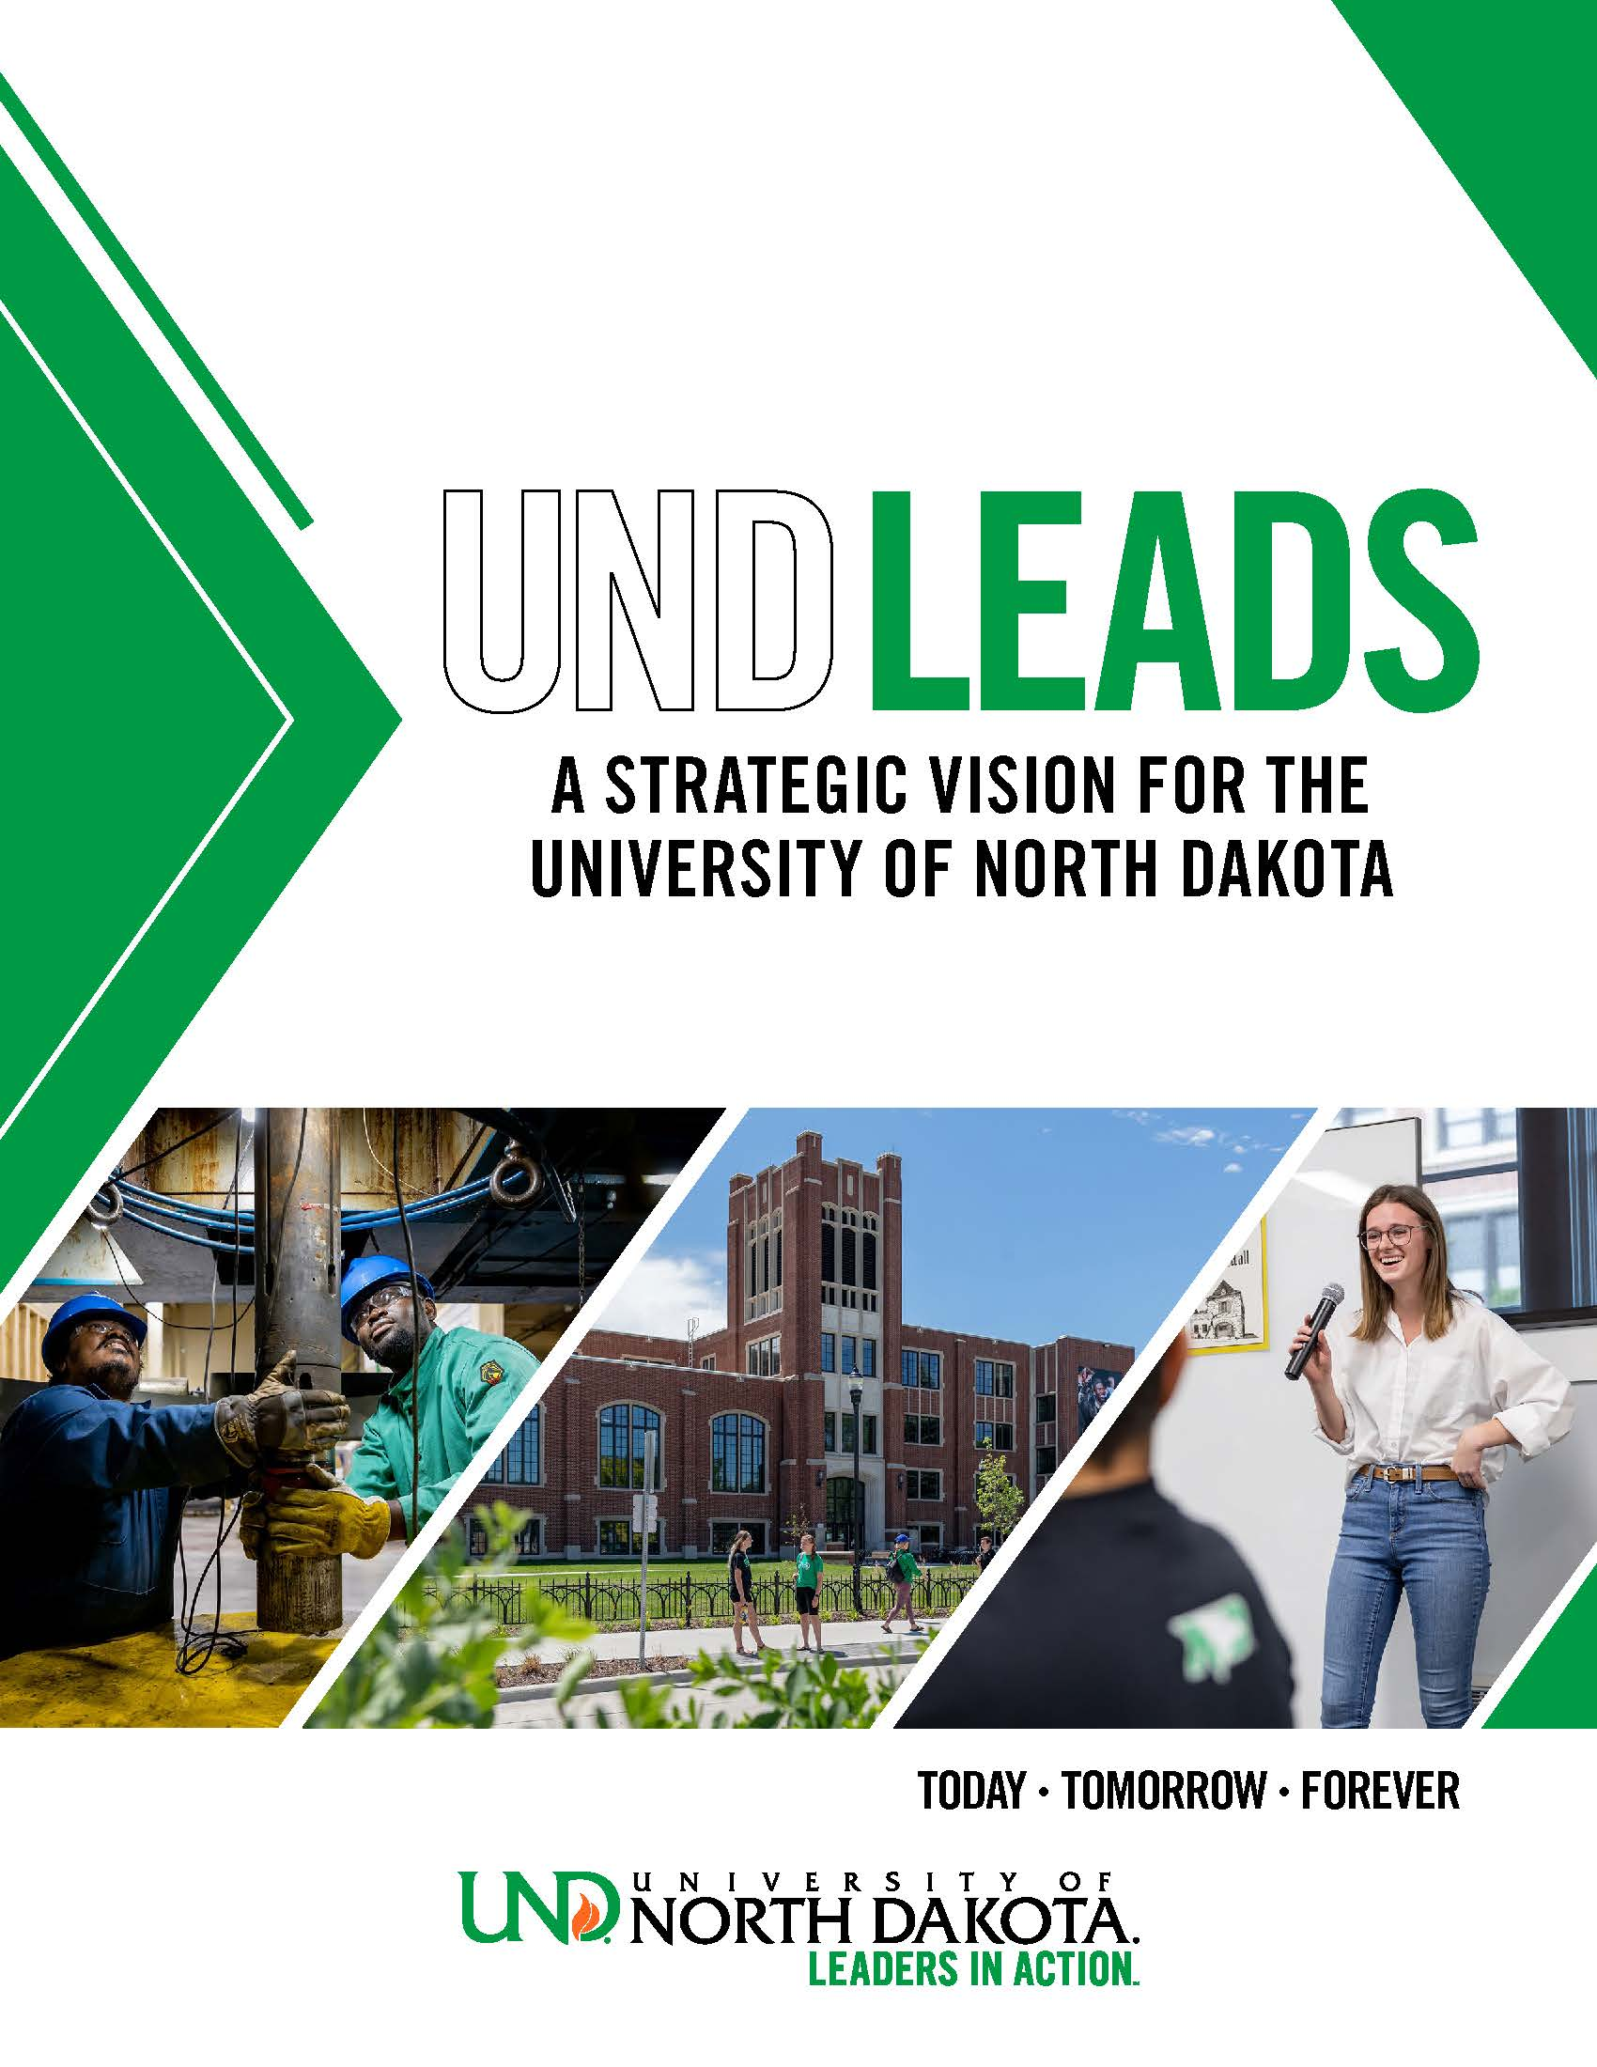
UND LEADS Implementation Team: Shared Governance in Action
UND LEADS Implementation Team
Crystal Alberts, Professor and Vice Chair/Chair-Elect of University Senate
Zarrina Azizova, Associate Professor and Past Chair of University Senate
Matt Berosik, Chief Data Officer
Jonathan Blankenship, Student Body President
Angie Carpenter, Director of Veteran & Military Affairs
Rob Carolin, Director of University Outreach
Anna Clark, Director of Communications & Planning
Tom Dennis, Editor of UND Today
Odella Fuqua, Associate Vice President for Finance
Crystal Kahl, Administrative Specialist
Anna Kinney, AI Instructional Manager and Past-Chair of Staff Senate
Adam Matz, Associate Professor and Chair of University Senate
Mariah Pingleton, Admissions Representative and Chair-Elect of Staff Senate
Shane Schellpfeffer, Director of Institutional Effectiveness & Accreditation
Judy Solberg, Chief of Staff
Brandon Wallace, Senior Financial Accountant and Chair of Staff Senate
Ryan Zerr, Professor and Associate Vice President for Strategy & Implementation
Assisted By:
Godwin Ahiase, Graduate Service Assistant
Sharmin Rahman, Communications Intern
From President Armacost:
“I hope that everyone at UND envisions themselves taking part in this plan and working to develop their own goals to move UND forward. We all share in UND’s success and are all responsible for carrying out UND’s mission…
From Implementation Team’s Charge:
“Ensure that throughout the lifetime of UND LEADS that shared governance processes that encourage campus-wide engagement in the work of the plan are promoted and that transparent processes are followed. This work should help enhance the diversity, quality, and quantity of voices across all dimensions of campus in the work of UND LEADS.”

Slide 3
LEARNING: A Sense of Wonder
What We’re Doing
The initiatives and activities from across campus that are aligned with the Learning core value of LEADS.
Strategic Investment Funding: FY24, FY25, & FY26
7 Total Learning-Aligned Projects
Simulated Emergency Training Program: Nursing & Professional Disciplines
Center for Engineering Education Research: Engineering & Mines and Education & Human Development
INMED Summer Institute: Medicine & Health Sciences
UND UAS Flight Operations and Research Center: Odegard School of Aerospace Sciences
Aerospace Experiential Learning Lab: Odegard School of Aerospace Sciences
Critical + Creative: Intro to Innovation and Design: Center for Innovation
Master of Social Work: Program Expansion: Nursing & Professional Disciplines
LEADS Activity by Learning Strategic Priority
How We’re Doing
The metrics we would expect to be influenced by our collective attention to Learning strategic priorities.
Learning Levels of Achievement by Strategic Priority
Examples of Learning Outcome Metrics
Total Strategic Investment Funding Awarded (FY24-26):
$10.87 million
Total for Learning-Related Initiatives:
$2.05 million (18.8%)
1. Students’ reported HIP involvement from NSSE
2. Trends in NSSE indicators related to Discussions with Diverse Others (see below left)
3. Trends in student participation in living-learning communities
1. Trends in courses/sections offered, SCH generated, and available fields of study (see below right)
2. Trends in numbers of attendees at campus events, gatherings, camps, and conferences
Foster a global perspective
Provide credit and non-credit learning opportunities
Although this only represents a sample of all Learning-aligned activity, it gives a sense of which priority areas are receiving more/less attention…thereby informing plans for future efforts.

Slide 4
EQUITY: Opportunities for Success
What We’re Doing
The initiatives and activities from across campus that are aligned with the Equity core value of LEADS.
Strategic Investment Funding: FY24, FY25, & FY26
3 Total Equity-Aligned Projects
Center for Engineering Education Research: Engineering & Mines and Education & Human Development
Alston Academic Awards: Athletics
Master of Social Work: Program Expansion: Nursing & Professional Disciplines
LEADS Activity by Equity Strategic Priority
How We’re Doing
The metrics we would expect to be influenced by our collective attention to Equity strategic priorities.
Equity Levels of Achievement by Strategic Priority
Examples of Equity Outcome Metrics
Total Strategic Investment Funding Awarded (FY24-26):
$10.87 million
Total for Equity-Related Initiatives:
$1.41 million (13.0%)
1. Trends in NSSE indicators related to interactions with others (see below left)
2. Trends in student enrollment by demographic group
3. Trends in military-affiliated student enrollment
1. Trends in student enrollment by demographic group (see below right)
2. Trends in textbook and course resource costs
3. Trends in retention and degree-completion for different student populations
Promote diverse perspectives and inclusive worldviews
Reduce barriers to higher education
Although this only represents a sample of all Equity-aligned activity, it gives a sense of which priority areas are receiving more/less attention…thereby informing plans for future efforts.
Undergraduate Student Enrollment by Demographic Category

Slide 5
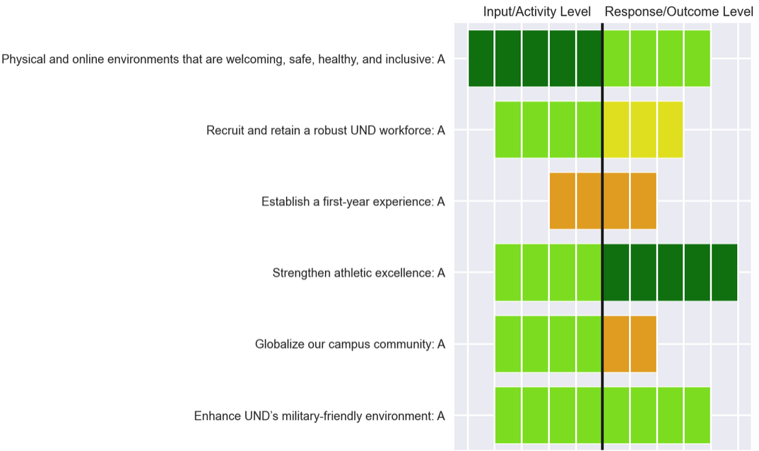
AFFINITY: A Sense of Belonging
What We’re Doing
The initiatives and activities from across campus that are aligned with the Affinity core value of LEADS.
Strategic Investment Funding: FY24, FY25, & FY26
3 Total Affinity-Aligned Projects
Alston Academic Awards: Athletics
Netting Curtains Systems for Pollard Athletic Center: Athletics
Dream Big! UCLC Outdoor Classroom Renewal: University Children’s Learning Center
LEADS Activity by Affinity Strategic Priority
How We’re Doing
The metrics we would expect to be influenced by our collective attention to Affinity strategic priorities.
Affinity Levels of Achievement by Strategic Priority
Examples of Affinity Outcome Metrics
Total Strategic Investment Funding Awarded (FY24-26):
$10.87 million
Total for Affinity-Related Initiatives:
$0.95 million (8.7%)
1. Trends in first-to-second year retention by demographic group (see below left)
2. Trends in student involvement in first-year experience programming
3. Trends in employee retention
1. Trends in military-affiliated student enrollment (see below right)
2. Trends in retention and graduation rates for military-affiliated students
Establish a first-year experience
Enhance UND’s military-friendly environment
Although this only represents a sample of all Affinity-aligned activity, it gives a sense of which priority areas are receiving more/less attention…thereby informing plans for future efforts.

Slide 6
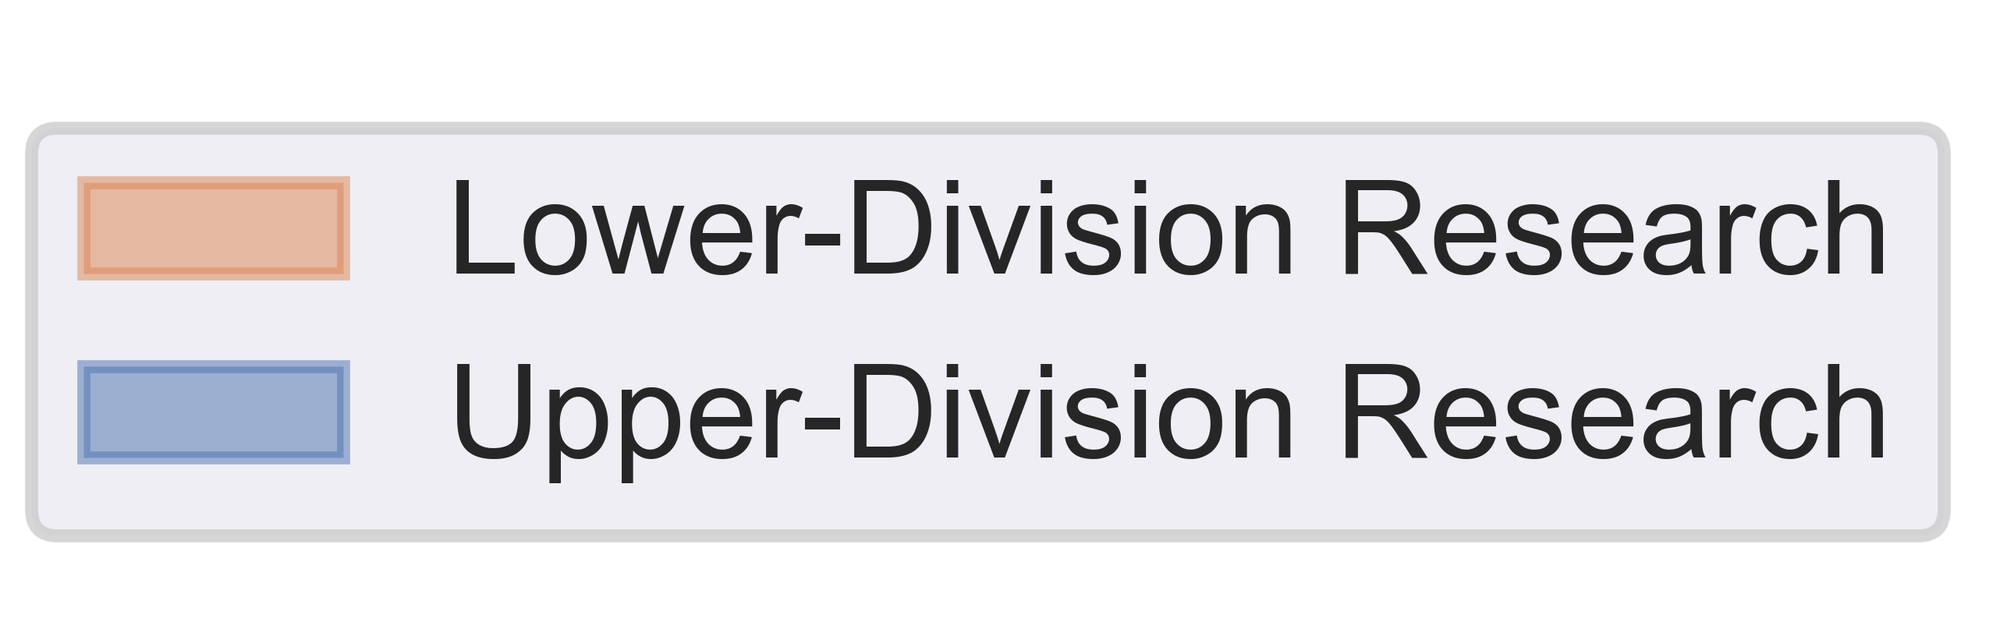
DISCOVERY: A Love of Inquiry & Creativity
What We’re Doing
The initiatives and activities from across campus that are aligned with the Discovery core value of LEADS.
Strategic Investment Funding: FY24, FY25, & FY26
5 Total Discovery-Aligned Projects
Quantitative Conservation Biology: Arts & Sciences
ND Aerospace Medicine Center: Odegard School of Aerospace Sciences and Medicine & Health Sciences
Unlocking the Full Potential of the UND Nanofoundry: Arts & Sciences
Hypersonics Initiative: Engineering & Mines
Critical + Creative: Intro to Innovation and Design: Center for Innovation
LEADS Activity by Discovery Strategic Priority
How We’re Doing
The metrics we would expect to be influenced by our collective attention to Discovery strategic priorities.
Discovery Levels of Achievement by Strategic Priority
Examples of Discovery Outcome Metrics
Total Strategic Investment Funding Awarded (FY24-26):
$10.87 million
Total for Discovery-Related Initiatives:
$3.29 million (30.3%)
1. Trends in HERD-reported R&D expenditures (see below left)
2. Trends in funding levels for internally-supported research and creative activity
3. Trends in grant and contract revenue
1. Trends in number of undergraduate students enrolled in course-based research (see below right)
2. Trends in nationally-competitive scholarship and fellowship applications
Coordinate and manage resources
Infuse creative expression, critical inquiry, & innovation
Although this only represents a sample of all Discovery-aligned activity, it gives a sense of which priority areas are receiving more/less attention…thereby informing plans for future efforts.
Although this only represents a sample of all Discovery-aligned activity, it gives a sense of which priority areas are receiving more/less attention…thereby informing plans for future efforts.

Slide 7
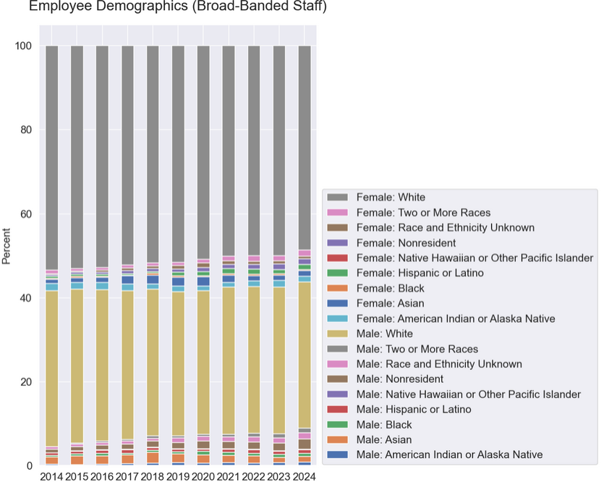
SERVICE: A Commitment to People and Communities
What We’re Doing
The initiatives and activities from across campus that are aligned with the Service core value of LEADS.
Strategic Investment Funding: FY24, FY25, & FY26
10 Total Service-Aligned Projects
Quantitative Conservation Biology: Arts & Sciences
Digital Journalism Education: Arts & Sciences
Simulated Emergency Training Program: Nursing & Professional Disciplines
ND Aerospace Medicine Center: Odegard School of Aerospace Sciences and Medicine & Health Sciences
Alston Academic Awards: Athletics
INMED Summer Institute: Medicine & Health Sciences
Netting Curtains Systems for Pollard Athletic Center: Athletics
Critical + Creative: Intro to Innovation and Design: Center for Innovation
Master of Social Work: Program Expansion: Nursing & Professional Disciplines
Enhancing Teacher Education Training, Engagement, and Community Partnerships: Education & Human Development
LEADS Activity by Service Strategic Priority
How We’re Doing
The metrics we would expect to be influenced by our collective attention to Service strategic priorities.
Service Levels of Achievement by Strategic Priority
Examples of Service Outcome Metrics
Total Strategic Investment Funding Awarded (FY24-26):
$10.87 million
Total for Service-Related Initiatives:
$3.17 million (29.1%)
1. Trends in non-traditional student headcount (see below left)
2. Trends in UND’s local and regional economic impact
3. Trends in number of external partners
1. Demographic trends for employees and students (see below right)
2. Trends in staff and faculty year-to-year retention rates and changes in job titles
3. Trends in non-traditional student headcount
Address health, educational, safety, cultural, economic, and workforce needs
Strengthen services and cultivate programs
Although this only represents a sample of all Service-aligned activity, it gives a sense of which priority areas are receiving more/less attention…thereby informing plans for future efforts.

