Slide 1
HyFlex Course Design
Transitioning Excellence Online to Support Students and Faculty Preparing for
Instructional Continuity
Dr. Brian Beatty
San Francisco State University
University of North Dakota| July 2020
Notes:
Welcome to the presentation:
Resilience & Flexibility in the Classroom through Hybrid-Flexible (HyFlex) Modalities
Session 3: Implementing HyFlex Courses and Programs: Administrative Considerations

Slide 2
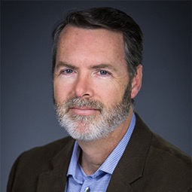
Brief Bio…
Faculty (and former Chair)
Instructional Technologies (College of Ed)
AVP Academic Affairs Operations (8yrs)
E-Learning Design and Development
Train-the-Trainer
Classroom teacher
Technical training (USN)
OER author: https://edtechbooks.org/hyflex/
Notes:
I’d like to give you a very brief overview of who I am as we begin.
From 2012-2020, I was the Associate Vice President for Academic Affairs Operations. I oversaw the use of academic technology within Academic Affairs across campus, and I coordinated people, conversations, and initiatives around IT with other university units.
I recently returned to my previous role as Associate Professor in the Instructional Technologies Program in the Graduate College of Education at San Francisco State University. I’ve been here for 15 years. The ITEC Program in the ELSIT Department offers an MA degree and several certificates for instructional designers and technology-using teachers. My role is a mix of teaching and advising graduate students, administering the programs, and conducting applied research. One of my main research interests has been online and hybrid learning, and HyFlex was one of the things I spent a lot of time developing.
Other aspects of my professional work include the design and development of e-learning for various business sectors, developing training for Subject Matter Experts who are moving into a training role, and supporting faculty as they learn how to teach online and in hybrid environments.
In the past, I’ve been a high school classroom teacher (Math, Science, and Computer Applications) and a US Navy officer working in the nuclear power field.
I’ve had a lot of hats, and I’ve found they’ve all contributed to my perspectives on learning and how to design for student success. One of the major beliefs I hold about teaching and learning is that there is almost never a “best” way, but there are often many good, effective ways to design and implement instruction. I think HyFlex is no different. It offers significant advantages in many situations, but is not a “silver bullet,” capable of solving all problems we see in higher education today. But that’s a point I hope to make clear in this workshop, and I hope you’ll be able to start making decisions about if and how HyFlex courses can help you in your specific setting.
Photo credits:
Portrait – (rights to use attained by Dr. Beatty)
Caps – MS Clip Art

Slide 3

Agenda
Introduction – Transitioning Excellence Online
What is a HyFlex Course? Principles and Practices
Student and Faculty Experiences
Needs and Opportunities
  Institutional, student and faculty
  COVID-19 considerations
Design – Transitioning Excellence
Faculty Development
Impact Research
Program Implementation
Questions and answers
Notes:
Image credits:
HyFlex Wordmark – Dr. Brian Beatty LLC
Plans – MS Clip Art Gallery

Slide 4

What is HyFlex?
Notes:
At the outset, I’d like to clearly state what HyFlex is, or means to me.
Simply put, HyFlex refers to a hybrid course using classroom-based and online delivery methods that allows students to choose how to attend and complete class in a given week (or session).
They have the flexibility to choose from among two major options – in-person attendance and participation in the classroom, or online participation (attendance) – sometimes with the additional choice of synchronous or asynchronous online participation.
Photo credit: MS Clip Art

Slide 5
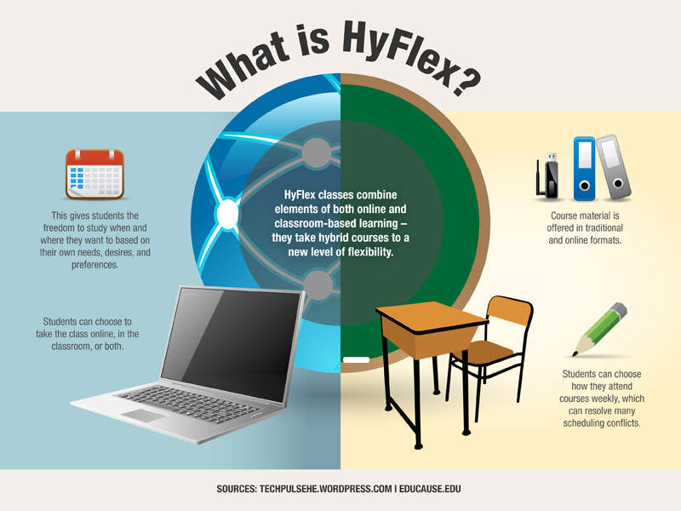

Slide 6


Previous Experience - HyFlex?
Notes:
The HyFlex design essentially combines online and face to face students in the same class sections and allows students the freedom to choose which mode they participate in from session to session.
Have you personally ever used a HyFlex-like approach, even if you called it something else?
Have you heard of this approach in use by people you trust?
[Allow for brief explanations of approaches]
Image credit: MS Clip Art

Slide 7

Policy Definition
In a Hybrid Flexible (HyFlex) Class, students can choose to attend class either in an assigned face-to-face environment or in an online environment, synchronously or asynchronously. Online technology is primarily used to provide students with flexibility in their choice of educational experience, and to communicate with the faculty member inside and outside of office hours.
Academic Senate Policy S19-264
https://senate.sfsu.edu/policy/online-education-policy-1
Notes:
At San Francisco State University, our Online Education Policy defines a HyFlex course this way:
Original: (2012) In a Hybrid Flexible (HyFlex) Class, students can choose to attend class either in an assigned face-to-face environment or in an online environment, synchronously or asynchronously. Online technology is primarily used to provide students with flexibility in their choice of educational experience, and to communicate with the faculty member inside and outside of office hours.
2019 revision: HyFlex courses are class sessions that allow students to choose whether to attend classes face-to-face or online, synchronously or asynchronously.
Photo credit: Right to use purchased from iStockphoto.com iStock_000005164588XSmall.jpg

Slide 8
HyFlex Key Principles
Alternatives
Equivalence
Reuse
Accessible
Notes:
Four key principles of HyFlex design:
First, real alternatives support learner choice or learner control in learning. In HyFlex classes, we try to provide students a choice in how they complete class activities; believing that when they have a choice, they take on more ownership for their participation and ultimately their learning. That’s especially important with graduate students.
Next, these choices should lead to equivalent learning – the achievement of the same student learning outcomes. Not identical specific instructional objectives, necessarily, but all options should help students meet the same fundamental set of learning objectives for a course, or a topic in that course.
Third, HyFlex encourages reuse in training and education design. In HyFlex, this means that the resources created for in-class students should also be useful for online students as well, and vice-versa. When students complete activities in-class or online, any artifacts created also become potential learning resources (or learning objects) for the other students. As well, in many graduate courses, the students themselves generate a large part of the learning resources - content - during their participation, whether in discussions, completing writing or project assignments, or reflecting on their learning in view of their peers. Essentially, in a way they are “prosumers”, to use Toffler’s term - they produce and consume content.
The fourth principle is accessibility. Learners need to have convenient and meaningful access to learning opportunities; resources and activities must be available and usable for all learners. This means that delivery and interaction technologies (computer tools, networks, etc.) are available and learners know how to use them. This also means that learning should fit the students as much as practicable - the physical, emotional, and cognitive characteristics that they bring to the course experience. (If you are interested in this further, see the “Universal Design for Learning” materials at www.cast.org)

Slide 9
Alternatives
HyFlex courses must have fully developed participation alternatives: classroom (face to face) and online (distance).
Online participation may include synchronous (same time) and asynchronous (time independent).
Determine how much flexibility students need to adequately participate; most situations require some level of time independence in addition to location independence, requiring an asynchronous online alternative.
Notes:
Real alternatives support learner choice or learner control in learning. In HyFlex classes, we try to provide students a choice in how they complete class activities; believing that when they have a choice, they take on more ownership for their participation and ultimately their learning. That’s especially important with graduate students.

Slide 10
Equivalence
Alternative paths in a HyFlex course must lead to equivalent learning outcomes.
Various participation modes may present content, engage students and assess learning with different media and activities, but all students should be able to achieve the same learning outcomes.
Outcomes based on process (e.g., participating in discussions, demonstrating learning) should fit the participation mode rather than being forced into the same form for all.
Learning outcomes do not change | Process outcomes may differ
Notes:
These choices should lead to equivalent learning – the achievement of the same student learning outcomes. Not identical specific instructional objectives, necessarily, but all options should help students meet the same fundamental set of learning objectives for a course, or a topic in that course.

Slide 11
Reuse
Instructional materials and student-generated artifacts from learning activities in each participation mode become learning resources for all students.
Instructional materials: build once and use in all modes as appropriate
Student activity: capture in-class activity for online student use and vice-versa. Audio | Video | Text | Documents
The LMS can be an excellent resource for capturing, curating and sharing resources for all modes.
Notes:
HyFlex encourages reuse in training and education design. In HyFlex, this means that the resources created for in-class students should also be useful for online students as well, and vice-versa. When students complete activities in-class or online, any artifacts created also become potential learning resources (or learning objects) for the other students. As well, in many graduate courses, the students themselves generate a large part of the learning resources - content - during their participation, whether in discussions, completing writing or project assignments, or reflecting on their learning in view of their peers. Essentially, in a way they are “prosumers”, to use Toffler’s term - they produce and consume content.

Slide 12
Accessible
Alternative participation modes in HyFlex courses must be accessible to all students.
Legal requirements for accessibility (Section 508 of ADA, local regulations, policies, and practices) for all media and activities
Meaningful accessibility includes access to network, technology, and skills needed to participate in online modes.
Alternative participation modes are valid alternatives only if students can effectively participate in all (or desired) modes.
Notes:
Learners need to have convenient and meaningful access to learning opportunities; resources and activities must be available and usable for all learners. This means that delivery and interaction technologies (computer tools, networks, etc.) are available and learners know how to use them. This also means that learning should fit the students as much as practicable - the physical, emotional, and cognitive characteristics that they bring to the course experience. (If you are interested in this further, see the “Universal Design for Learning” materials at www.cast.org)

Slide 13
More than just “HyFlex”
Multi-Access Learning (2009)
Mode-Neutral (2008)
Multi-Options (2014)
Converged Learning (2012)
Flexible Hybrid (2014)
Peirce Fit ® (2014)
FlexLearning (2012)
Blendflex (2016)
Comodal (2016)
Flexibly Accessible Learning Environment (FALE) (2018)
Provides multiple options with student control over participation mode
Provides multiple options but (perhaps) no student control over participation mode
Synchronous Learning in Distributed Environments (SLIDE) (2011)
Remote Live Participation (RLP) (2018)
gxLearning (2011)
Blendsync (2011)
For more about these, visit https://edtechbooks.org/hyflex/book_intro
Notes:
Other universities, colleges and systems and faculty have used other terms to refer to Hybrid-Flexible approaches.
These are the ones I am familiar with – references can be found at https://edtechbooks.org/hyflex/book_intro

Slide 14
Who is using a form of HyFlex?
Ohio State University
University of Michigan
SUNY Buffalo
SUNY Oswego
Harper College
Herkimer County Community College
University of Texas of the Permian Basin
Portland State University
Texas A&M San Antonio
University of Texas at Tyler
New Mexico State University
Church Divinity School of the Pacific
Minot State University
Wisconsin Lutheran College
University of Denver
University of St. Thomas
University of California Riverside
Peirce College
San Diego Christian College
Concordia University, Irvine
Orange Lutheran High School
Glendale Community College
Penn State Lehigh Valley
Central Georgia Technical College
Montana State University – Billings
Cambrian College of Applied Arts and Sciences
University of Victoria
University of Massachusetts Boston
Central Georgia Technical College
National University
Rutgers University
Rush University Medical Center
Elmhurst College
University of Georgia
University of Hawaii
University of British Columbia
Lehigh University
DeSalles University
Luther University
Delgado Community College
George Fox University
Lewis University
Southern Cross University
Columbia University
Bentley University
Michigan State University
University of Aalborg Copenhagen
Eastern Institute of Technology, New Zealand
Nichols College
Universidad Técnica Particular de Loja
Malmo University
Griffith University
Instituto Michoacano de Ciencias de la Educación
Universidad Veracruzana
Eastern Washington University
UC Santa Barbara
Genesee Community College (SUNY)
This is a partial list (and pre-COVID-19) based on literature reviews, workshops, and personal communications.

Slide 15

Student and Faculty Experiences
Notes:
What about the student and faculty experience?

Slide 16

CLASSROOM PARTICIPATION
ONLINE PARTICIPATION
And then, the following week…
Asynchronous
Interaction
In any given week…
Synchronous
Interaction
10-15% movement
each week
Notes:
[animated slide]
Here is a simplified picture of what happens in one of our typical seminar-style HyFlex courses. This model is often used in graduate or upper-division undergraduate courses.
[click]
In a class of twenty students, I often see a majority of students in class, in person each week (I’ll share more data later about that). But I always have some students who are participating online and some, when the option is available, attending live online.
[click]
These numbers are typically pretty consistent overall, but I’ve found that the people in the room are often changing. Not all of them will take advantage of the participations options – some show up for class each week in the same mode, but many do change once, twice, or more often throughout a course.
[click] In my classes, I see about 15% change from week to week.
I believe that this is the primary advantage of the HyFlex course design – accommodating and fully supporting participation flexibility.

Slide 17
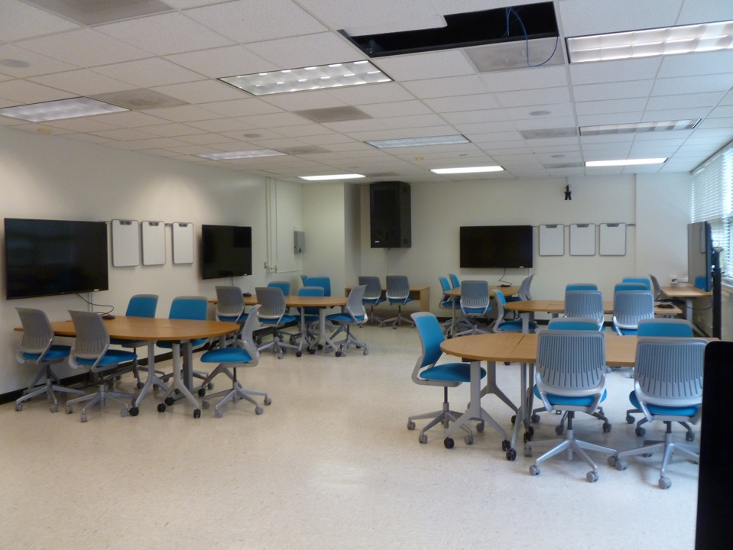

Slide 18
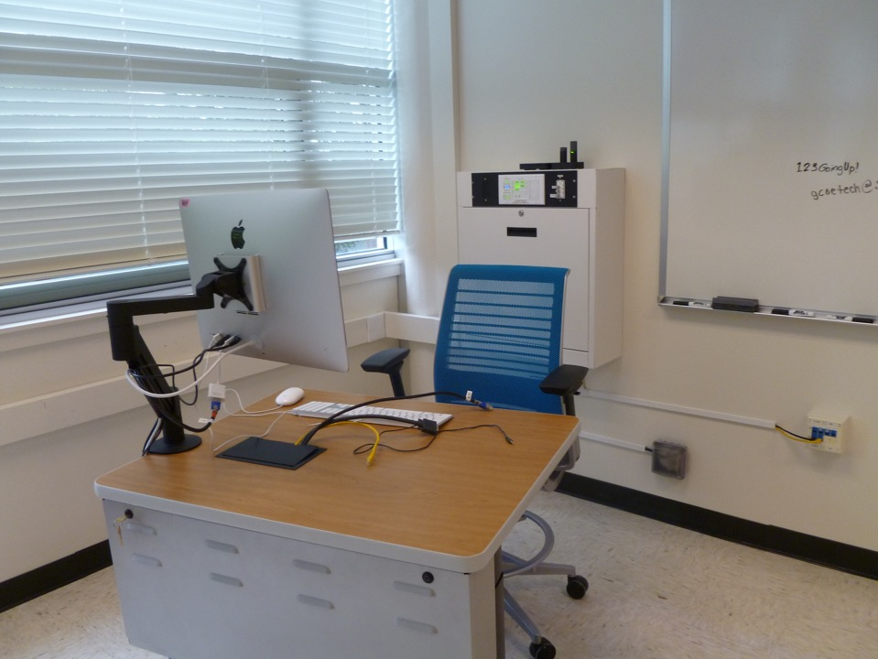

Slide 19

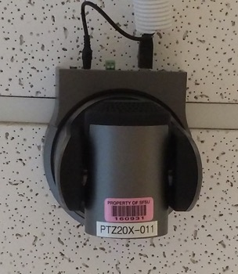
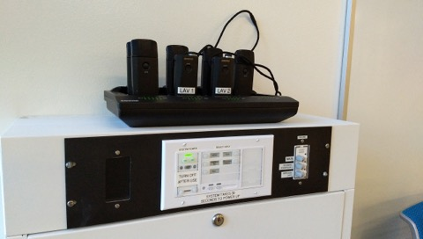
https://www.owllabs.com/meeting-owl
https://na.panasonic.com/us/panasonic-professional-ptz-cameras
https://www.shure.com/en-US/products/accessories/mxwncs8

Slide 20

What do students say?
Visit and listen to students’ perspectives: https://edtechbooks.org/hyflex/student_experience
Nate Kaufman: http://youtu.be/h60x7Miy9fk
Gustavo Campos: http://youtu.be/0zddgiLVt5Y
Jess Kaufmann: http://youtu.be/jVlzWRXBDyY
Joel Compton: http://youtu.be/6ExBNhNuTPc
Notes:
We also asked students, in many ways over the years, about their experience with HyFlex. Visit and listen to students’ perspectives: https://edtechbooks.org/hyflex/student_experience
Play two student videos: (full list provided here for use after the workshop)
What advantages do you see with HyFlex?
What challenges has a HyFlex course presented to you?
What scares you about changing the way you learn?
What excites you about changing the way you learn?
ITEC graduate students share a few insights:
Nate Kaufman: http://youtu.be/h60x7Miy9fk
Gustavo Campos: http://youtu.be/0zddgiLVt5Y
Jess Kaufmann: http://youtu.be/jVlzWRXBDyY
Joel Compton: http://youtu.be/6ExBNhNuTPc

Slide 21
Guidance from Students to Students (CSU Chico)
Claim a Study Space
Manage Distractions
Stay Motivated
Communicate with Your Instructors
Manage Your Time
Ask for Help
Video Tips from Peers
https://www.csuchico.edu/keep-learning/tips-remote-work/peer-videos.shtml

Slide 22

What do faculty say?
Visit https://edtechbooks.org/hyflex/teaching_hyflex to listen to several faculty share a few insights about their own HyFlex teaching experience.
Jeff Brain:
http://youtu.be/PTCS-kbczME
Patricia Donohue:
http://youtu.be/B5FTHXA1Vbk
Notes:
We also asked faculty about their experience using HyFlex. Visit https://edtechbooks.org/hyflex/teaching_hyflex to listen to several faculty share a few insights about their own HyFlex teaching experience.
Play one faculty video. (The other will be played during the second session.)
What advantages do you see with HyFlex?
What challenges will you and your students need to overcome?
What scares you about changing the way you teach?
What excites you about changing the way you teach?
Faculty using HyFlex course designs share a few insights:
Jeff Brain: http://youtu.be/PTCS-kbczME
Patricia Donohue: http://youtu.be/B5FTHXA1Vbk

Slide 23
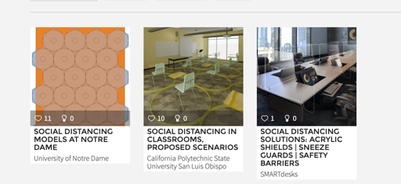
Fall 2020 Classrooms?
Flexspace.org
For classroom layout designs for physical distancing, see https://flexspace.org/2020/05/new-social-distancing-collection-of-learning-space-layouts-specs-and-planning-resources-in-flexspace/

Slide 24
What will teaching in-person be like?
Will interactive classroom activities be possible? Practical?
Students and Teachers in masks – speaking clarity? Hearing ability?
Students at least 6 feet from each other
No movement from assigned area
Teacher restricted to front of room
Sharing resources?
Can online synchronous methods support interactive learning in the classroom also? (students in class also in the synchronous environment)

Slide 25
Interactive Ideas for Hybrid and in-class
Active Learning in Hybrid and Physically Distanced Classrooms, blog post by Derek Bruff
https://cft.vanderbilt.edu/2020/06/active-learning-in-hybrid-and-socially-distanced-classrooms/
Class-wide Discussion
Live Polling
Backchannel
Collaborative Notetaking
Groupwork?
Written Work
Hybrid Pair Work
Jigsaw
Fishbowl
Physical Movement?

Slide 26

Needs and Opportunities
Notes:
Photo credit: Lake Louise, British Columbia, CA Dr. Brian Beatty

Slide 27
Institutions Value
Enroll more students (increase access)
Graduate more students… and faster (increase efficiency)
Support working (busy) students (schedule control)
Support busy faculty (travel-related schedule control)
Reduce demand on facilities (do more with same/less space)
Reduce impact on environment (reduce commuting)
Leverage the power of hybrid environments (more learning opportunity)
Develop online teaching and learning expertise with built-in “comfort” of face to face environment as a backup
Allow students freedom to choose how they participate (partial support for student-directed learning)
Build institutional online capacity step-by-step (teaching and learning)
Facilitate faculty development
Create new, customized models of instruction using emerging communications technologies to support teaching and learning
Notes:
What are some of the pressing needs we see in higher education in our current environment?
These are some of the common needs many programs or institutions express. Think about which are part of your experience.
The items highlighted may be especially relevant for administrators.

Slide 28
Students Value (benefits)
Choose when to attend class in-person, and when to attend online
Use additional learning resources available from all modes for review at any time (richer learning environment)
Learn how to learn online without full commitment to only online
Well-designed options available when in-class attendance isn’t possible or convenient (improved access to learning)
Notes:
What are some of the pressing needs we see in higher education in our current environment?
These are some of the common needs many programs or institutions express. Think about which are part of your experience.
The items highlighted may be especially relevant for administrators.

Slide 29
Faculty Value
No path for “absent” students – no excused absences. If students can’t attend in-person, they are expected to attend as an online student.
Opportunity for deeper learning with more learning resources available
Engagement with students between regular class sessions (when managed well)
Support lower enrolled classes with additional access to students (up to section capacity)
Built in backup when in-class instruction is not possible (professional travel, campus closure, etc.)
Notes:
What are some of the pressing needs we see in higher education in our current environment?
These are some of the common needs many programs or institutions express. Think about which are part of your experience.
The items highlighted may be especially relevant for administrators.

Slide 30
For AY 20-21 (CV-19 situation)
If both face to face (classroom) and online instruction are possible and desired:
Physical distancing: HyFlex approach can provide an instructional environment that reduces the number of students in a classroom and allows students to choose their mode – no one is forced into an environment they do not want.
  Caveat: If classroom seats are limited, a seat reservation system could be useful – modifying the flexibility aspect of HyFlex to fit the situation.
Instructional continuity: If a shift to fully online is mandated, course development is already complete.
Notes:
Planning for Fall 20 and beyond presents additional challenges; HyFlex can be part of the solution.

Slide 31
Your Specific Needs and Opportunities
What are they?
fewer students allowed in class?
prepare for possible reversion to fully online?
better serve students with varying needs for online access; improve online experience (go beyond “emergency remote teaching”)
Notes:
Add your own specific needs to this list.

Slide 32

Design and Implementation
Notes:
Expect discussion in these areas:
Designing for Access
Designing for Re-use
Designing for Equivalent Outcomes
Implementing Alternative Pathways to Learning
Photo credit: Murray River, British Columbia, CA Dr. Brian Beatty

Slide 33
Choose a Strategic Approach
Assumption: Starting with effective face to face
Choose which online modes you will support
  Asynchronous?
  Synchronous?
Design for the online mode, knowing the design will also support F2F
  I recommend designing for the asynchronous environment first, then using those materials (content, activities, assessment) to support students participating in other modes as well.
  For an alternative view, see the video explaining a “Zoomflex” design strategy which recommends designing for the synchronous environment first. (What assumptions does this imply?) https://www.youtube.com/watch?v=C7VScPdhMvY

Slide 34
Steps to HyFlex
Strategic Decision
Content
Assessment
Engagement
Implementation
Communication to Stakeholders
Evaluation
https://edtechbooks.org/hyflex/hyflex_design
Notes:
Very briefly, we could think of the HyFlex design process as five steps that build on each other.
Clarify Goals and Establish Objectives
Identify and Gather Content
Select or Design Specific Activities
Develop Clear Instructions
Build or Acquire Learning Supports (technology, documents, interactive tools, admin support)
For more, see https://edtechbooks.org/hyflex/hyflex_design

Slide 35
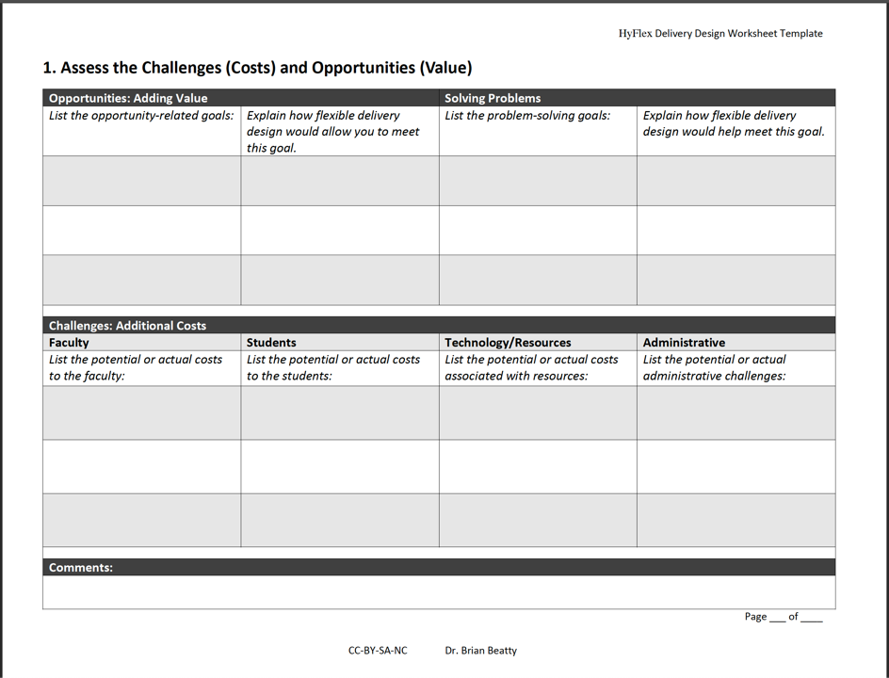

Slide 36

Getting Started with Design
Overall Course Goals
Student Learning Outcomes
Specific Learning Objectives
Notes:
We should start our design work at the highest, but most basic, level – the overall course goals. In any design situation, you need to keep the goal in mind – this is the “problem” that the design solution is created to solve.
The course goals will lead to student learning outcomes, and the student learning outcomes form the basis for the set of learning objectives (or instructional objectives) the students should be able to meet during the course.
Take the time to write these out now (early in the design process) or review the ones you’ve been using for years, so you are sure that your design is on target.
[Use handout page 2. Analyze/Modify Expected Student Learning Outcomes]
Photo credit: MS Office Clip Art Online

Slide 37
Design Alternatives
Outcome or Objective
In-class
Online (sync)
Online (async)
Notes:
Since the product-oriented outcomes (or objectives) typically remain the same, we can use those as anchors to ensure both participation modes lead to equivalent learning.
We’ll start with the learning outcome or objective, and then vary the learning process that students will use to achieve the objective (or outcome) in any of the modes we offer.
This diagram shows one product-oriented learning outcome being accomplished through three alternative modes – classroom, online and synchronous, or online asynchronous. (Your approach might only have one of the online alternatives.)
As we look through several specific examples, use page 3 of the handout, “Plan Student Learning Activities” as a guide. Write out a few notes to yourself. In a few minutes, you’ll have a chance to share those ideas with your colleagues.
[See handout page 3. Plan Student Learning Activities ]

Slide 38
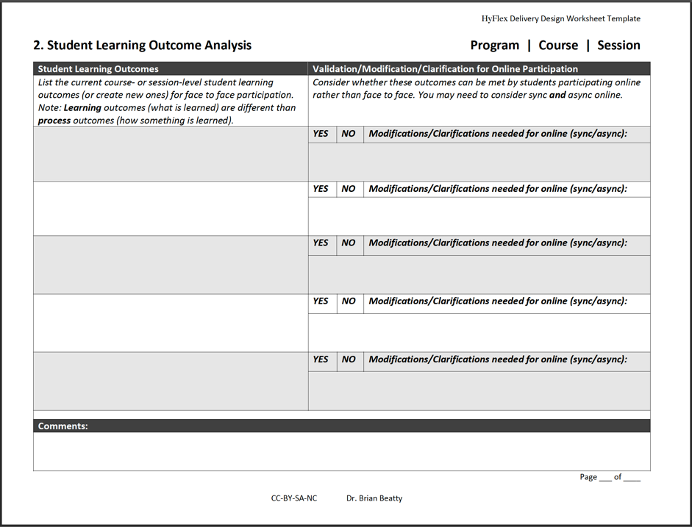

Slide 39
Continue [re-]designing
Content, Assessment, Engagement
In-class
Online (sync)
Online (async)

Slide 40
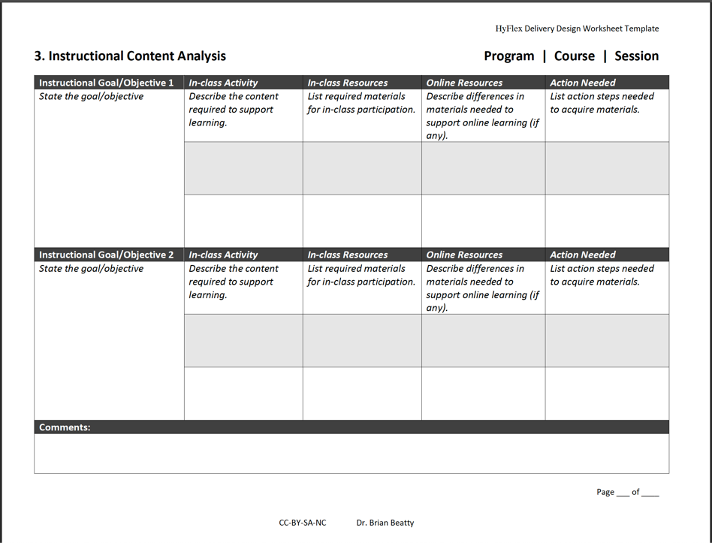

Slide 41
Example – Discussion Activity
Objective: After reading about varied approaches to writing instructional objectives, students will draft a set of IOs for their own instructional project. (Product)
Activity/Process
In-class: Students write out 1-2 objectives individually, then share in small groups, then discuss what they learned and ask questions in whole class discussion. (May have them post samples to forum in class)
Online (sync): Same task as in-class – using web conferencing tool; assign to breakout room for small group discussion
Online (async): Students listen to the recording of the class discussion about IOs, then draft a full set of IOs and post to forum, also commenting on the IOs posted by peers.
Notes:
This is an example of how a discussion activity could be designed to use different processes to help students achieve the same outcome no matter the participation mode each chooses.

Slide 42
Example – Peer Review
Objective: Students draft an assigned paper and engage in peer review – providing and receiving constructive criticism from peers. (Products)
Activity/Process
In-class: Students write a draft of an assigned paper and post to discussion forum. They bring copies of paper to class and review the drafts of 1-3 peers, then provide written comments and verbal debrief in small groups.
Online (sync): Students write a draft of an assigned paper and post to discussion forum. During class, they review the drafts of 1-3 peers (files also posted to the forum), then provide written comments and verbal debrief in small groups – using breakout rooms in web conference system or through other communication channel.
Online (async): Students write a draft of an assigned paper and post to discussion forum. During the week, they provide written comments to several peers and solicit review from peers.
Notes:
This is another, perhaps more complicated example of how a class activity could be designed to use different processes to help students achieve the same outcome no matter the participation mode each chooses. This one addresses the outcome of drafting a paper (product) and engaging in peer review (process) as a way of evaluating and improving the draft paper.
An additional, though unstated, outcome is the development of a professional network/learning community.

Slide 43
Examples – No Difference
Objective: Students record their introspective comments on their learning process, struggles with course content or process, or any other topic relevant to course completion.
  Activity: Refection/journal posts to an online forum; completed out of class
Objective: Students review assigned readings and other content documents before participating in class activities.
  Activity: Individual reading and reviewing resources; completed out of class
Objective: Students demonstrate understanding of basic terms and concepts associated with course content.
  Activity: Individual completes short online quiz weekly, one per major topic; completed out of class
Notes:
Here are several examples of outcomes (products) that can be achieved following the exact same process in all three delivery modes.
Essentially this requires all students to jump into the asynchronous online mode to complete the quiz activity. When all students have access to the technology and skill using the technology, this isn’t a problem. If some students do not have access or skill, then this common activity (process) might not be appropriate. In a case like that, the instructor might have a paper and pencil quiz form to have students complete at the beginning of class, and use the online quiz only for the online participants. There are obvious disadvantages with this approach, but it might be as good as the situation allows.
In general, with the near-ubiquitous access to networked technology we find these days, it is probably less problematic to require some forms of asynchronous activity of students in all modes than to require participation in some form of in-class (co-located presence in time and place) participation.

Slide 44
Notes:
This is a sample of a weekly (or topical) session from a HyFlex course.
Once again, let me remind you that this course was built up over time… please don’t be overwhelmed with the range and depth of resources provided for students. (Some faculty say – “I don’t have the time to do this for my class.”)

Slide 45
Notes:
This is a sample agenda from a HyFlex course.
Look at the list of activities for each type of student. They are very similar.
The activities can be very similar, perhaps even identical, as long as students in both modes can complete them successfully and achieve the learning outcomes.

Slide 46
Student Engagement/Interaction
How do students interact with content? (Is this engaging for them?)
How do students interact with each other to support learning? (Is this engaging for them?)
How do students interact with the instructor? (Is this engaging for them?)
STUDENT
LEARNING
CONTENT
INSTRUCTOR

Slide 47
Who is Present?
Social presence: communication, relationship
Cognitive presence: construct and confirm understanding
Instructor/teaching presence: instructional design, facilitation, direct instruction
Community of Inquiry: build a solid foundation of social presence and teaching presence to stimulate cognitive presence in a course.
Social Presence
Learning Experience
Cognitive
Presence
Teaching
Presence

Slide 48

Connections among Students
Weekly reflection posts – online, open, forum
Encourage participation mode “churn”
Form small group discussions with in-class and online sync students
Use online forums to “capture” the report-outs from in-class discussion activities
Require peer feedback on draft assignments
Subscribe all students to all discussion forums; encourage participation of all students
Notes:
One thing I have found very important is to design ways to establish and maintain connections among students in all modes. When students are spread across two or even three modes of participation, it is very possible that some may feel disconnected from the class, the other students, and the instructor. And the research shows that feelings of disconnections are associated with lower persistence and may lead to lower overall performance.
Here are six ways I’ve designed connecting opportunities into a HyFlex course. You might find these useful, and you can surely design other ways that work in your situation. As with most of the course features I use and I am showing you, there are many ways to achieve important learning outcomes.
Weekly reflection posts – online, open, forum
Encourage participation mode “churn”
Form small group discussions with in-class and online sync students
Use online forums to “capture” the report-outs from in-class discussion activities
Require peer feedback on draft assignments
Subscribe all students to all discussion forums; encourage participation of all students

Slide 49
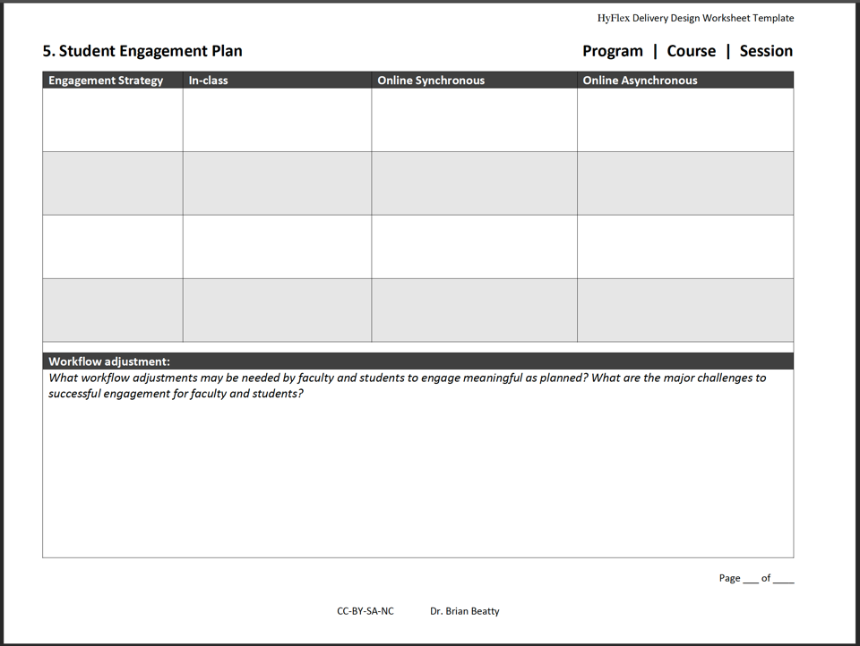

Slide 50
Assessing Learning
Be consistent! Students in all modes should have essentially the same testing environments, and this usually means all are taking online quizzes, tests and exams.
Is proctoring needed for quizzes, tests, and high-stakes exams? If yes, how will it be implemented?
  Students required to come to campus for tests
    Still may require some accommodations
      Local test centers?
      Online exam without proctoring?
Consider a shift to low-stakes (non-proctored) quizzes tests and exams supplemented (or replaced) by authentic assessments: performances that provide evidence for learning and understanding.

Slide 51
Assessing Learning Online
Ideas:
Vademecum for the Remote Assessment of Students
https://www.itqb.unl.pt/education/online-learning/vademecum-for-the-remote-assessment-of-students-2.pdf

Slide 52
What about Cheating?
Lessons Learned from Cheating
Podcast
Provided by Inside Higher Ed, this podcast and associated resources highlight James Lang and his work on addressing the cheating reality in higher education. https://teachinginhighered.com/podcast/lessons-learned-cheating/
Series of three Chronicle of Higher Ed articles written by James Lang
Cheating Lessons Part 1: Focuses on how the learning environments we create might play a role in inducing students to cheat
Cheating Lesson Part 2: Focuses on the value of more frequent, lower stakes assessments of learning
Cheating Lessons Part 3: Focuses on how these kinds of assessments not only reduce cheating but also increase learning
Book
If you want more - read the book! Cheating Lessons: Learning from Academic Dishonesty https://www.amazon.com/Cheating-Lessons-Learning-Academic-Dishonesty/dp/0674724631

Slide 53
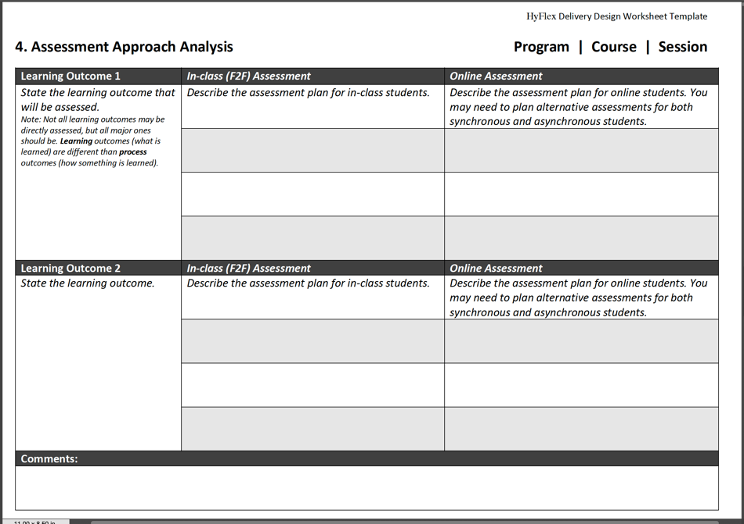

Slide 54

Faculty Development
Notes:
Photo credit: Sky over Antioch, CA June 2020 Dr. Brian Beatty

Slide 55
Where are faculty starting?
Assumed: Classroom teaching effective (experienced)
  Is this a good assumption?
  Do you need to verify?
  How can you support improvement where necessary?
Experience teaching fully online
  Synchronous and/or asynchronous?
  How effective have students learned?
  Where are the gaps in skills, abilities and resources?
Experience teaching hybrid
  What forms? Flipped? Co-modal?
  Basic understanding of HyFlex principles?

Slide 56
Where do faculty want to go?
Transitioning excellent face to face teaching to an online environment?
Combining existing high quality face to face and online classes?
Trying out HyFlex in a few class sessions?
Full HyFlex development and deployment?

Slide 57
What type of support fits?
Webinar-style “What is HyFlex?
  Goal: Understand the fundamental goals, design aspects and value proposition of HyFlex instruction
  Process: 60 minutes with Q&A (if live)
    Viewing an existing recording may suffice
  Walkaway: Might HyFlex be a good fit for my teaching situation?
  Limitation: High scale but low customization to specifics
One-one instructional design consultation
  Conditions: Faculty already have experience with classroom and online teaching, online course materials are largely in place
  Timeframe: One to several weeks to start, follow-up over first term
  Limitation: High cost (time, staffing) but high customization

Slide 58
Multi-day Workshop
  Goal: Begin developing a high quality HyFlex course based on an existing high quality face to face course
  Process:
    Five sessions, at least one day (24 hrs) in-between for application and discussion
    Synchronous (online or in-person) session start (60-90 min)
    Rich learning resources online in institution’s LMS
    Asynchronous activity with interactive discussion
  Walkaway: High level, comprehensive HyFlex design plan for a single course – ready to develop further, often with peer and/or ID support
  Limitation: Scales to about 20-30, moderate expense, time from faculty to learn, apply, and discuss

Slide 59
Workshop Sessions
  Getting Started with HyFlex: Goals and Learning Outcomes
    Confirm decision to try HyFlex, Learning Outcomes analysis
  Designing your HyFlex Solution: Content and Assessment
    Instructional Content Analysis, Assessment Approach Analysis
  Engaging Students within and across Participation Modes
    Student Engagement Plan
  Implementing HyFlex in Your Context
    Implementation Plan
  Explaining your HyFlex Course to Stakeholders, Planning for Evaluating the Return on Expectations (ROE)
    HyFlex Design Explanation(s), Potential ROE plan
Supporting resources: Hybrid Flexible Course Design ebook, online “effective practices” guidance, design worksheets templates and design samples, peer discussion!

Slide 60

Impact Research
Notes:
Photo credit: Murray River, British Columbia, CA Dr. Brian Beatty

Slide 61

Evaluating Impact
Student Perspective
  Participation Patterns
  Learning Outcomes
Faculty Perspective
  Concerns and Hopes
  Early Adoption
https://edtechbooks.org/hyflex/impact
Notes:
We can also look at this from a higher level and evaluate the larger impact of implementing a HyFlex approach.
We’ll look at this from two primary perspectives – students and faculty.
These perspectives are sometimes very similar, and often very different, as you’ll see in the following slides.
For brief summaries of 13 studies, and citations for many more, see https://edtechbooks.org/hyflex/impact
Photo credit: MS Office Clip Art online

Slide 62
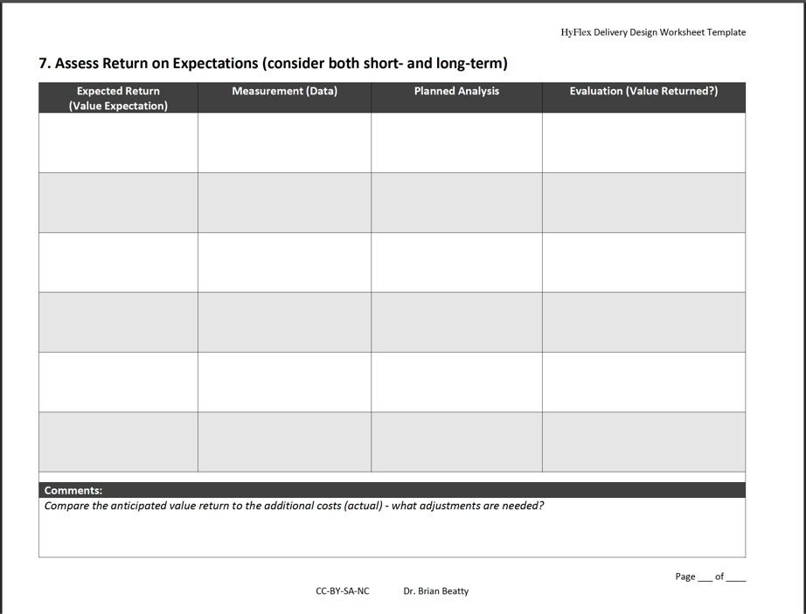

Slide 63
Student Participation Patterns
Do students take advantage of the flexibility?
Notes:
A critical question we had to ask, was this one. Do students take advantage of the flexibility? If they didn’t, were we wasting our efforts?

Slide 64
Overall Average Participation by Mode
Notes:
2 minutes
In the graduate seminar, this is the summative participation data I’ve collected.
60% of students, on average, are in class each week.
30% of students are participating online (either synchronously or asynchronously).
The rest (10%) are not participating during that week, or at least are leaving no evidence of participation during that week. These students may be accessing course information and reading through discussions without posting their own thoughts and comments – lurking – but they don’t receive credit for participating if they are silent online.
In a seminar class of 15-20 students, I see about 10-12 students in class, another 2-4 are often online with us when a live web conference is available, and the rest (3-6 typically) are participating asynchronously.

Slide 65
Overall Participation with Flex
Notes:
These two charts show the overall participation rates over a 3-4 year period in one course, with one instructor.
The “double” course refers to a class which combined two official sections, one listed in the catalog as online and the other listed as traditional (classroom-based). The faculty received credit for teaching two sections, and the students in both sections were invited to either attend the weekly classroom session or participate online.
The amount of “flex” in the top chart indicates what percentage of students voluntarily changed their participation mode from week to week. The overall average is about 10%, but has been growing in recent years.

Slide 66
Participation in Large Lecture Section
5-10%
5-10%
* 80-90%
Notes:
When we use HyFlex in large lecture classes, we often see a very different participation pattern emerging.
Approximately 80-90% of students are choosing to participate asynchronously online, 5-10% listen and watch to the live stream, and the rest show up for class in person. This pattern physically allows us to schedule a 1200 person lecture course in a room seating only 150 students.
And we see by the server logs that, on average, students are viewing the archived lessons repeatedly prior to major assignments and exams.

Slide 67
Student Performance
Does overall student performance correlate with participation mode?
Notes:
Another important question we asked was this one. Does the participation mode correlate to overall student performance (course grade)? We certainly sis not want to offer an alternative participation strategy that would lead to lower student success.

Slide 68
Correlation Coefficients Matrix
Sample size | 56 | Critical value (2%) | 2.39741
 |  | F2F | A | OL | FLX | PTS | PROJ | GRD
F2F | Pearson's r | 1.
 | p-value
A | Pearson's r | -0.18547 | 1.
 | p-value | 0.17114
OL | Pearson's r | -0.91564 | -0.16019 | 1.
 | p-value | 0.E+0 | 0.23827
FLX | Pearson's r | 0.05609 | 0.00889 | -0.02255 | 1.
 | p-value | 0.68137 | 0.94813 | 0.86897
PTS | Pearson's r | 0.06263 | -0.2819 | 0.05198 | 0.00455 | 1.
 | p-value | 0.64657 | 0.03531 | 0.70362 | 0.97346
PROJ | Pearson's r | 0.12977 | 0.09769 | -0.18159 | -0.03406 | 0.52961 | 1.
 | p-value | 0.34047 | 0.47384 | 0.18043 | 0.80322 | 0.00003
GRD | Pearson's r | 0.2081 | -0.4497 | -0.05255 | 0.1342 | 0.73581 | 0.54696 | 1.
 | p-value | 0.1238 | 0.00051 | 0.70053 | 0.3241 | 0. | 0.00001
Notes:
This data is from the students in my graduate seminar, taken over a recent two year period.
Bottom line on this simple analysis is that there is no statistical correlation between participation mode and overall grade (points, final project, or letter grade). The only statistically significant correlation is a negative one between the number of Absences and the course grade, and that is due to the connection between number of absences and the participation grade (10%). You might also notice that there is no statistically significant correlation between number of absences and the final project grade (30%) – which may mean that these students are able to reach course outcomes even when their participation is irregular.
For me, the overall lack of correlation is good news. Allowing these students to “HyFlex” isn’t hurting their overall performance.

Slide 69
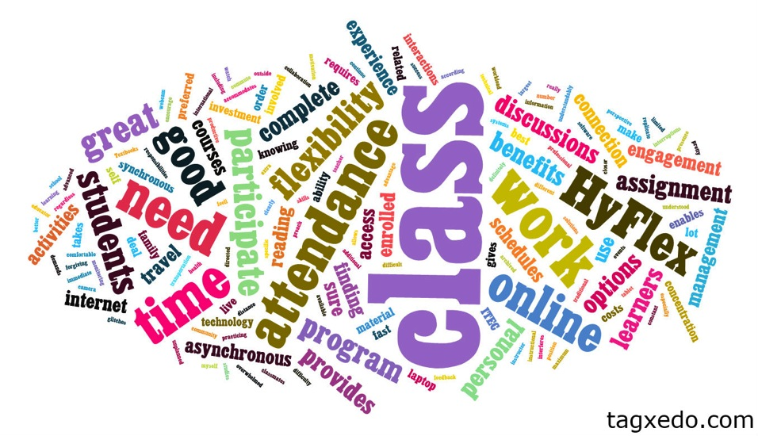
What do Students Talk About?
Notes:
When I ask students about their HyFlex experience, here is a typical word cloud that might result.
Which words dominate the discussion?

Slide 70
HyFlex Tips from Students
If you’d like to listen to students describing their experience, or read tips for student success offered by students themselves, see:
https://edtechbooks.org/hyflex/student_experience

Slide 71
Faculty Survey: Online teaching (hybrid/hyflex)
Perception that interactivity and learning are reduced
“What I do in class is worth doing, but not worth watching passively”
“I find it highly valuable to interact with students in real time and in the same space.”
“interactive lecture is a different experience than a ‘captured’ one“
“large part of the value of classroom teaching resides in the spontaneity of the interaction.”
“I fear that students would over-rely on these and not attend class to contribute to the learning”
“Encourages, justifies and condones student absenteeism from class attendance”
“on line or even hybrid courses are extremely inadequate in providing the kind of critically engaged environment to facilitate learning”
Notes:
There is both truth and myth in these statements. (continues on to the next two slides also)
Which aspects are real? True? Myth?
Whose interests dominate in these statements?
ECAR data: 20% of students report that they ‘skip class’ when lectures are available online

Slide 72
Faculty Survey: Online teaching (hybrid/hyflex)
Perception that online teaching puts intellectual property and jobs at risk
“strong supporter of contractually explicit provisions protecting faculty intellectual property”
“Who controls the copyright? would captured lectures be used to replace live lectures?”
“Capturing will make professors obsolete; course content is my intellectual property, not SFSU's”
“possibility of unauthorized reproduction/circulation”
“the fact that they are tied up in a proprietary format and stored by AT makes professors feel that they do not have control of their own material”
Notes:
(continuing)

Slide 73
Faculty Survey: Online teaching (hybrid/hyflex)
Perception that teaching using online technology adds to workload. Faculty don’t see an advantage to them.
“I'm not interested in using software to allow students to avoid coming to class or to help me enroll even more students”
“Adding more to what we do--in this case, adding more technology to our courses--feels like a burden”
“worried that it will take extra time without benefit”
“for HyFlex - what is the advantage of taking more students? If it would result in course release, or in some other easing of the job then I can see an incentive, otherwise, why would anyone want more than a class-full?”
Notes:
(continuing)

Slide 74

Research Summaries (2007-2019)
Chapter 2.5
Beatty, B. J. (2019). Evaluating the Impact of Hybrid-Flexible Courses and Programs: Highlights from Selected Studies. In B. J. Beatty (Ed.), Hybrid-Flexible Course Design. EdTech Books. Retrieved from https://edtechbooks.org/hyflex/impact

Slide 75
Research Summaries
Beatty, B. (2007, October). Hybrid Classes with Flexible Participation Options – If you build it, how will they come? Proceedings of the Association for Educational Communication and Technology International Conference, Anaheim, CA.
Taylor, J. A., and Newton, D. (2012). Beyond Blended Learning: A case study of institutional change at an Australian university. Internet and Higher Education 18(2013) pp. 54-60.
Miller, J., Risser, M. & Griffiths, R. (2013). Student Choice, Instructor Flexibility: Moving Beyond the Blended Instructional Model. Issues and Trends in Educational Technology, 1(1), 8-24. University of Arizona Libraries.
Lakhal, S., Khechine, H. & Pascot, D. (2014). Academic Students’ Satisfaction and Learning Outcomes in a HyFlex Course: Do Delivery Modes Matter?. In T. Bastiaens (Ed.), Proceedings of World Conference on E-Learning (pp. 1075-1083). New Orleans, LA, USA: Association for the Advancement of Computing in Education (AACE).
He, W., Gajski, D., Farkas, G., & Warschauer, M. (2015). Implementing flexible hybrid instruction in an electrical engineering course: The best of three worlds? Computers & Education,81, 59-68.

Slide 76
Research Summaries (cont.)
Meyer zu Hörste, H., and Vanderbeke, J. (2018). Multimedia Students: Engaging across platforms. An Investigation of Student Engagement in the Media and Communication Master Programme at Malmö University. Master’s thesis at Malmö universitet/Kultur och samhälle (2018)
Lightner, C. A. & Lightner-Laws, C. A. (2016). A blended model: simultaneously teaching a quantitative course traditionally, online, and remotely. Interactive Learning Environments, 24:1, 224-238
Lafortune, A. M. (2018). Differences in Students’ Perceptions of the Community of Inquiry in a Blended Synchronous Delivery Mode. Université de Sherbrooke Dissertation.
Love, S. (2015). A Quantitative Inquiry into First Generation Students' Readiness for Distance Education. n.p.: ProQuest Dissertations Publishing.
Binnewies, S., Wang, Z. (2019) Challenges of Student Equity and Engagement in a HyFlex Course. In C. Allan, C. Campbell, and J. Crough (Eds.) Blended Learning Designs in STEM Higher Education: Putting Learning First (pp. 209-230). Singapore: Springer Nature

Slide 77
Research Summaries (cont.)
Gobeil-Proulx, J. (2019). La perspective étudiante sur la formation comodale, ou hybride flexible. [What do university students think about hybrid-flexible, or HyFlex courses?] Revue internationale des technologies en pédagogie universitaire, 16(1), pp. 56-67. Available online: https://doi.org/10.18162/ritpu-2019-v16n1-04
Lakhal, S., Bateman, D. & Bédard, J. (2017). Blended Synchronous Delivery Mode in Graduate Programs: A Literature Review and Its Implementation in the Master Teacher Program.
Collected Essays on Learning and Teaching 10, pp. 47-60.
Detienne, L., Raes, A. & Depaepe, F. (2018). Benefits, Challenges and Design Guidelines for Synchronous Hybrid Learning: A Systematic Literature Review. In T. Bastiaens, et.al (Eds.), Proceedings of EdMedia: World Conference on Educational Media and Technology (pp. 2004-2009). Amsterdam, Netherlands: Association for the Advancement of Computing in Education (AACE). Retrieved June 20, 2019 from https://www.learntechlib.org/primary/p/184440/.
See https://edtechbooks.org/hyflex/impact for more discussion.

Slide 78

Program Implementation
Notes:
Program Implementation: Earlier we talked about the details of HyFlex implementation at a course or activity level, and that’s important for the designers and faculty as they get started with specifics. But that’s not the only level of implementation that matters.
We should talk for a few minutes about the change process, since adopting a HyFlex approach requires change at multiple levels – the instructor, the students, and the administration – perhaps even an entire organization (program, department, institution)
Fundamentally, it is critical that you understand your system: Know the components of your system and how they interact, especially to support or resist change.
As you consider or plan for a HyFlex approach, you’ll need to appreciate the innovative nature of this approach (in most cases) – and social innovations diffuse along predicable vectors and patterns – HyFlex is no different.
Photo credit: iStockphoto 11038062 – permission to use purchased by Dr. Brian Beatty LLC

Slide 79
Planning for Resilience
Acknowledge the need for “dynamic stability” – be prepared to adapt, flex, change as needed to meet the current situation while keeping the institution “on course” for the long term.
Major administrative decisions include:
deciding to launch HyFlex for an institution,
enabling student schedule flexibility,
managing workload agreements, and
aligning support for students and faculty
For much more, visit https://edtechbooks.org/hyflex/admin_factors (administrative supports) and https://edtechbooks.org/hyflex/adoption (supporting adoption processes)

Slide 80
Deciding to “HyFlex”
Conduct a feasibility analysis (informal or formal; depending on scope)
  Establish or validate the need to use both types of delivery – online and classroom – in the same class sections.
  Cost/benefit analysis
Define your HyFlex parameters (which modes? how much flexibility?)

Slide 81
Student Schedule Flexibility
Communicate the HyFlex approach (opportunity) to students before the enrollment/registration process
Registering for Classes (4 common approaches)
Treat all classes the same (as if all were classroom-based only). Communicate options after enrollment.
Split single class enrollment into two smaller sections – one online and one in classroom; allow students to participate in either one week by week.
For multi-section courses, list one section as classroom, one section as online.
Create new class section type in registration system.

Slide 82
Manage Faculty Workload
The major increase in faculty workload is usually developing the additional online course (materials, activities) to accompany the classroom course. There is often increased workload associated with facilitating engaged online participation throughout the course. Four common ways this is managed:
Additional stipend (pay) for faculty who design, develop and teach a HyFlex course.
Course release for faculty who design, develop and teach a HyFlex course.
Instructional design support to build, assigned teaching assistants (TAs) to help manage the workload of teaching both classroom and online versions of the course.
Doubling up teaching assignments (prepare one, teach two)

Slide 83
Align Student Support
Typical supports for fully online students
  Administrative processes and forms
  Technical support resources (network, hardware, software)
  Online technical help (24/7?)
  Advising and tutoring services
Additional decision-making support for students
  “Should I participate online or in the classroom?”
Consider restricting flexibility as needed
  International students
  Students not experiencing online learning success
  Classroom seat availability

Slide 84
Align Faculty Support
Learning how to teach effectively online (assumption: Faculty know how to teach effectively in the classroom)
Instructional design assistance to design an effective and interactive HyFlex course
  Requires instructional design expertise and staffing
In-class supports depends on technology complexity, faculty technical ability, and scale of class
Re-ordering daily and weekly workflow to include engagements with online students: changes are required!

Slide 85
Common Faculty Perspectives
Pre-COVID-19
Most already using LMS (90%)
Some interested in lecture capture (up to 75%)
Today?
All using LMS (100%)
Most experienced synchronous online teaching (web conference)
Common concerns
Workload (how much to do)
Boundaries around time; workflow (when to do it)
Seeing students faces every week
Interaction in class activities
Security, privacy and plagiarism
Intellectual Property rights
Notes:
When I look at what is happening on the campus of SF State and speak to various faculty groups in different places, here are some very high-level summaries.

Slide 86
Technology Adoption Lifecycle (typical)
from “the Diffusion of Innovations” by Everett Rogers and “Crossing the Chasm”, by Geoffrey Moore
Where are your faculty, students, and administrators?
Pragmatists
Stick with the herd!
Conservatives
Hold on!
Visionaries
Get ahead of the herd!
Skeptics
Techies
No way!
Try it!
Innovators
Early
Early Majority
Late Majority
Laggards
Adopters
https://edtechbooks.org/hyflex/adoption
Notes:
The adoption of a HyFlex course design is likely to follow a typical adoption curve – encountering people at various stages of the adoption lifecycle. Your faculty, students, and administrators may be at very different places, too.
The appeal and message to groups at different stages should be different. And the appeal and messaging to the same person who is moving through the adoption process will also change. What attracts a person to an innovation in the beginning may not keep them interested as they try it out. I’ve found that the unintended benefits of using the HyFlex design are sometime as powerful as meeting the initial expressed need.
If you choose to advocate for HyFlex in your organization, be prepared to address these adoption groups as you encounter them with different messaging about value, risk/reward, etc.
ECAR data for students (self-reported percentages) – Adoption of new technology: First adopter-10, Early adopter-23, early majority-50, late majority-11, laggard-7
For a full explanation, see: Beatty, B. J. (2019). Expanding the Implementation of Hybrid-Flexible Courses and Programs: Encouraging the Adoption of HyFlex within the Institution. In B. J. Beatty, Hybrid-Flexible Course Design: Implementing student-directed hybrid classes. EdTech Books. Retrieved from https://edtechbooks.org/hyflex/adoption

Slide 87

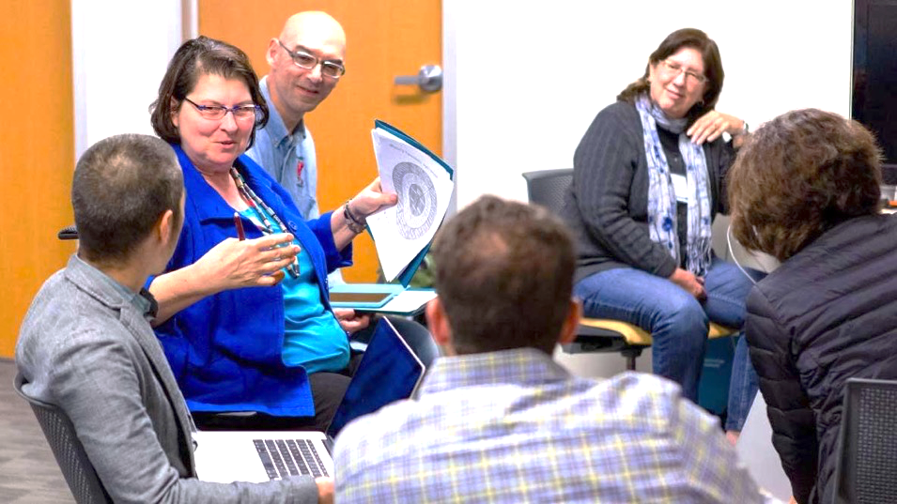
Designing HyFlex Courses
Perspectives from Eight Universities
Photogarph by Andrew Corpuz

Slide 88

Peirce College
Fitting Flexibility Across the Curriculum
Cathy Littlefield
Stephanie Donovan
Primary goal: increase enrollment and retention by increasing course access to students who needed flexible attendance options
Initial pilot 2014 with a few Business and Health courses, expansion soon after to all Health Programs and Graduate Studies courses; followed by more Business programs
https://www.peirce.edu
Private
Small
Urban
Non-traditional Students
Student-Directed Hybrid Design Guidance | Brian Beatty

Slide 89
Peirce College
https://www.peirce.edu
Strategic initiative supported by both faculty and senior leadership
Pilot governed by steering committee: dean, program chair(s), ID, student learning assessment
Program implementation team: Marketing & Communications, Instruction, Faculty & Student Support, and Assessment
Faculty focus groups engaged as part of program evaluation after two years; six areas of “opportunity” identified
Littlefield, C. M. & Donovan, S. (2019). Fitting Flexibility Across the Curriculum: Peirce College. In B. J. Beatty, Hybrid-Flexible Course Design: Implementing student-directed hybrid classes. EdTech Books. Retrieved from https://edtechbooks.org/hyflex/fitting_flexibility

Slide 90

Delgado Community College
https://dcc.edu
One Size Fits None
Jeanne C. Samuel
Amanda H. Rosenzweig
Mark McLean
René Cintrón
Initial HyFlex effort: 2014, as a form of personalized learning in Business courses
Goals: 1) serve more students in same space, 2) increase enrollment, 3) increase retention, 4) prepare for business continuity
Public
13,586 students
Urban
Non-traditional Students
largest and oldest community college in Louisiana
Louisiana Community and Technical College System

Slide 91
Delgado Community College
https://dcc.edu
System-level development support ($)
Ongoing faculty support:
HyFlex Faculty Professional Development Course
Course Planning Resources: design template, lesson plan template, media tools
HyFlex video explanation: https://youtu.be/Bu4aVBxf760
Starting with Business faculty, extending to History and English in 2019, exploring for use in Criminal Justice program
Samuel, J. C., Rosenzweig, A. H., McLean, M., & Cintrón, R. (2019). One Size Fits None: Delgado Community College and Louisiana Community & Technical College System. In B. J. Beatty, Hybrid-Flexible Course Design: Implementing student-directed hybrid classes. EdTech Books. Retrieved from https://edtechbooks.org/hyflex/one-size_fits_none

Slide 92

University of St. Thomas
https://www.stthomas.edu
New Technologies Deliver on the Promise of HyFlex
Glori Hinck
Lisa Burke
First HyFlex course: 2016-2017, more each term
Business faculty the first adopters
Goals:
increase student choice in attendance, and
2) recapture “lost” summer enrollments
Private
Small
Urban
Mix of traditional and non-traditional students

Slide 93
University of St. Thomas
https://www.stthomas.edu
St. Thomas eLearning and Research group (STELAR) supports efforts with instructional design and development services.
HyFlex PD integrated into online teaching PD programs
Course development grants funded by institution (Provost) to individual faculty; no overarching university strategic goals for HyFlex
Two Hybrid-Flexible course design definition: two (synchronous) mode (co-location) and three mode (HyFlex)
Hinck, G. & Burke, L. (2019). New Technologies Deliver on the Promise of HyFlex: University of St. Thomas. In B. J. Beatty, Hybrid-Flexible Course Design: Implementing student-directed hybrid classes. EdTech Books. Retrieved from https://edtechbooks.org/hyflex/hyflex-UST

Slide 94
University of Michigan
https://umich.edu
Using HyFlex in Statistics for Engineers and (Data) Scientists
Jackie Bryce Miller
Melinda E. Baham
Goal: increase student access (enrollment) and success (learning/grades) in required Statistics courses
HyFlex since 2011 (Jackie at OSU); 2014 at UMich
Courses: Introductory Statistics, Probability and Statistics
Public
Huge
Urban
Traditional Students

Slide 95
University of Michigan
https://umich.edu
Serving larger enrollments than class seating capacity; workload compromises
Supported by Instructional Support Services unit: lecture capture and live streaming
Synchronous backchannel connects live streaming students to the live class
Managing student access to recordings to encourage active engagement; ongoing design debate
Miller, J. B. & Baham, M. E. (2019). Using HyFlex in Statistics for Engineers and (Data) Scientists: University of Michigan. In B. J. Beatty, Hybrid-Flexible Course Design: Implementing student-directed hybrid classes. EdTech Books. Retrieved from https://edtechbooks.org/hyflex/umich

Slide 96

Cambrian College
HyFlex in Northern Ontario
Melanie Lefebvre
Initial pilot of Flex Learning: 2018
Multiple post-graduate certificate programs: Business and IT, Community Services, Health Sciences, Skills and Trades, Law and Justice
https://cambriancollege.ca/flex-learning/
Goal: Develop a teaching and learning framework to advance and sustain innovative approaches in flexible, customizable learning experiences.
https://cambriancollege.ca
Public
11,000 students
Three campuses in Ontario, Canada
Mix of traditional and non-traditional Students

Slide 97
Cambrian College
College strategic plan from 2015 called for the development of
“a teaching and learning framework to advance and sustain innovative approaches in flexible, customizable learning experiences.”
HyFlex was a natural outgrowth of this direction.
Faculty reports their personal journey starting a position where HyFlex was already being implemented and describes the process used by faculty to produce content for their online students, leveraging classroom instruction
Faculty Support Hub: https://teaching.cambriancollege.ca/plan/planning-your-hyflex-course/
https://cambriancollege.ca
Lefebvre, M. (2019). HyFlex in Northern Ontario: Cambrian College. In B. J. Beatty, Hybrid-Flexible Course Design: Implementing student-directed hybrid classes. EdTech Books. Retrieved from https://edtechbooks.org/hyflex/northernontario

Slide 98

Montana State University Billings
http://www.msubillings.edu
HyFlex at Montana State University Billings
Susan Balter-Reitz
Samuel Boerboom
Initial pilot of HyFlex: 2018
Multiple programs: business, sociology, communications
Goals: maintain classroom learning option as low-enrolled sections are cancelled, provide better access to classes for students who need both classroom and online options
Public
5,000 students
Large # of online programs and courses
Mix of traditional and non-traditional Students

Slide 99
Montana State University Billings
http://www.msubillings.edu
Faculty leaders (within two unions, among peers) were engaged from the beginning as the university explored HyFlex as a strategic option
Faculty, unions, and campus administration agreed on compensation before pilot development; for course development and for professional development (teaching online, teaching hybrid)
Pilot included three courses from three distinct disciplines (business, sociology, and communication) with very different students
Planning for scale in 2020; challenges include formal class schedule identification and managing “over-enthusiastic” faculty
Balter-Reitz, S. & Boerboom, S. (2019). HyFlex at Montana State University Billings: Montana State University Billings. In B. J. Beatty, Hybrid-Flexible Course Design: Implementing student-directed hybrid classes. EdTech Books. Retrieved from https://edtechbooks.org/hyflex/msub

Slide 100

San Francisco State University
https://sfsu.edu
A Faculty Transitional Journey from Single Mode to HyFlex Teaching
Zahira Merchant
Initial development of HyFlex in 2005/6; this faculty story begins in 2013
ITEC MA program, other courses in varied disciplines and levels
Goals: increase student enrollment, retention, and success in classes; new faculty survival!
Public
28,000 students
Mix of traditional and non-traditional students

Slide 101
San Francisco State University
https://sfsu.edu
New faculty experience additional challenges when HyFlex designs are expected by students and peers
Technology platforms that work and faculty skill in using the technology are crucial to success, especially for faculty who may already be experiencing stress in a new situation.
As long as both classroom and online participation options are provided, faculty may want to restrict some alternatives, such as asynchronous participation to influence student learning behavior.
LMS’s and related tools should explicitly support multiple modes “by design”
Merchant, Z. (2019). A Faculty Transitional Journey from Single Mode to HyFlex Teaching. In B. J. Beatty, Hybrid-Flexible Course Design: Implementing student-directed hybrid classes. EdTech Books. Retrieved from https://edtechbooks.org/hyflex/sfsu

Slide 102

KU Leuven
https://www.kuleuven.be/english/
HyFlex Learning within the Master of Teaching Program@KU Leuven
Annelies Raes, Marieke Pieters, & Piet Bonte
Master Teaching Program serves students across Flanders: 14 universities in 9 cities.
Initial deployment of HyFlex in Fall 2019 with a high-tech Hybrid Virtual Classroom development (see next slide)
Goals: support student access and participation mode flexibility, improve student and faculty engagement with remote students in live sessions
Public
50,000+ students
Mix of traditional and non-traditional students

Slide 103
KU Leuven
https://www.kuleuven.be/english/

Slide 104
KU Leuven
https://www.kuleuven.be/english/
Live polling, Q&A, and visual connections support faculty and student engagement without regard to location
Remote students are projected on the screens in the back of the classroom as they are the last row in the classroom. This makes them part of the classroom.
Teachers can naturally interact with on-site and remote students as both are clearly visible
Design Guidelines: 1) Prepare yourself and your session in advance, 2) Trust the room operator; focus on teaching, 3) Welcoming students, 4) Clear communication, 5) Cognitively activate students
Raes, A., Pieters, M., & Bonte, P. (2019). Hyflex Learning within the Master of Teaching Program@KU Leuven: KU LEUVEN, Belgium. In B. J. Beatty, Hybrid-Flexible Course Design: Implementing student-directed hybrid classes. EdTech Books. Retrieved from https://edtechbooks.org/hyflex/hyflex_MTP_KULeuven

Slide 105

San Diego Christian College
https://sdcc.edu
Increasing Flexibility, Satisfaction, and Efficiency Using the Hybrid Flexible Approach
David Rhoads, Vanguard University
Private
<1000 students
Mix of traditional and non-traditional students
Initial development of HyFlex in 2016/17
Non-traditional undergraduate degree programs
Goals:
combine existing online and classroom course sections
increase student enrollment to designed class capacity
reduce instructional costs

Slide 106
San Francisco State University
https://sdcc.edu
Compressed non-traditional program course schedule (five weeks); potential clash with traditional course schedule of 16 weeks
Initially no synchronous mode provided; after one year some faculty added synchronous attendance option.
All courses in the degree program were built by the instructional design support team, including faculty subject matter experts
Recommendation to design first for fully online, then plan to use online resources and activities to support face to face and online synchronous students as well. Interactive classroom time supplements out-of-class learning.
Rhoads, D. (2019). Increasing Flexibility, Satisfaction, and Efficiency Using the Hybrid Flexible Approach: Vanguard University. In B. J. Beatty (Ed.), Hybrid-Flexible Course Design. EdTech Books. Retrieved from https://edtechbooks.org/hyflex/increasing_flexibility

Slide 107
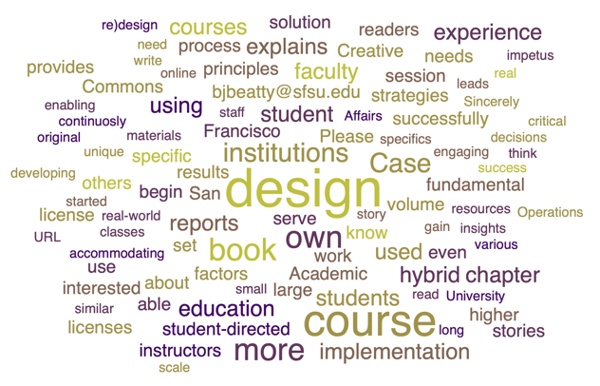
Add your story! (open Call for Case Reports)
Your name(s) Here. (2019-2020). Your story name here.
In B. J. Beatty, Hybrid-Flexible Course Design: Implementing student-directed hybrid classes.
EdTech Books. Retrieved from https://edtechbooks.org/hyflex/case1_university

Slide 108

Contact
Brian Beatty, PhD
Professor of Instructional
Technologies
San Francisco State University
(415) 338-6833
bjbeatty@sfsu.edu
https://edtechbooks.org/hyflex

