Slide 1
Practical Tips for Teaching Online
Dr. Khalifa Alshaya
khalifa.alshaya@und.edu
Dr. Kizito Mukuni
kizito.mukuni@und.edu
Teaching Transformation and Development Academy (TTaDA)

Slide 2
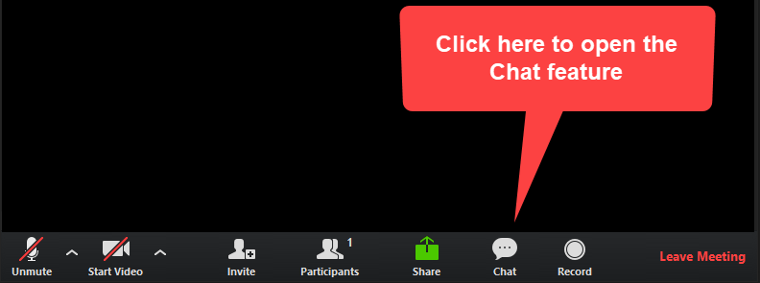
Before we start
Make sure to mute your mic
Turn off your video if you’re experiencing slow connection
Post your questions in the chat or unmute your mic to share them

Slide 3
What we will be covering
Best Practices for Online Course Design
Synchronous vs Asynchronous
TTaDA’s resources
Pedagogical consideration
Blackboard
Zoom
YuJa
Questions and open the floor for discussion

Slide 4

Best Practices for Online Course Design
Instructor Presence and Humanizing
Course Design
Universal Design

Slide 5
Instructor Presence and Humanizing
Instructor Role
Interactions in an Online Learning Community
Instructor Presence and Humanizing
Practical examples:
Creating a welcome video
Checking in with students
Get to know your students

Slide 6
Course Design
Backwards Course Design
Course Learning Objectives
Syllabus Components
Practical examples:
Writing effective learning objectives
Building and connecting assignments and assessments
Building course content

Slide 7
Universal Design
Understand Universal Design and Accessibility
Accessibility Guidelines
Practical examples:
Offering different assignment options
Having closed captioning

Slide 8
Synchronous
Synchronous learning is learning that happens in real time. This means the instructor, and students interact in a specific virtual place, through a specific online medium, at a specific time.

Slide 9
Asynchronous
take a more non-traditional approach. Students do not “attend” class at a set time, but rather, access pre-recorded lectures and digital curriculum materials and respond through email, discussion boards, social networking, and collaborative documents at a time of their own choosing.

Slide 10
Synchronous vs Asynchronous
Asynchronous | Synchronous
Flexibility | Live interactions
Delayed feedback | Immediate feedback
Recorded lectures | Live lectures
Self-paced | Group-paced
Same time | Different times
Fixed | Dynamic Learning
Notes:
What delivery format are you thinking for your course?
Asynchronous
Synchronous
Undecided

Slide 11

Engaging Students
Synchronous
Zoom Polling
Poll Everywhere
Kahoot!
Asynchronous
YuJa In-Video Quizzing
Discussion boards
Wiki, Blogs, Journals

Slide 12
TTaDA’s Resources
und.edu/academics/ttada
An overview & services offered
Upcoming workshops and previews recordings
Fall 2020 Course Planning - syllabus & matrix
Alternative Assessment Strategies
Proctoring
Interacting Online
Notes:
TTaDA’s Website ~20
How to find it: https://und.edu/academics/ttada/
An overview & services offered
Upcoming workshops and previews recordings
Fall 2020 Course Planning - syllabus & matrix
Alternative Assessment Strategies
Proctoring
Interacting Online

Slide 13

Blackboard
blackboard.und.edu
Creating announcements
Welcoming students
Reminders
Course communication
Resources
Chunking up content
Grade book
Notes:
Blackboard ~10
Logging in - firstname.lastname
Creating announcements
Chunking up content
Grade book

Slide 14
Recording Tips
Before you record:
Rehearse once
Minimize your hand movement
Use a dedicated microphone
Minimize background noise
Notes:
Login into YuJa
Recording a video
Linking a video

Slide 15
YuJa
UND.yuja.com
Login into YuJa
Recording a video
Deploying your video to blackboard

Slide 16
Pedagogical Considerations

Slide 17
Your Role

Slide 18
Prepare your content, materials and the technology Ensure that your speakers, microphone and camera are fully functional before the class

Slide 19
If you will use video, remember to turn on your camera so that students can see your face

Slide 20
Introduce yourself to your students at the beginning of the class (you could provide a fun fact about yourself)

Slide 21
Provide your contact information to the students e.g. email, office phone, Zoom Office Link, etc.

Slide 22
Provide opportunities for learner-leaner interactions such as group work or discussions You can use Zoom breakout room feature to create and monitor group work

Slide 23
Provide opportunities for learner participation. You can use tools such as Kahoot, Zoom polling, AnswerGarden,etc

Slide 24
Variate the strategies you use to engage your learners​

Slide 25
Best Practices

Slide 26
Consistency
Ensure that all the lessons are designed consistently

Slide 27
Chunking up content
Videos more than 20 minutes could be segmented to reduce cognitive overload
Consider using folders

Slide 28
Clear instructions
Present clear instructions in writing or through video or audio
All classroom activities and exams should have clear instructions and should also align with your lesson objectives and goals
Use repetition

Slide 29
Objectives
Your lesson level objectives should be measurable and clear and should tell students what they will be able to do at the end of the lesson
They should align with your activities and assessments

Slide 30


Slide 31
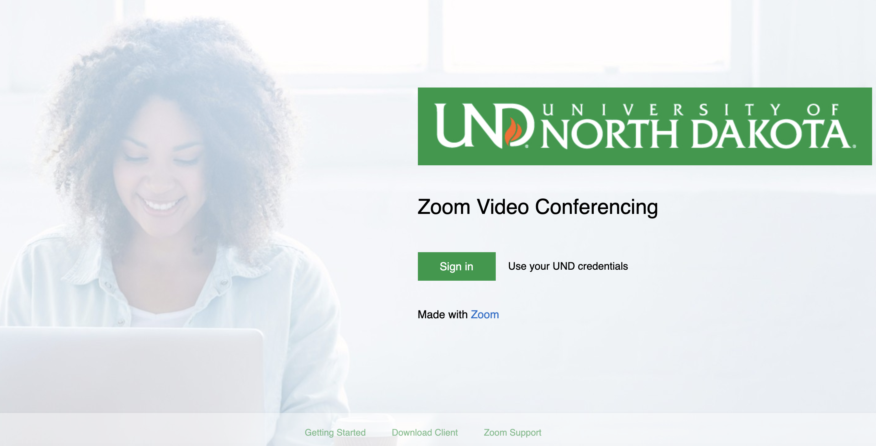
https://und.zoom.us

Slide 32
To open Zoom client, click on the Zoom Icon

Slide 33
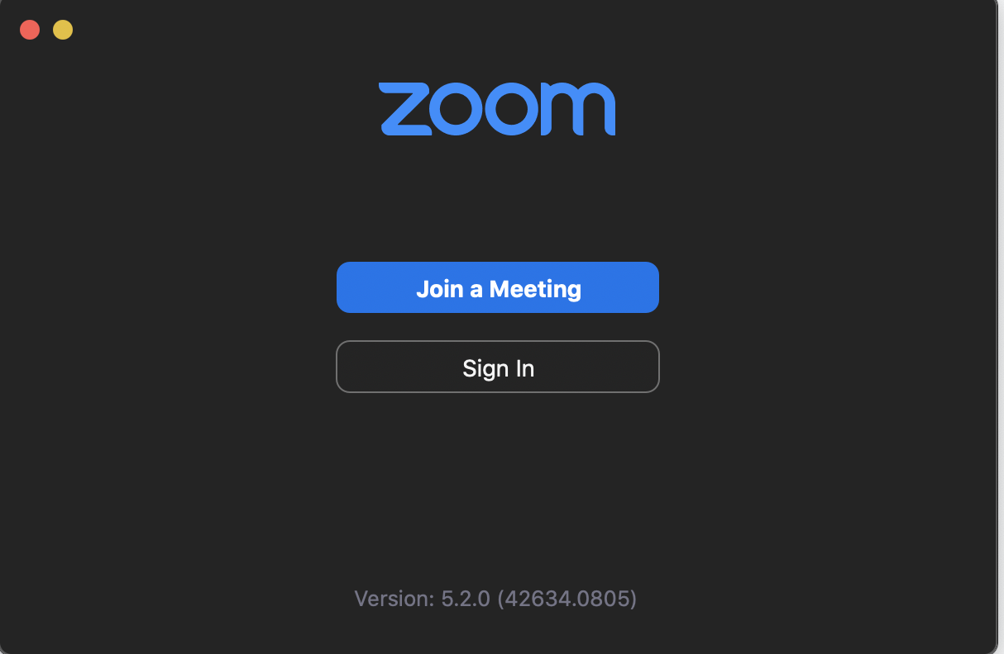
Select ‘Sign In’

Slide 34
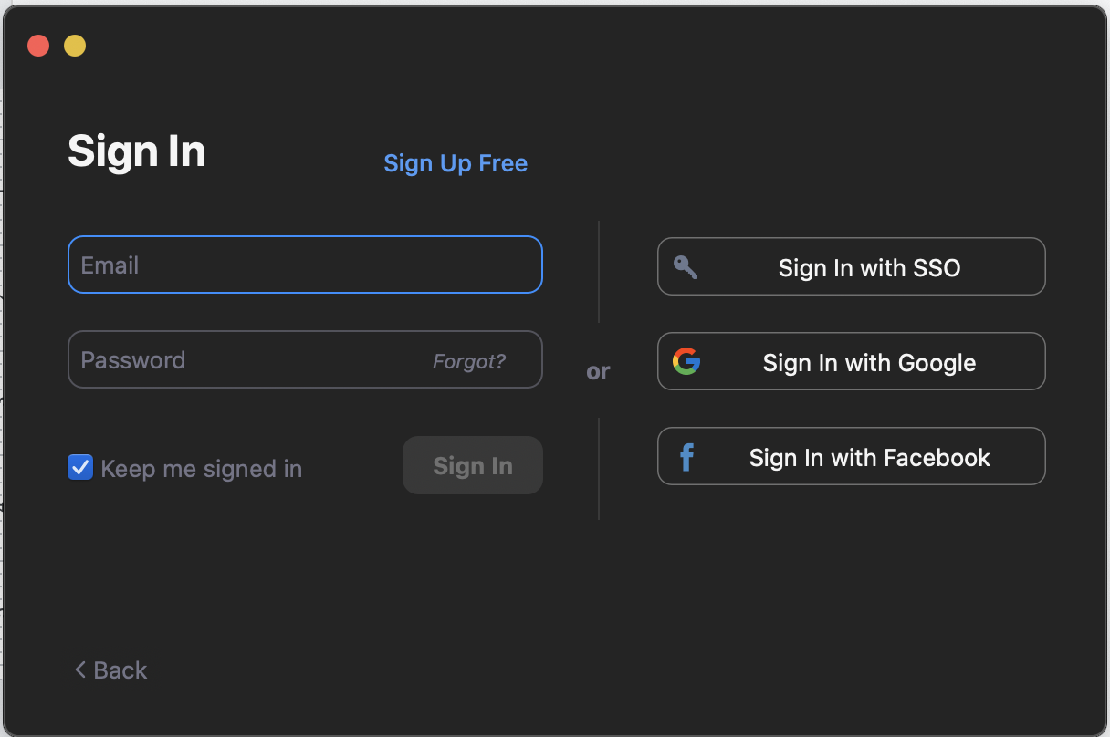
Select ‘Sign In with SSO’ (Single Sign On)

Slide 35
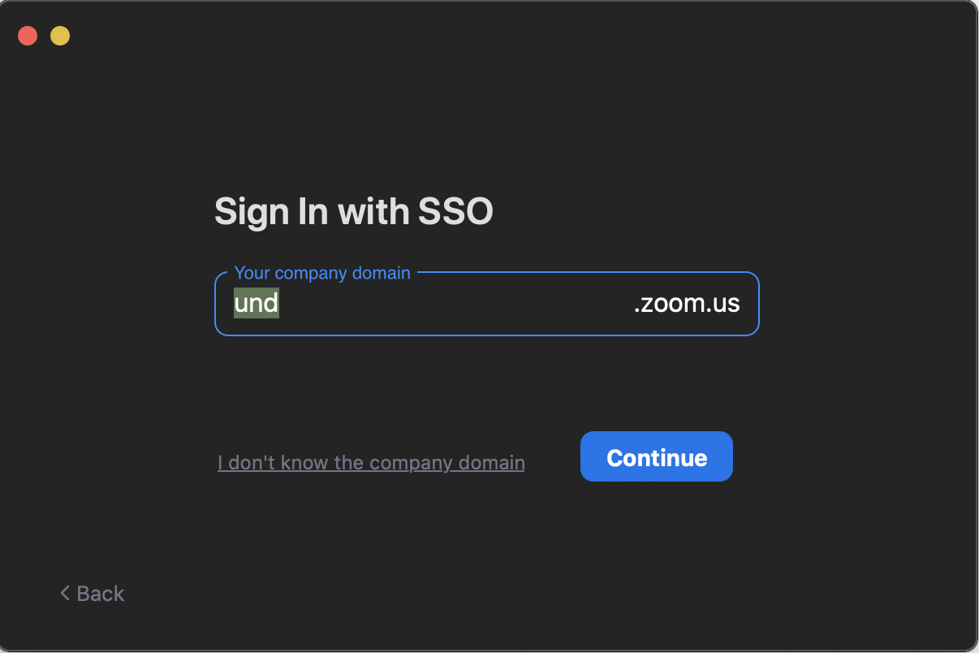
1
2
(1) Use ‘und’ for company domain
(2) Select ‘Continue’

Slide 36

1
2
(1) Log in using your und credentials
(2) Select ‘Sign in’

Slide 37
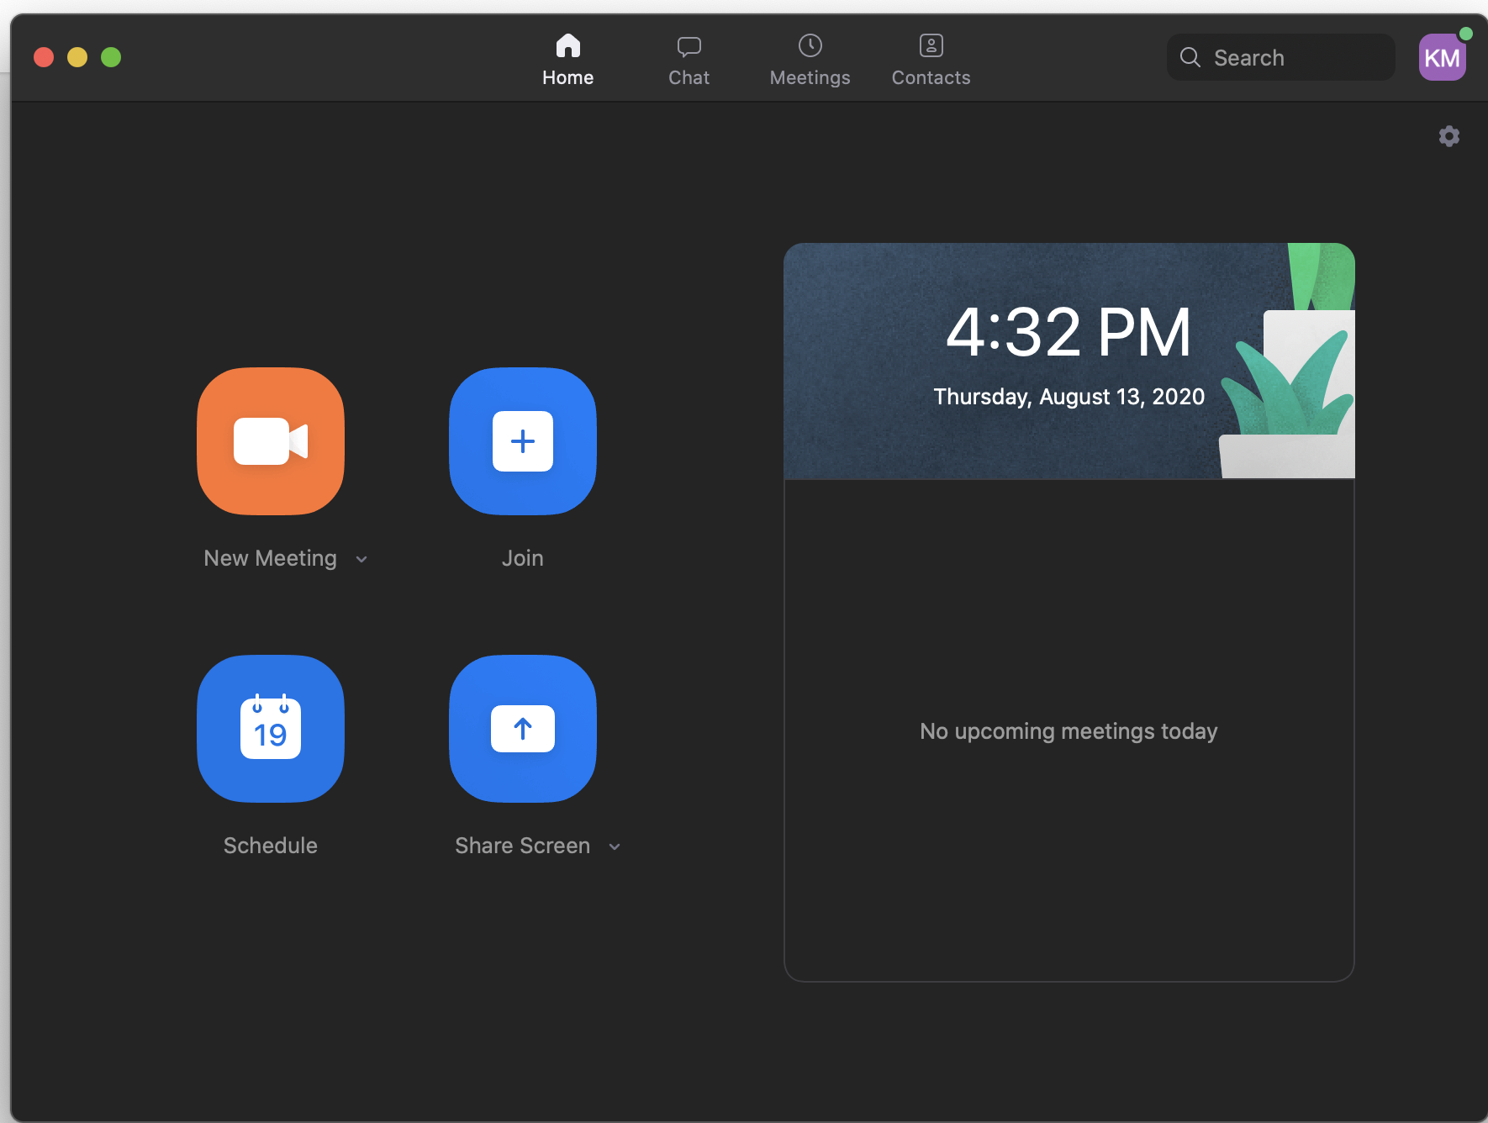
You will then be signed in to your Zoom client

Slide 38
Scheduling a Meeting

Slide 39
Click on ‘Schedule’

Slide 40
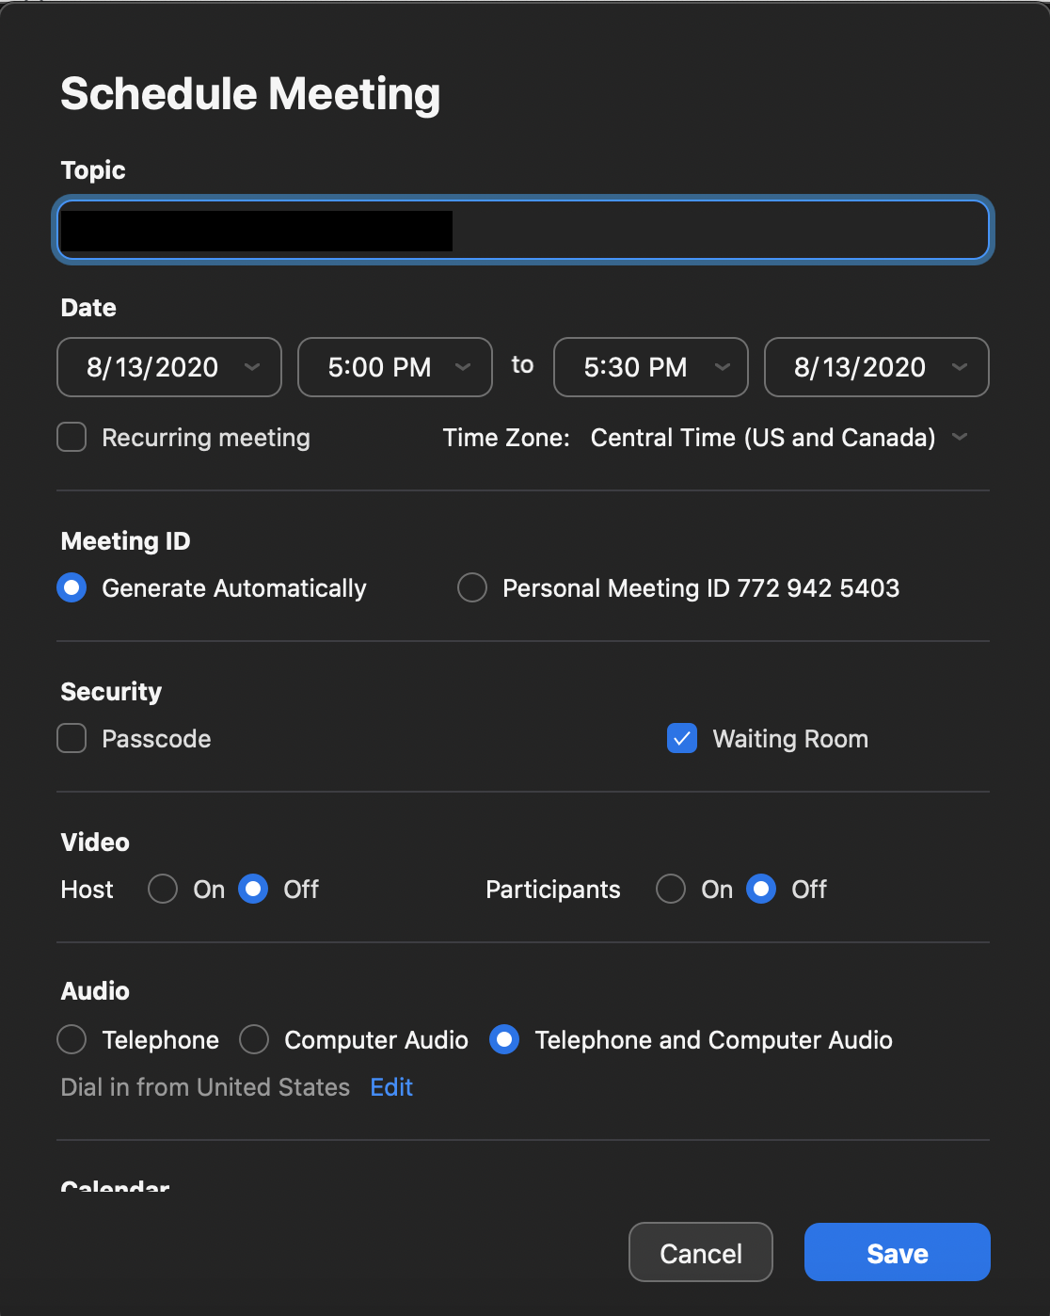
Select a topic for your meeting
Choose date and time or select recurring meeting
Check ‘Waiting Room’ if you want (Best for Zoom office Hours)
Select save

Slide 41
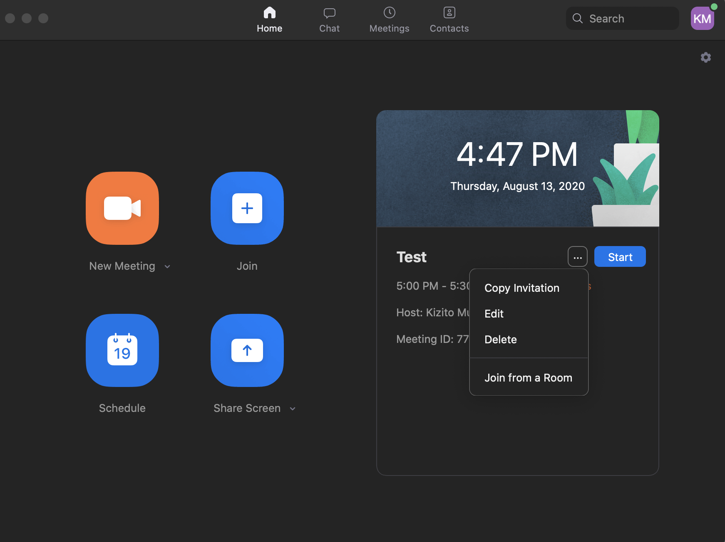
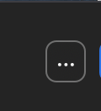
To obtain the Zoom link, click on the ...icon and select ‘Copy invitation’

Slide 42
Linking Zoom to Blackboard

Slide 43
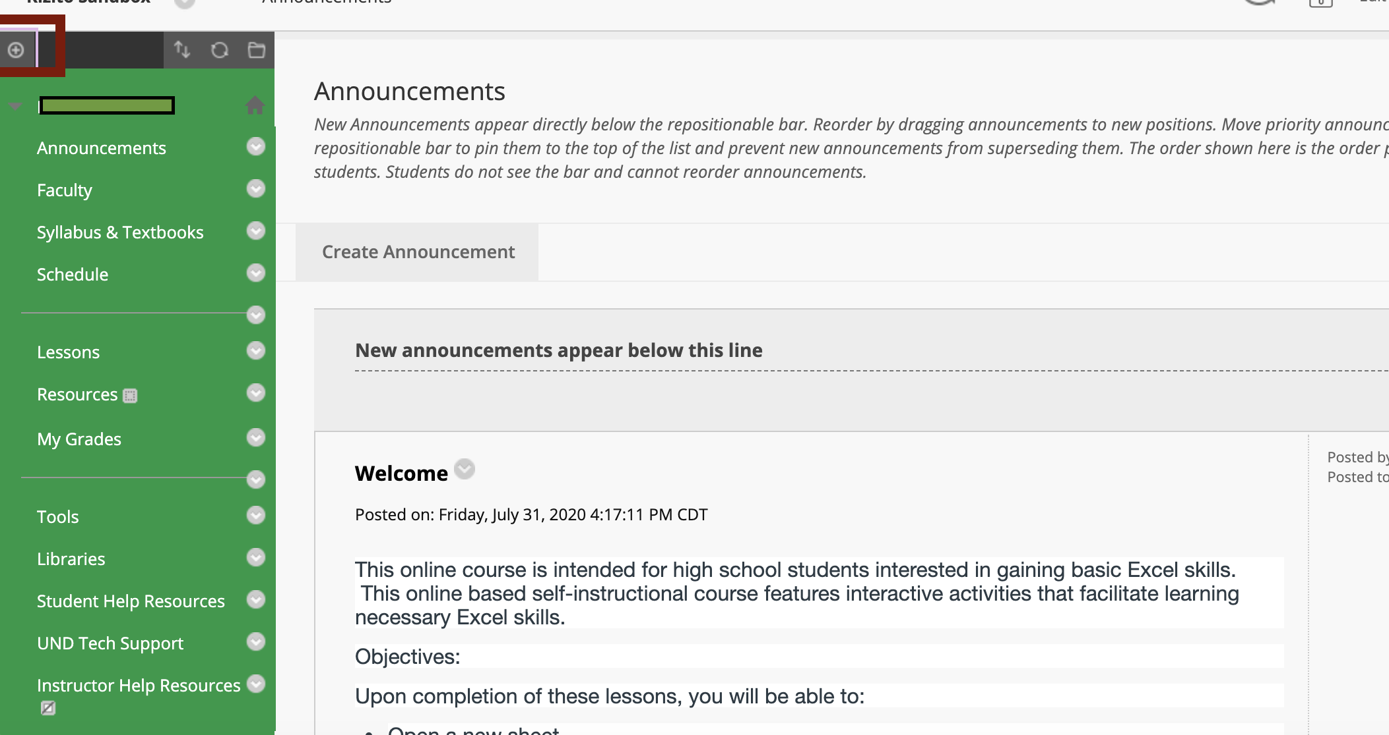

Select the ‘Add menu items’ icon

Slide 44
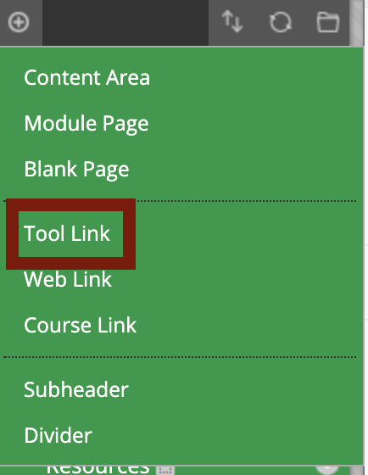
Select ‘Tool Link’

Slide 45
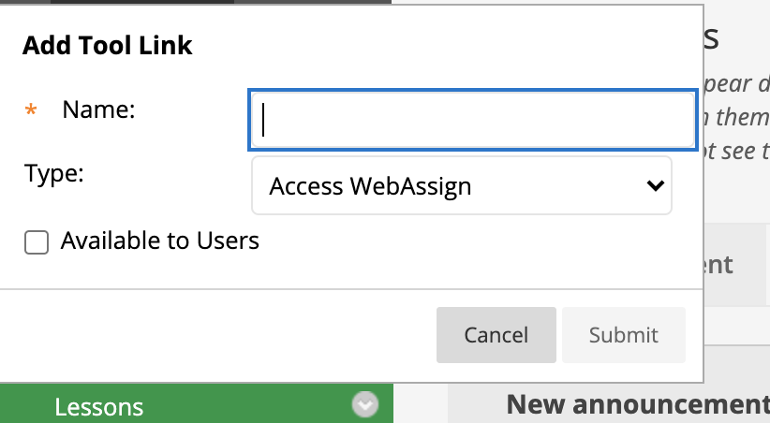
Provide a descriptive name

Slide 46
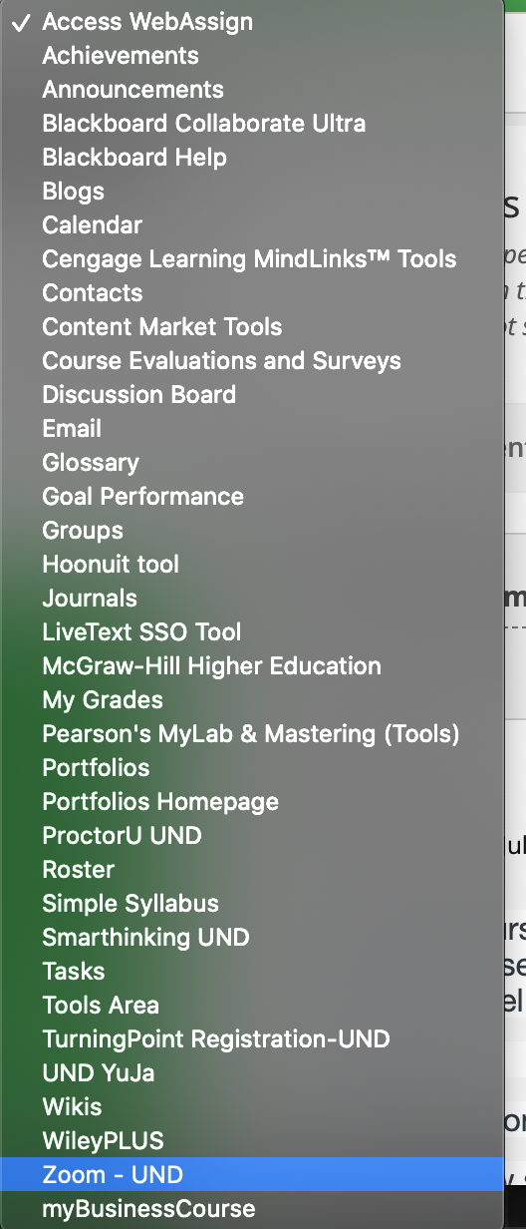
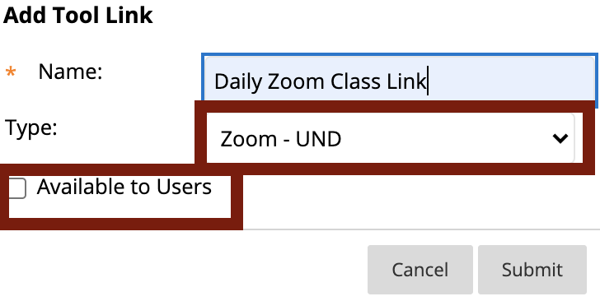
Under ‘Type,’ select Zoom-UND
Check ‘Available to Users’ and submit

Slide 47
Scheduling a Zoom Meeting via Blackboard

Slide 48
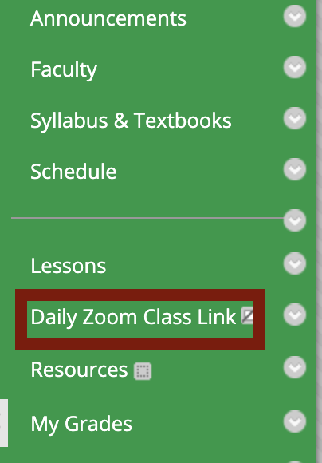
Click on the appropriate Zoom tool link

Slide 49
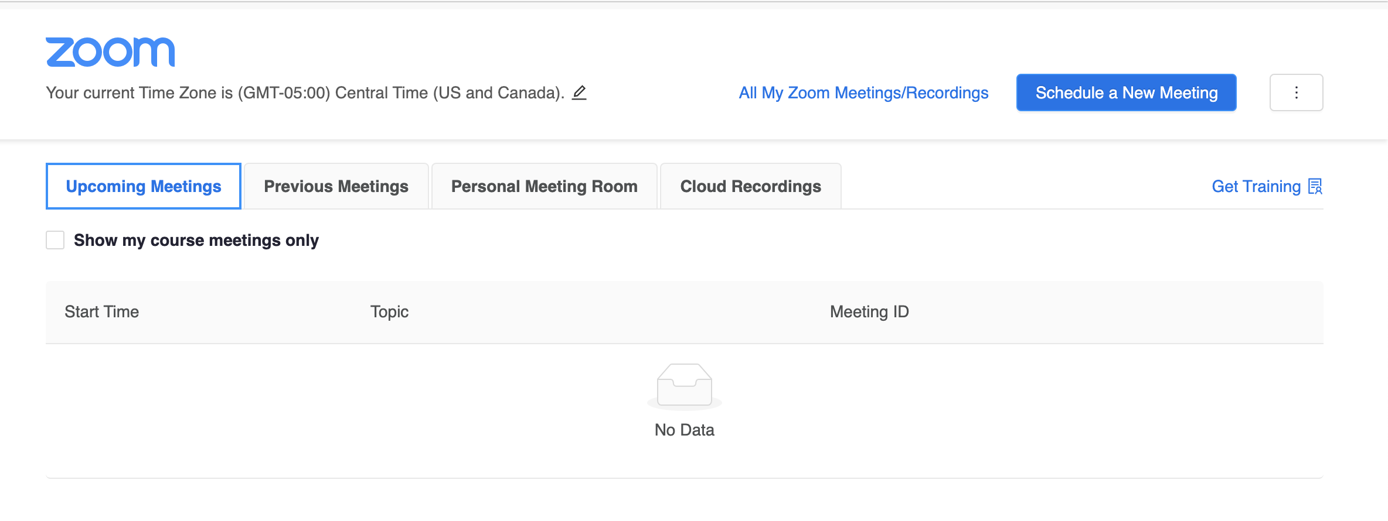
Select ‘Schedule New Meeting’

Slide 50
Breakout Rooms

Slide 51
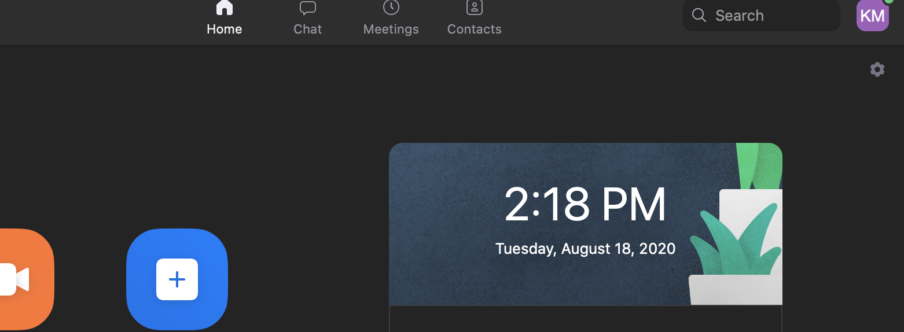
Enable Breakout rooms in your advanced settings

Slide 52
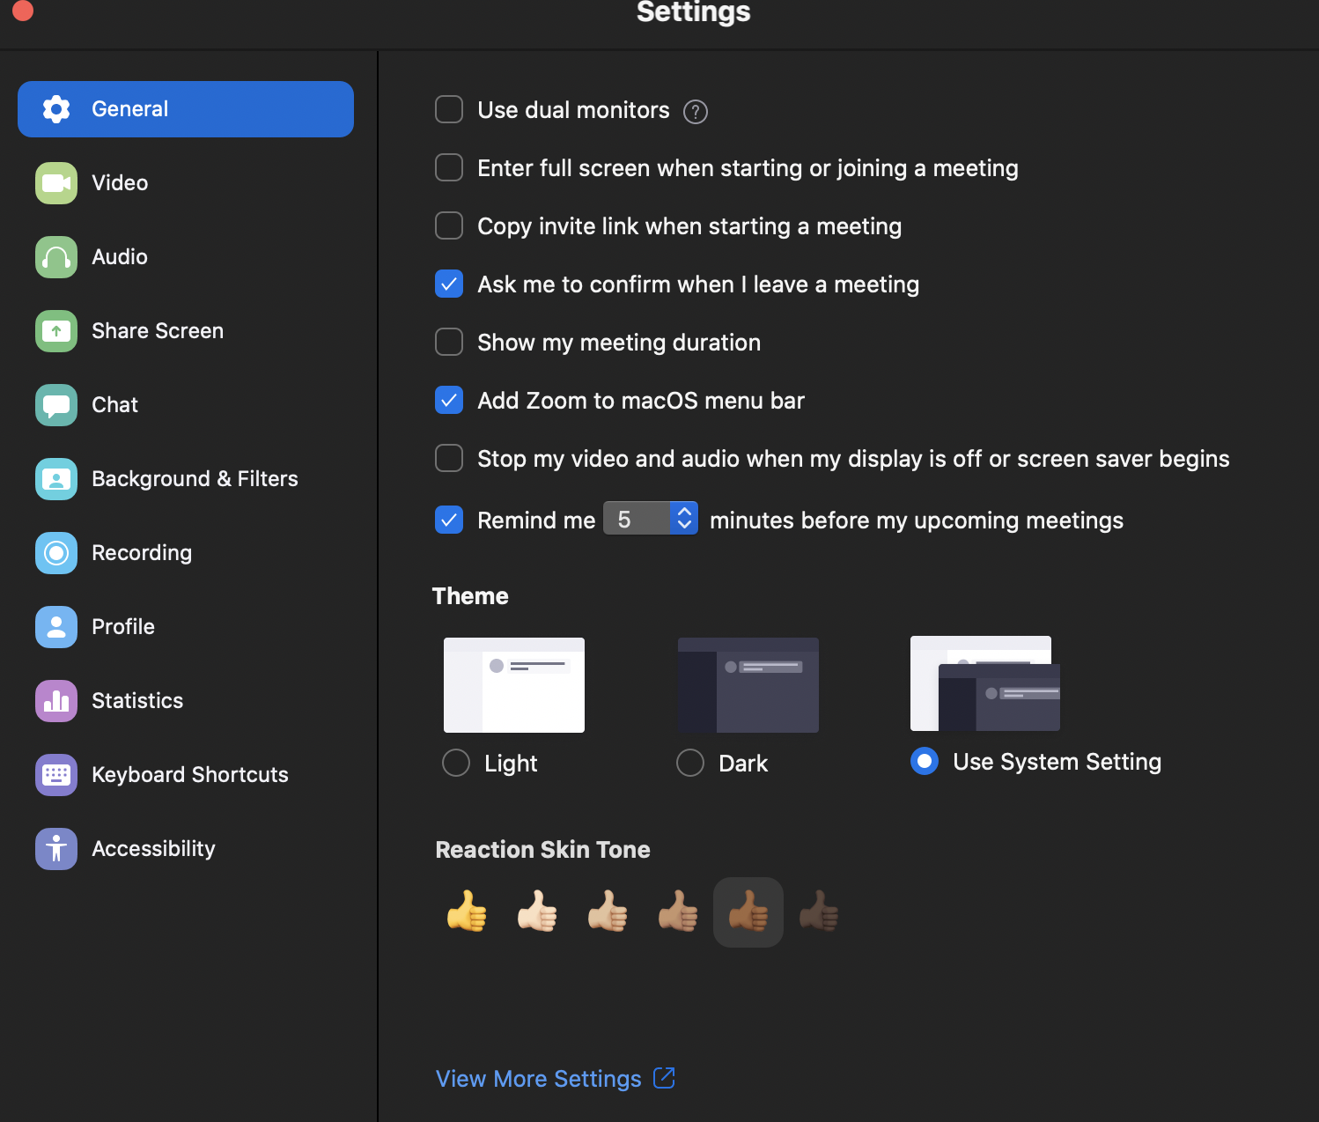
Select ‘View More Settings’

Slide 53
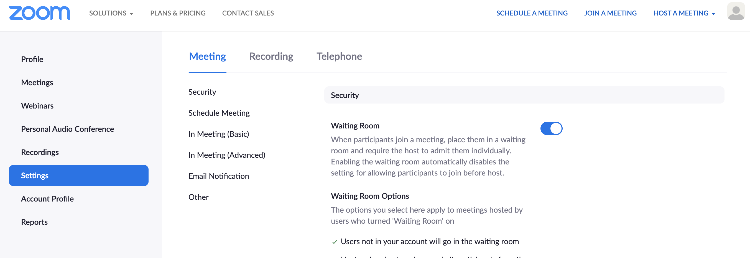
Locate ‘Breakout room’ in your advanced settings

Slide 54
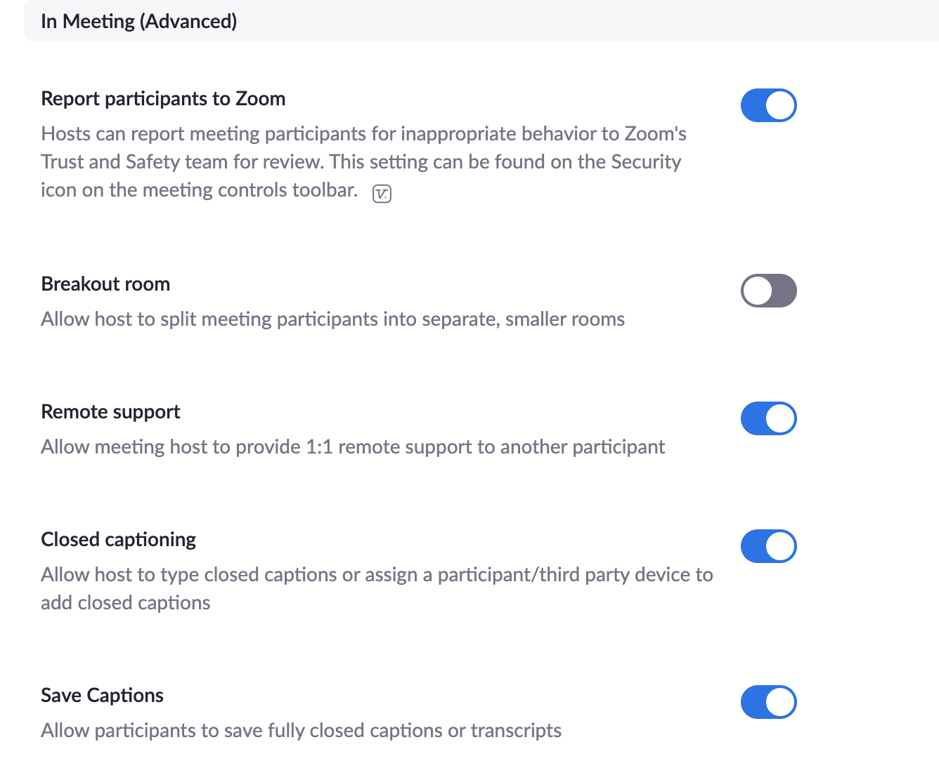
2
1
(1) Disable ‘Remote support’ first
(2) Enable Breakout room

Slide 55
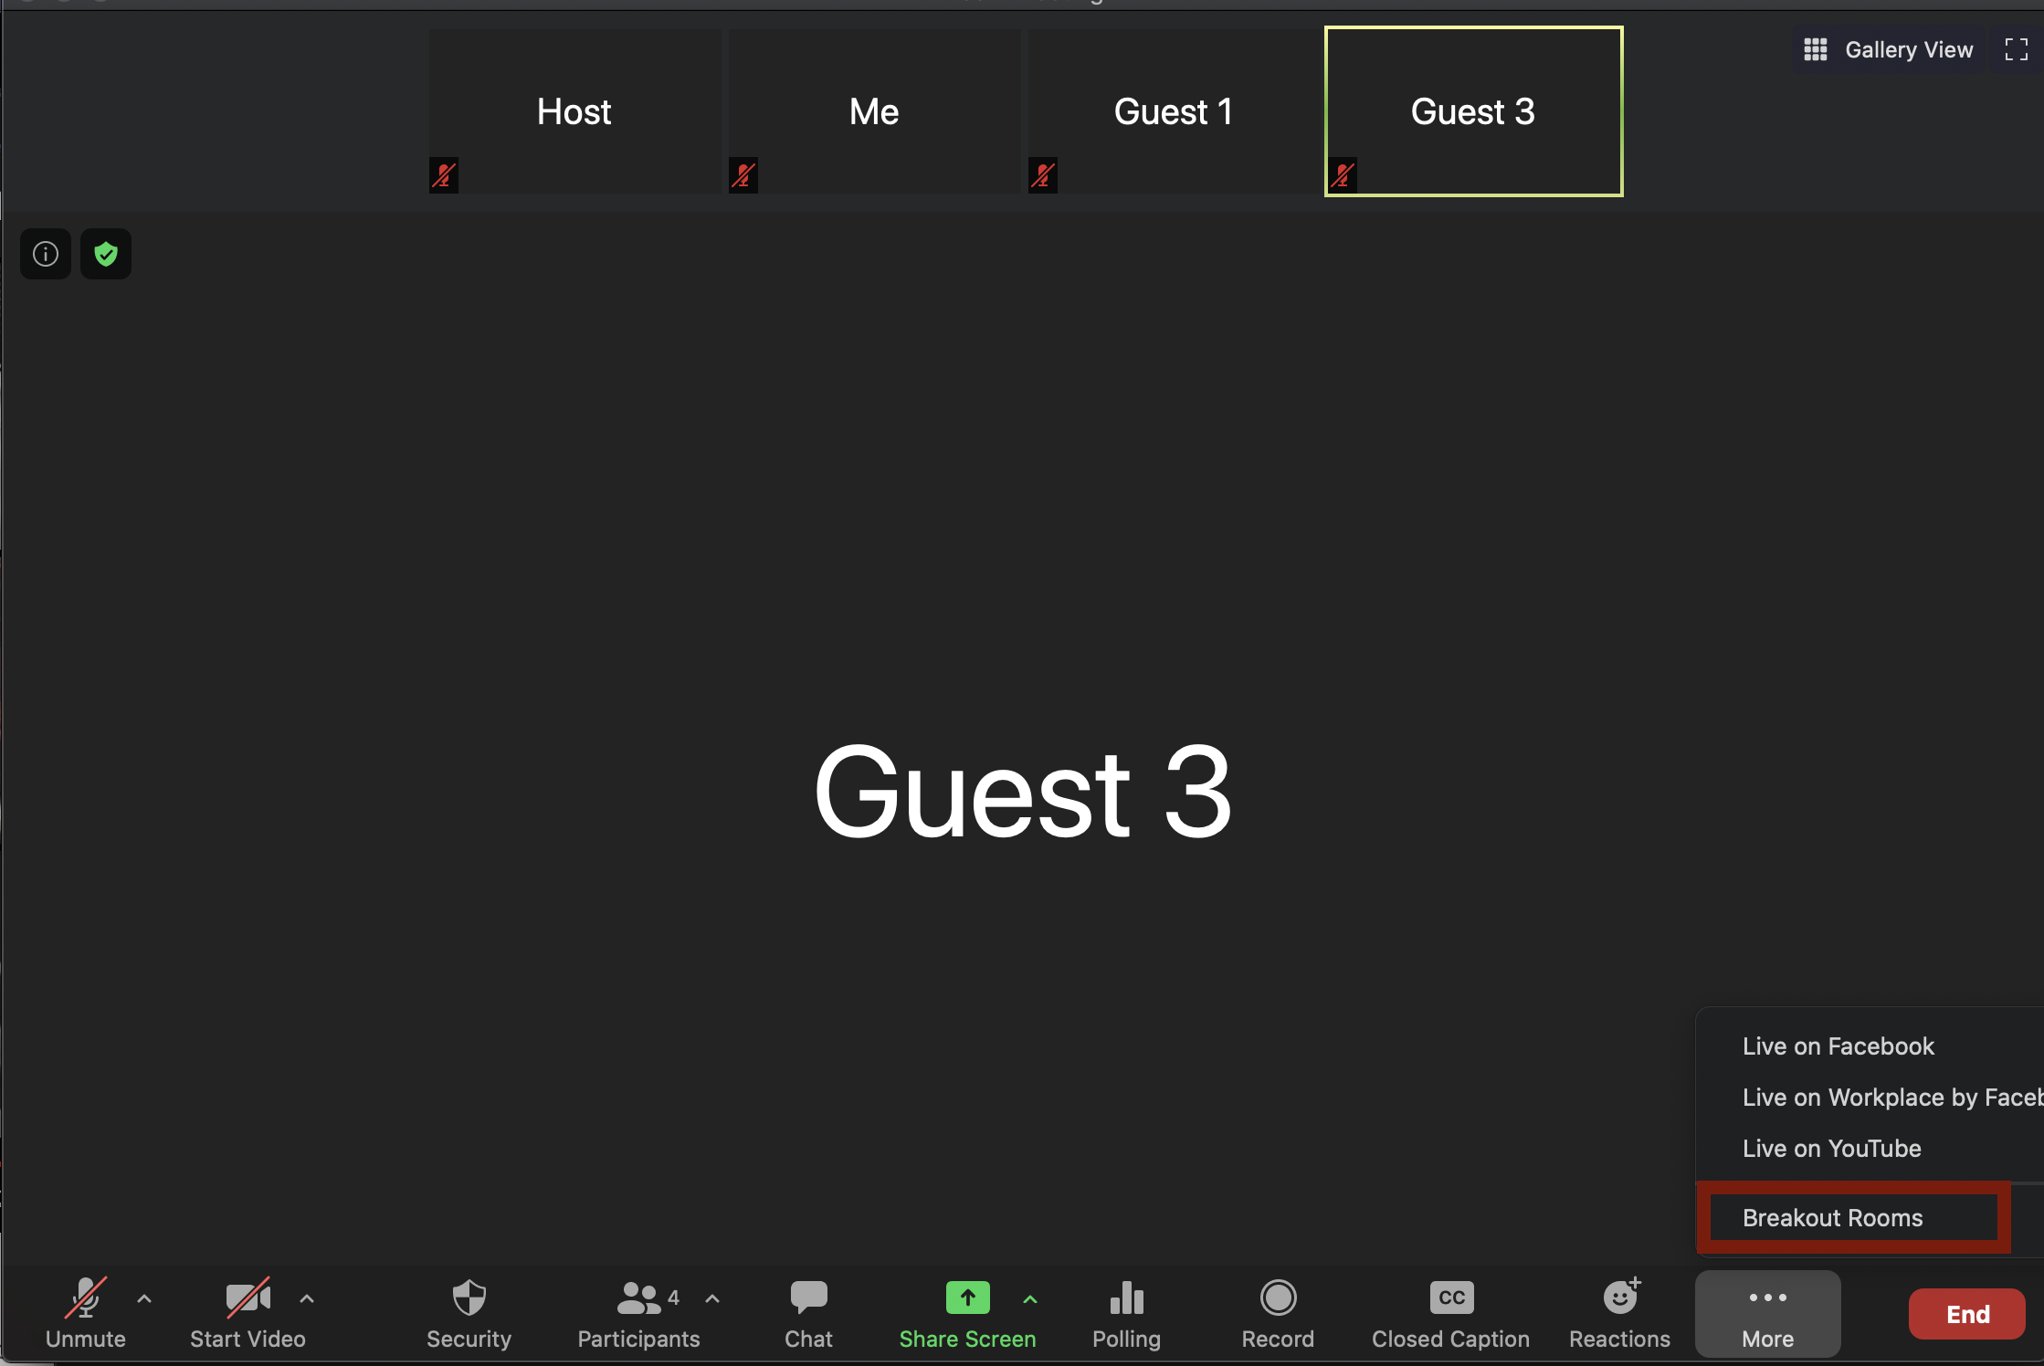
Click on ‘More’ and select ‘Breakout Rooms’

Slide 56
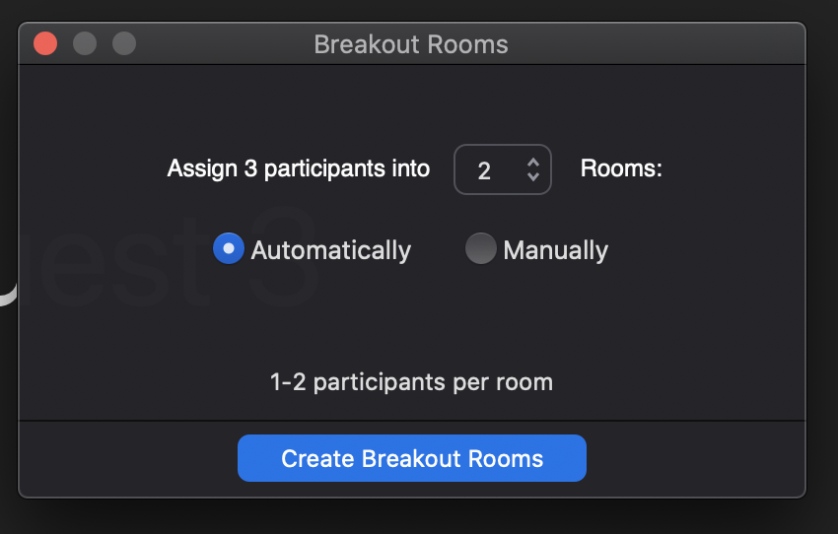
Select your best option and then select ‘Create Breakout Rooms’

Slide 57
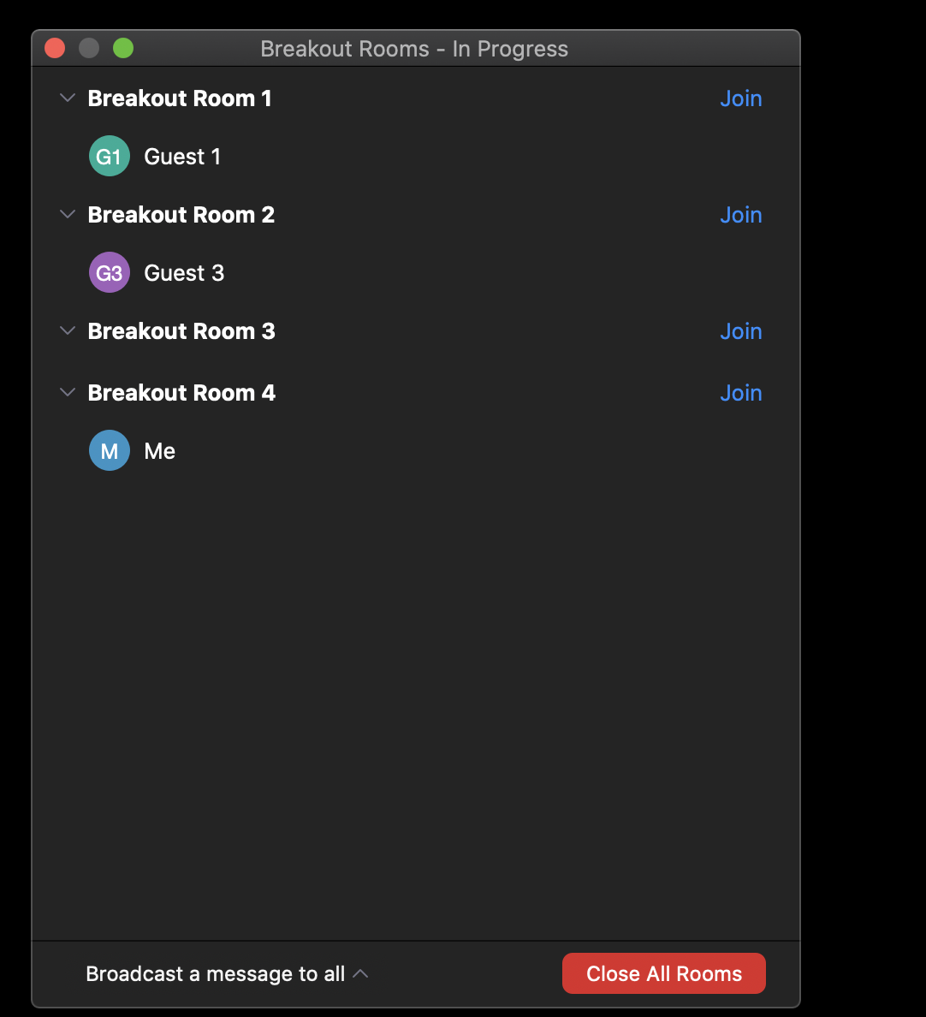
Select which breakout room to join

Slide 58
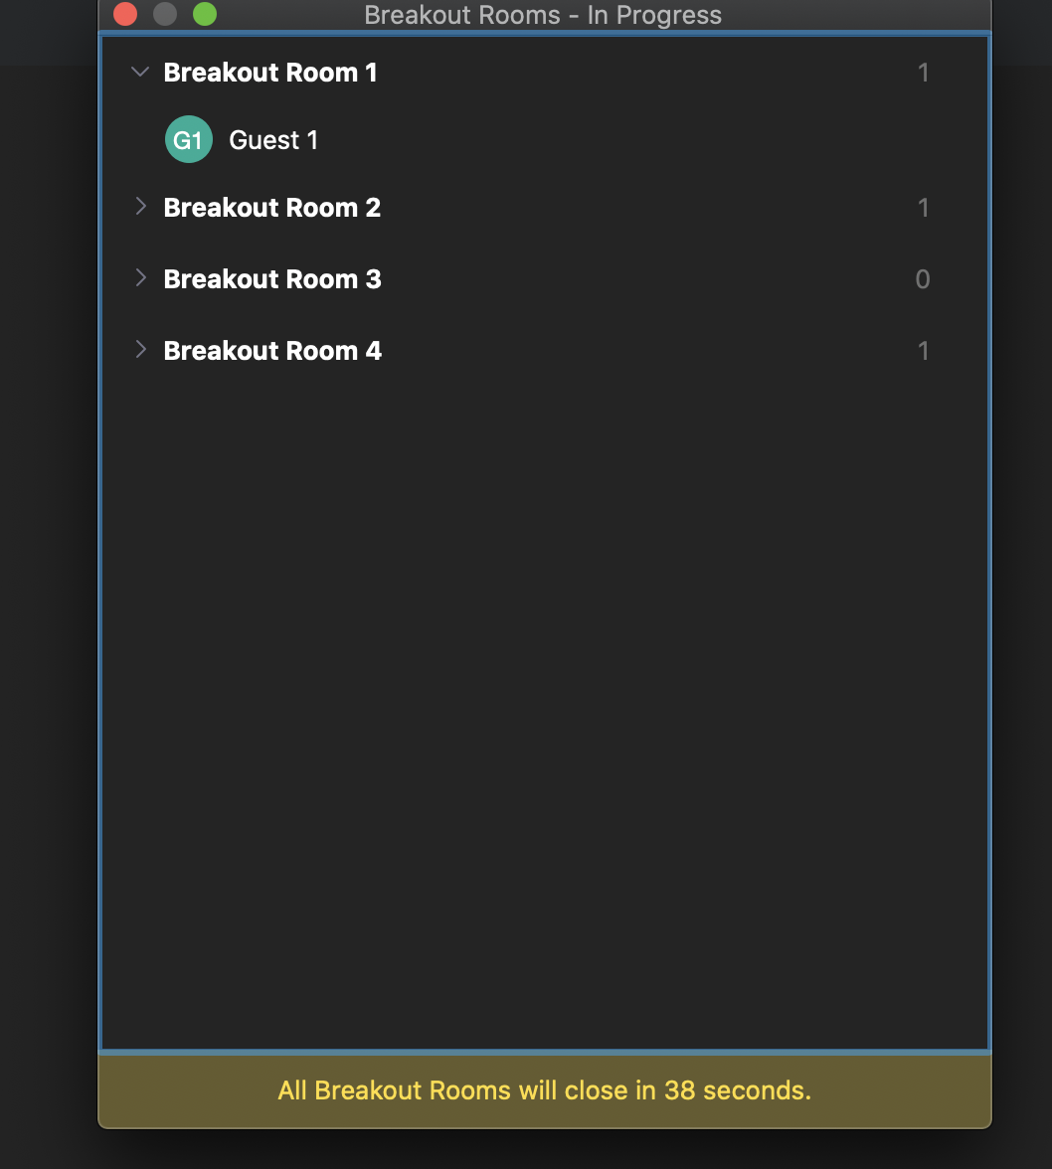
To end Breakout rooms select ‘Close all Rooms’

Slide 59
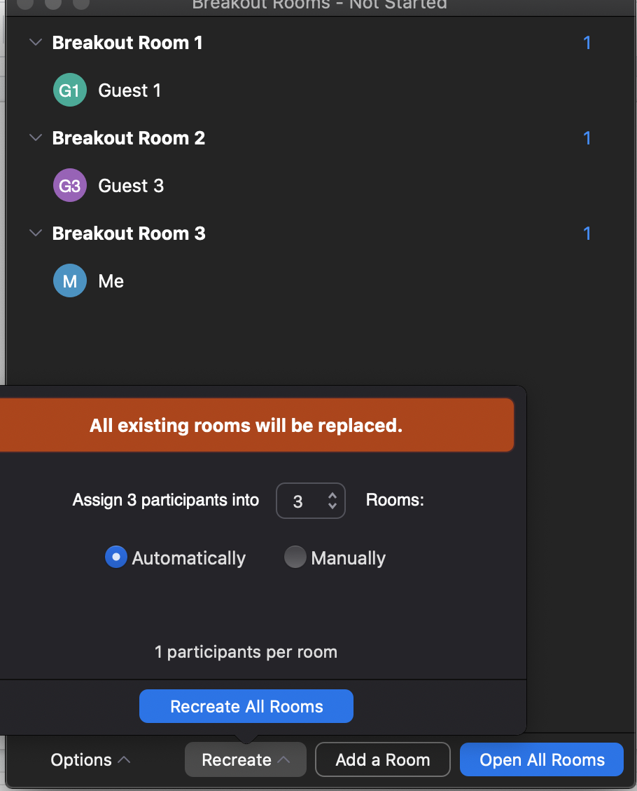
You can Recreate the rooms by selecting ‘Recreate’
Select ‘Recreate All Rooms’ and then select ‘Open All Rooms’

Slide 60
Sharing a Screen

Slide 61
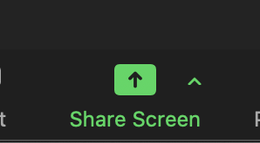
Click on the ‘Share Screen’ icon at the bottom of your screen

Slide 62
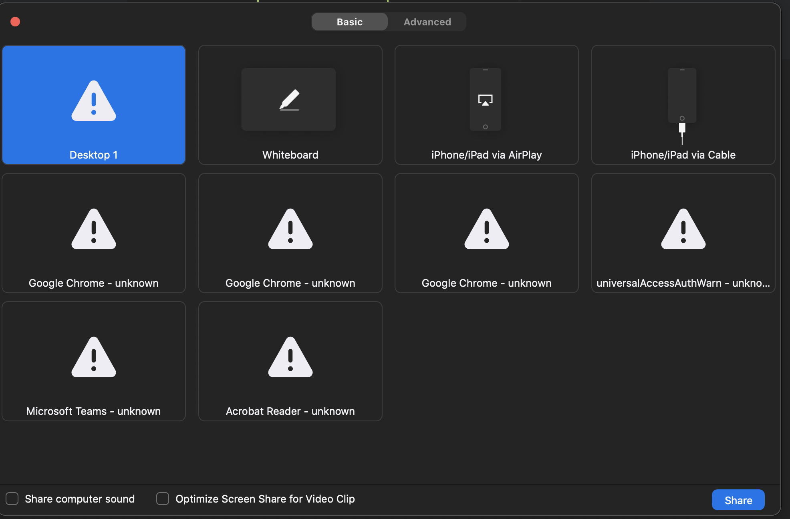
Select what you want to share

Slide 63
If you want to share video with audio, check both options and then select ‘Share’

Slide 64
Using the Whiteboard

Slide 65
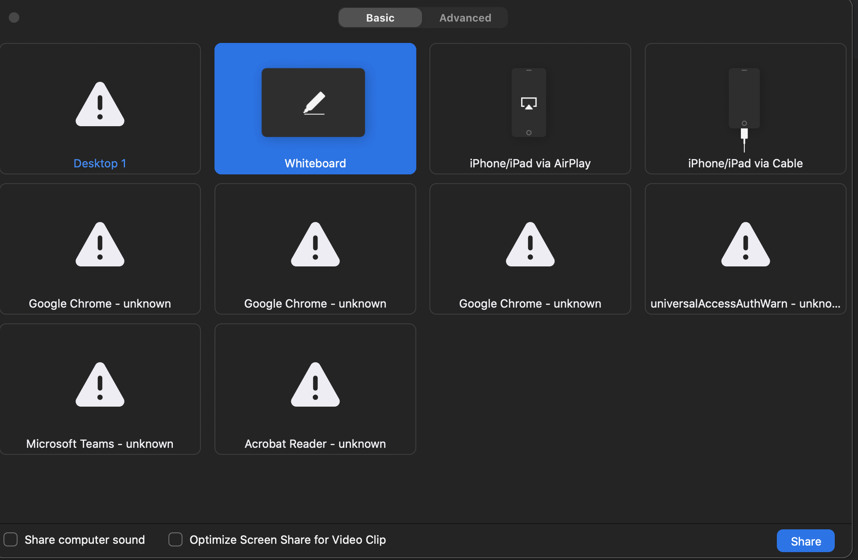
Under the share option, select ‘Whiteboard’ and then click on ‘Share’

Slide 66
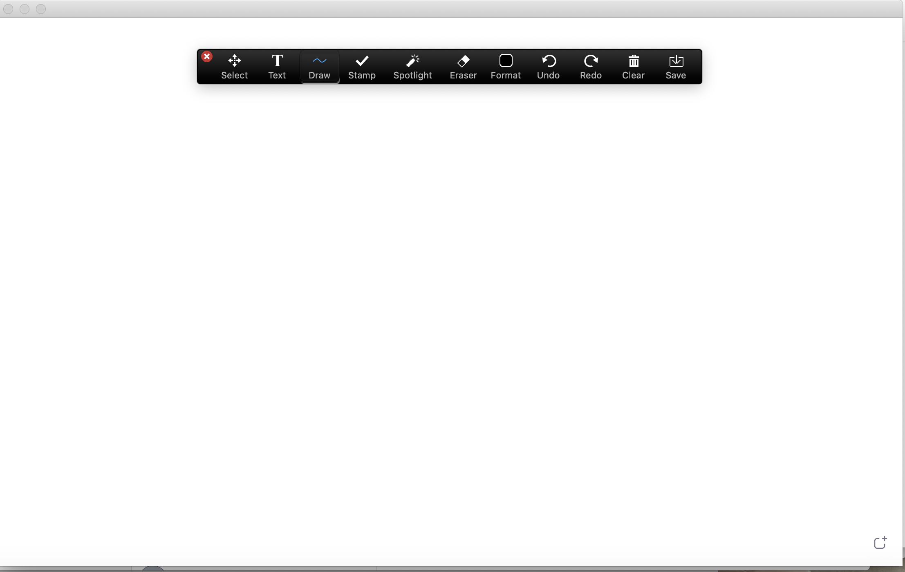
You can draw or use text. You can also save the Whiteboard

Slide 67
Sources
Cheng, C. K., Paré, D. E., Collimore, L. M., & Joordens, S. (2011). Assessing the effectiveness of a voluntary online discussion forum on improving students’ course performance. Computers & Education, 56(1), 253-261.
Mukuni, K., Wang, X., Solis, O., & Almunive, W. (2018, February). Online learning and gender differences in the perception of engagement and instructor presence. Conference on Higher Education Pedagogy, Blacksburg, Virginia.

